Slide 1
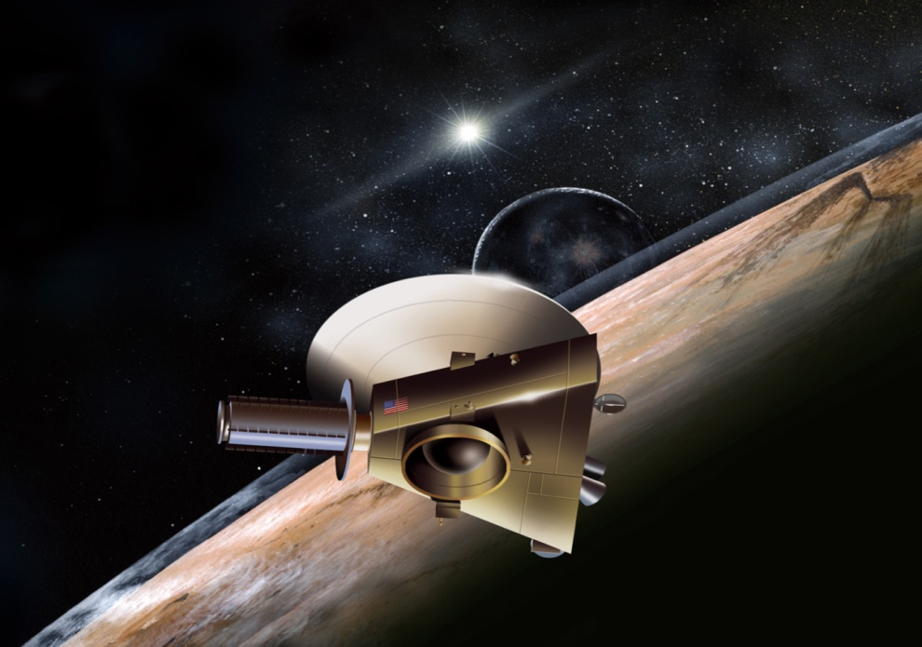
Exploring the Kuiper Belt
with the New Horizons spacecraft
Ultima Thule (latin):
“The most distant place beyond
the borders of the known world”
Brian Enke
Senior Space Research Analyst
Southwest Research Institute

Slide 2
SPACE…… is…… BIG!!

Slide 3
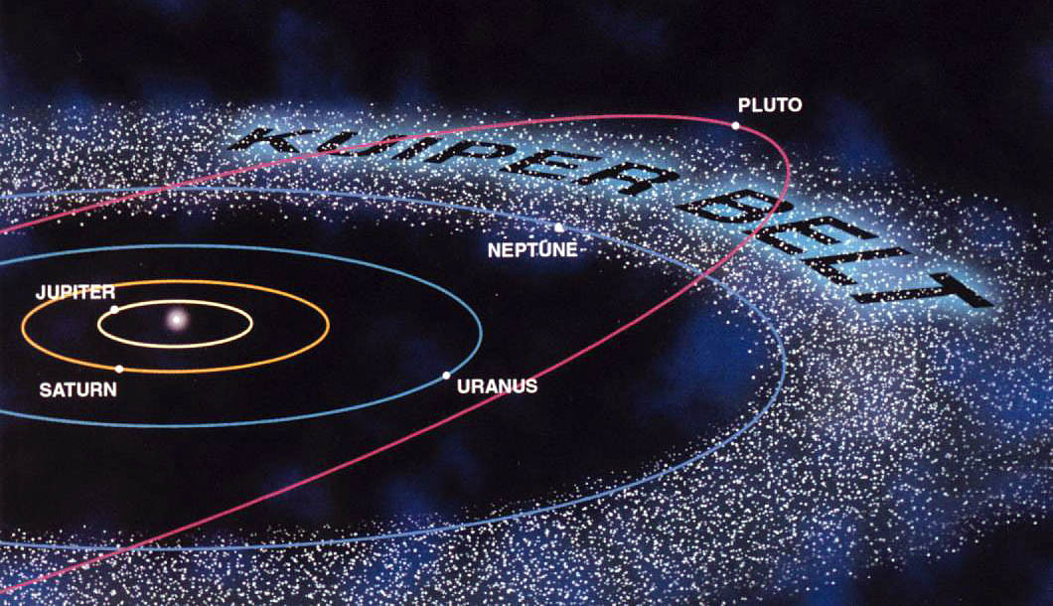
Kuiper Belt (30-50 AUs)
(1000 NEOs, 1,000,000 asteroids, 1,000,000,000,000 comet cores?)

Slide 4
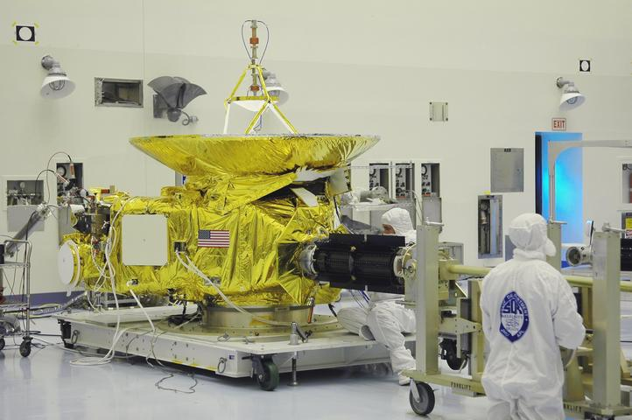
Let’s Meet New Horizons
NASA/SwRI/APL

Slide 5
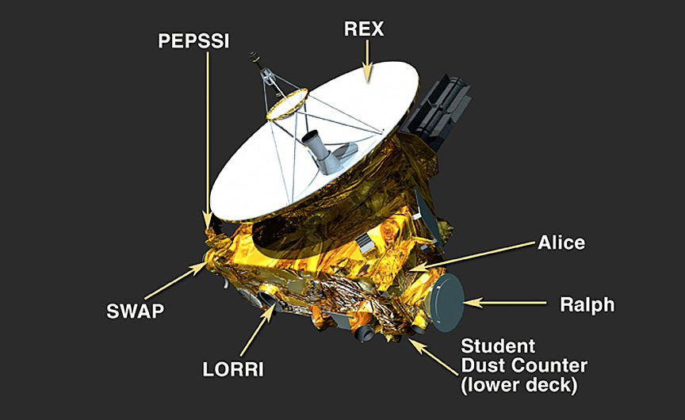
Instruments! (7… or 8?)
MVIC
LEISA
NASA/SwRI/APL

Slide 6
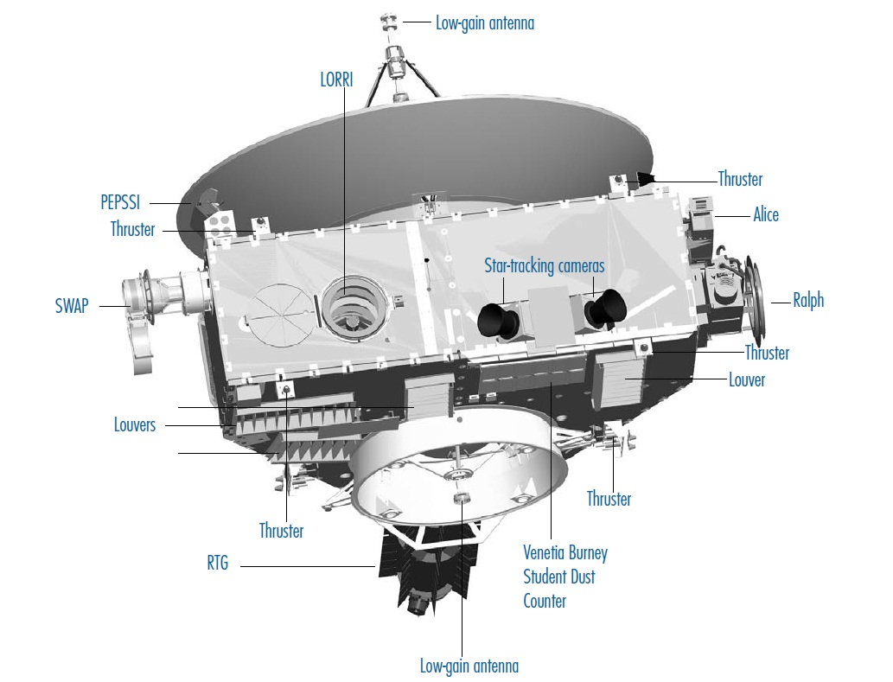
Other Stuff
NASA/SwRI/APL

Slide 7
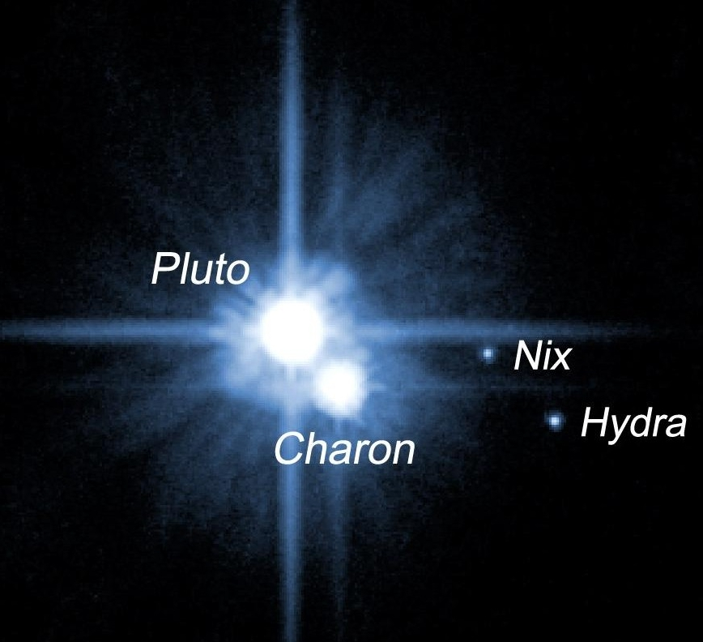
Pluto (2005)
NASA

Slide 8
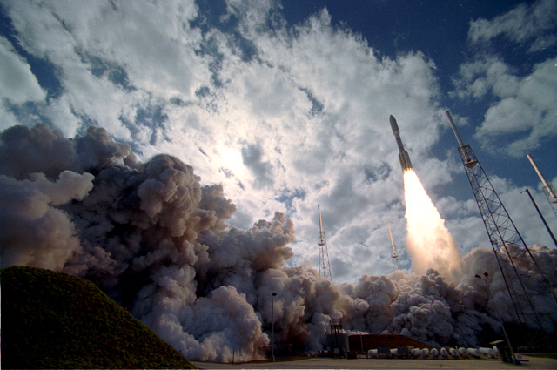
Launch! (Jan 19, 2006)
NASA/SwRI/APL

Slide 9
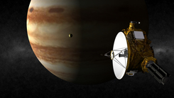
Jupiter (Feb 28, 2007)
Altitude: 2.3 Mkm

Slide 10
ACO 1 - 8 (Feb 28, 2007 - Jul 14, 2015)
NASA

Slide 11
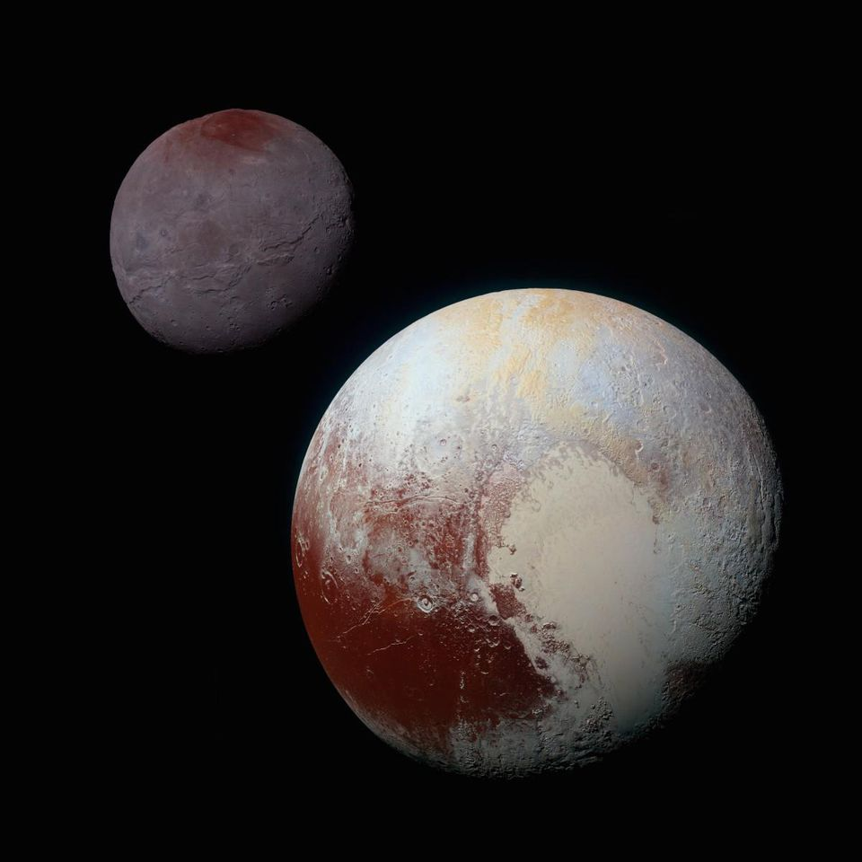
Pluto (Jul 14, 2015)
Altitude: 12,500 km
NASA/SwRI/APL

Slide 12
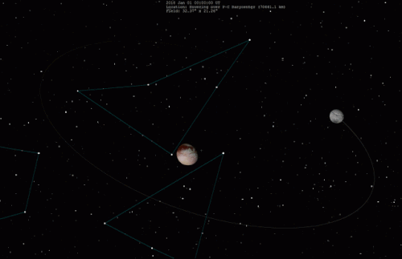
Pluto (Jul 14, 2015)
Altitude: 12,500 km
NASA/SwRI/APL
NASA/SwRI/APL

Slide 13
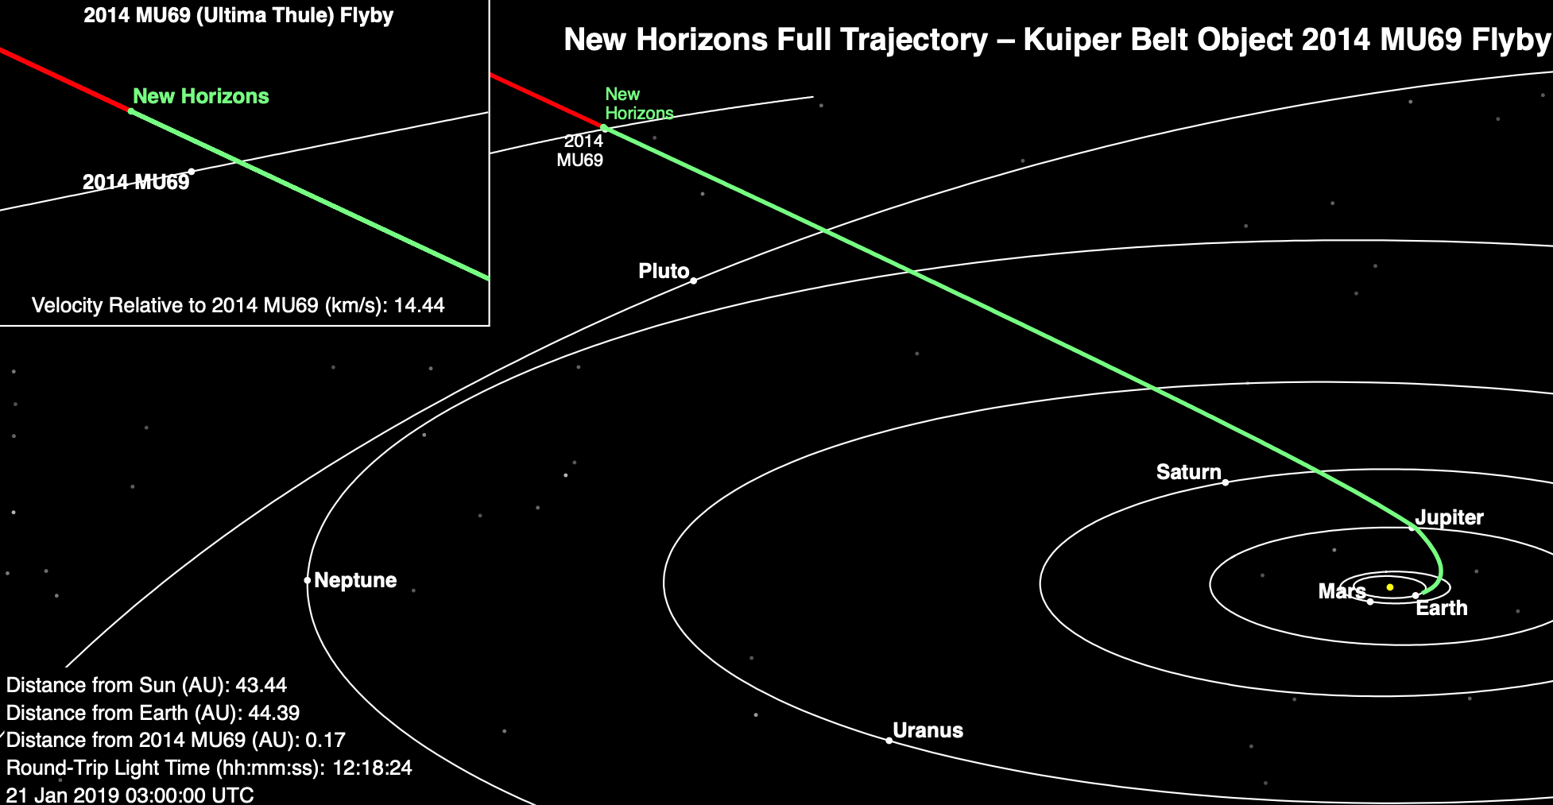
Welcome to the Kuiper Belt
(hope you packed a lunch…)

Slide 14
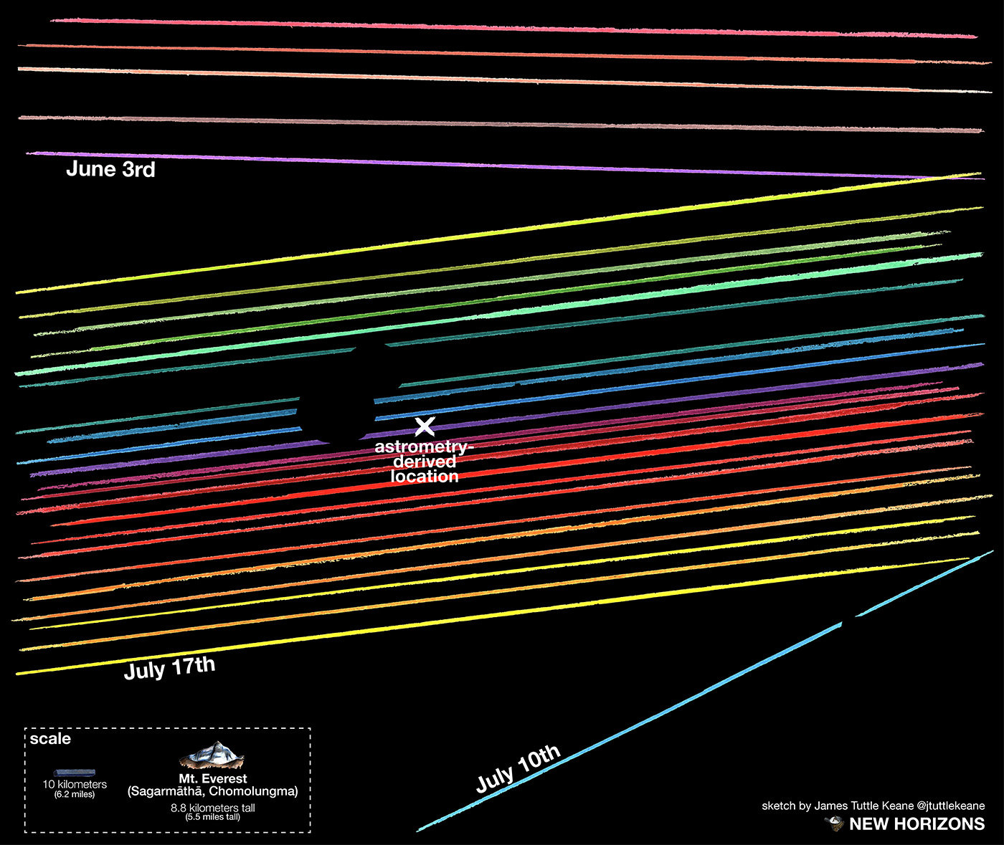
Occultations (Jul 17, 2017)

Slide 15
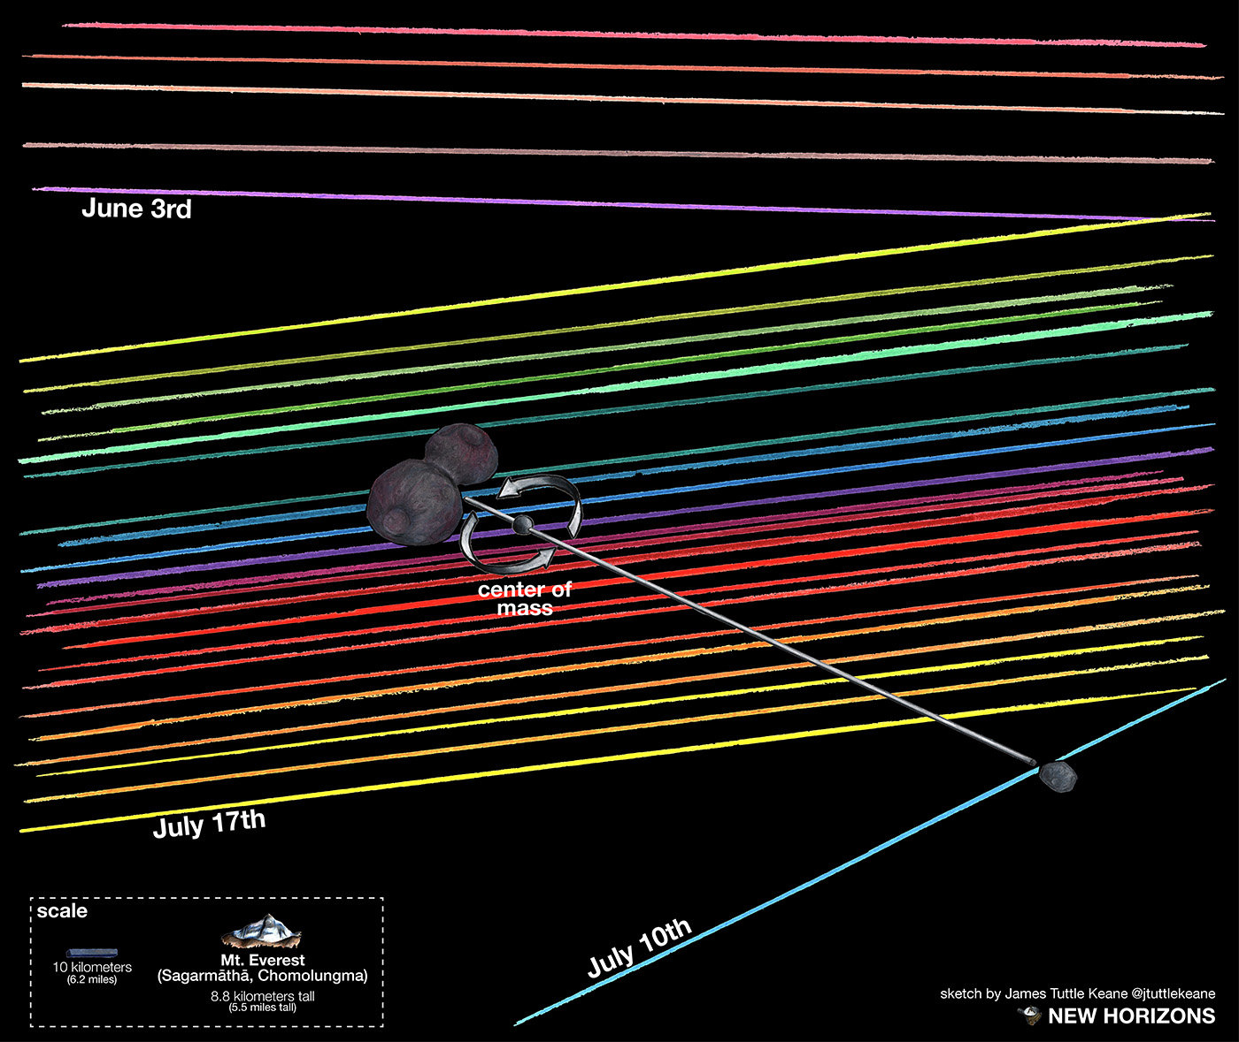
Occultations (Jul 17, 2017)

Slide 16
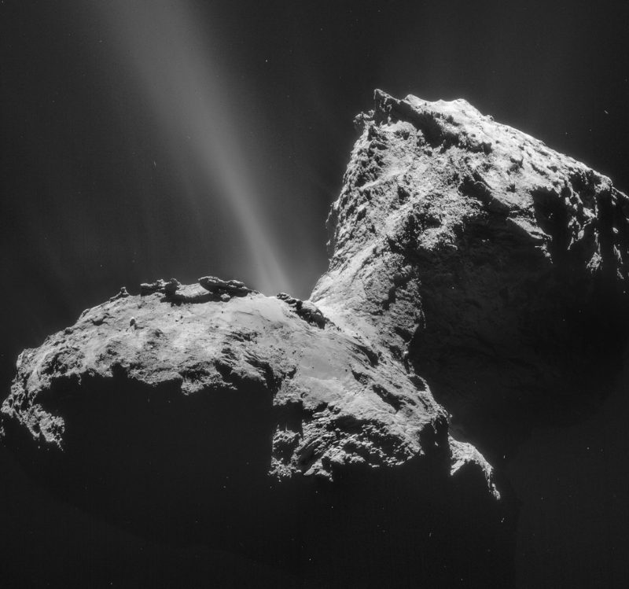
Comet 67P - like? Maybe…
ESA

Slide 17
Olaf? He fits!

Slide 18
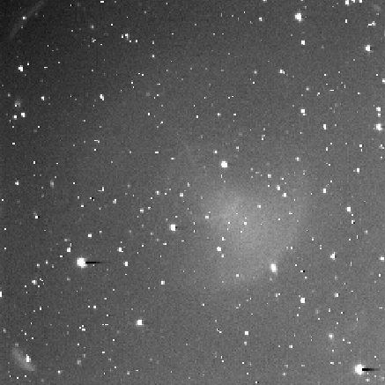
I See…. Stars! (Sep 28 - Nov 25, 2018)
LORRI 4x4’s, Sep-Dec
NASA/SwRI/APL

Slide 19
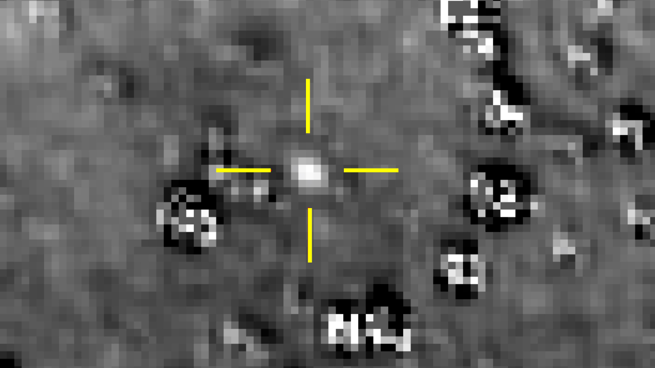
Then we remove the stars (Dec 2, 2018)
NASA/SwRI/APL

Slide 20
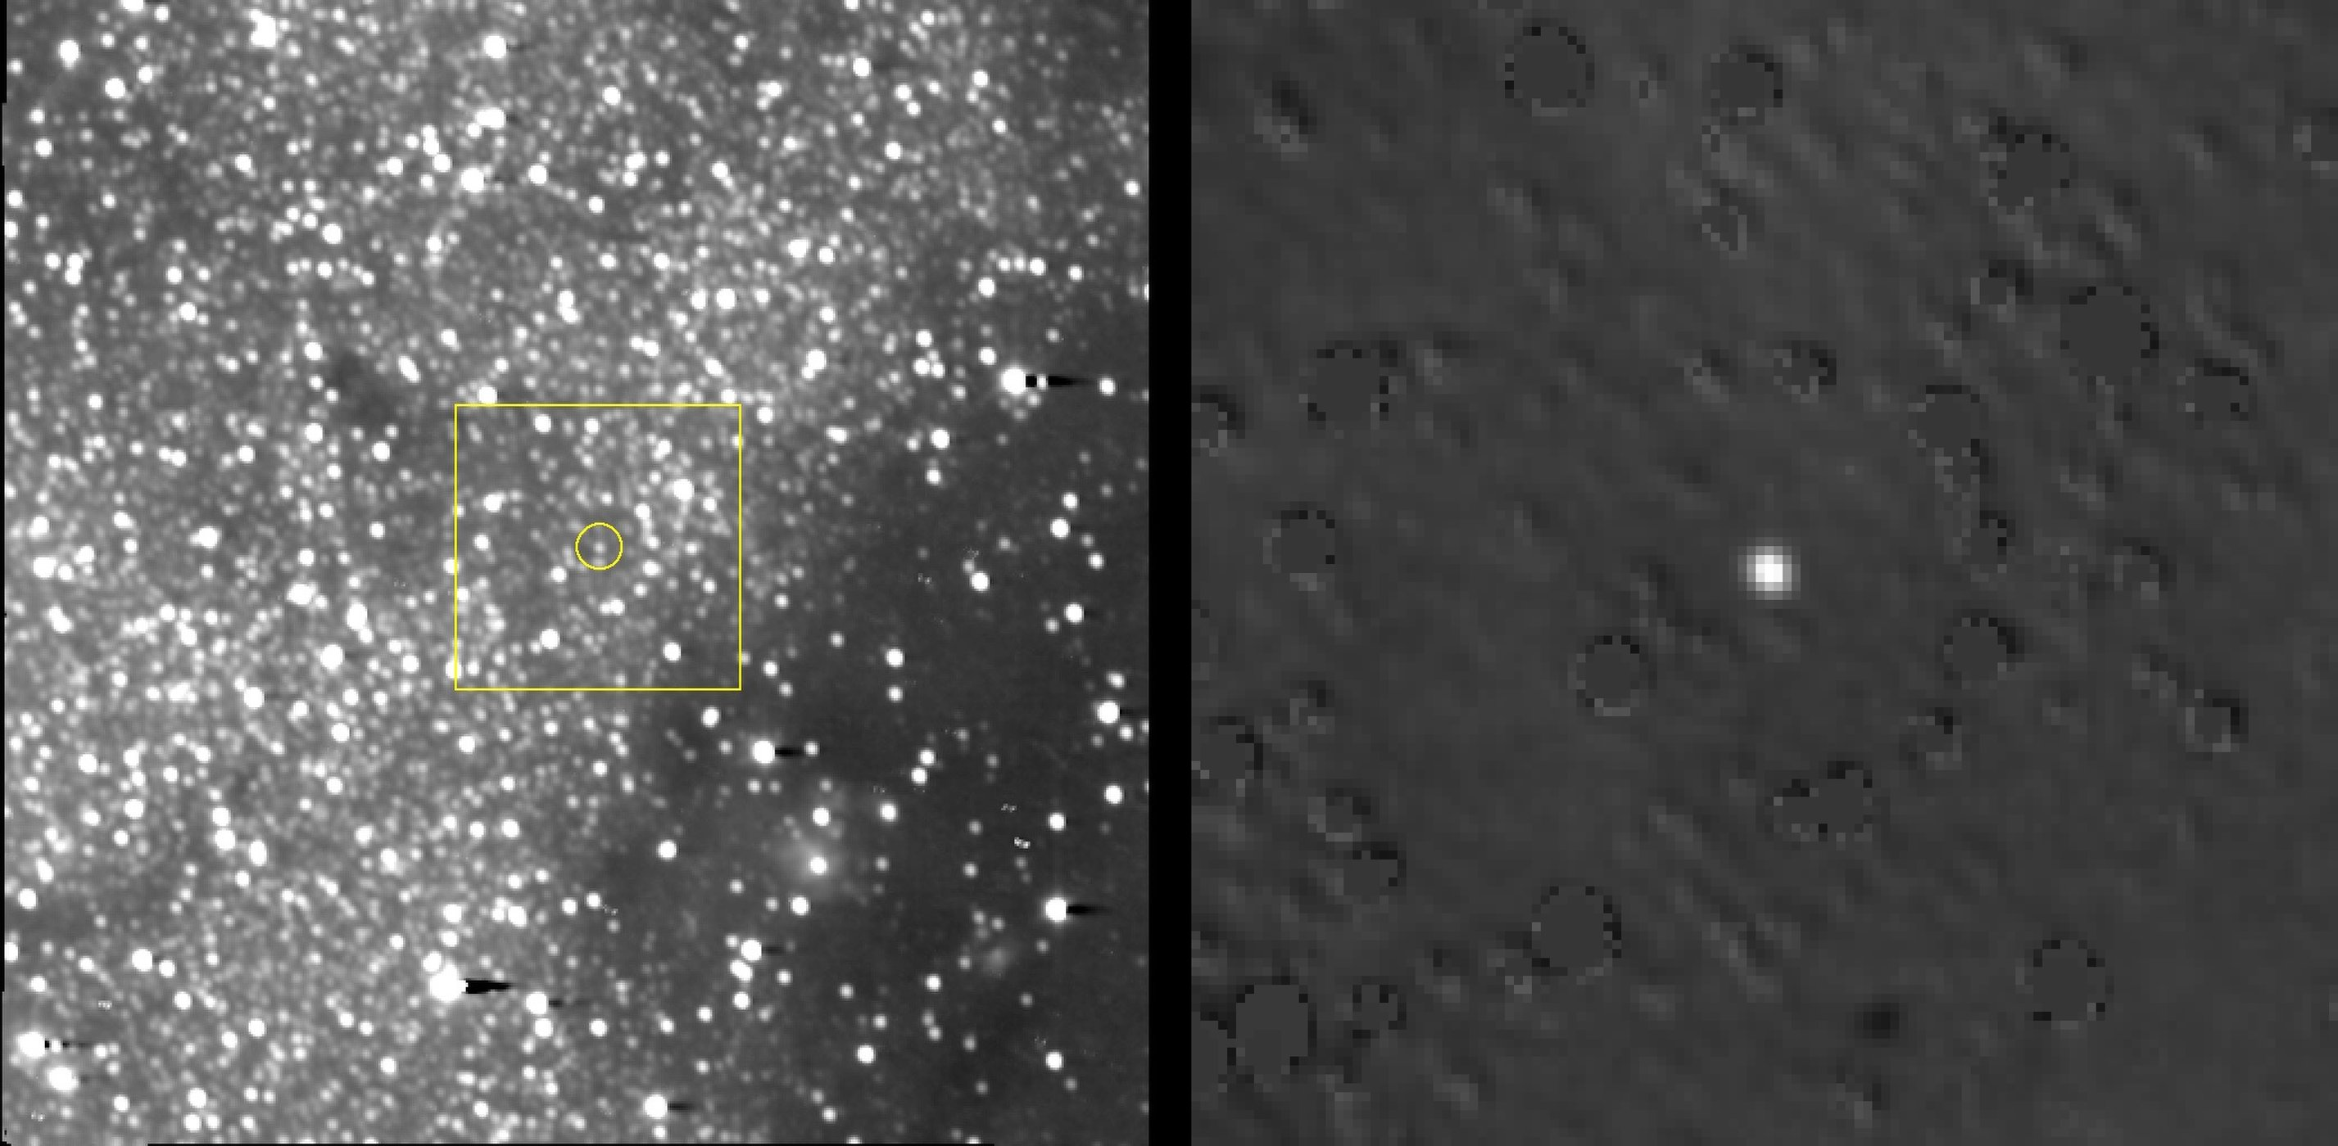
Navigation, Hazards (Dec 2, 2018)
LORRI 4x4’s, Aug-Dec
One pixel!
(no changes in brightness)
NASA/SwRI/APL

Slide 21
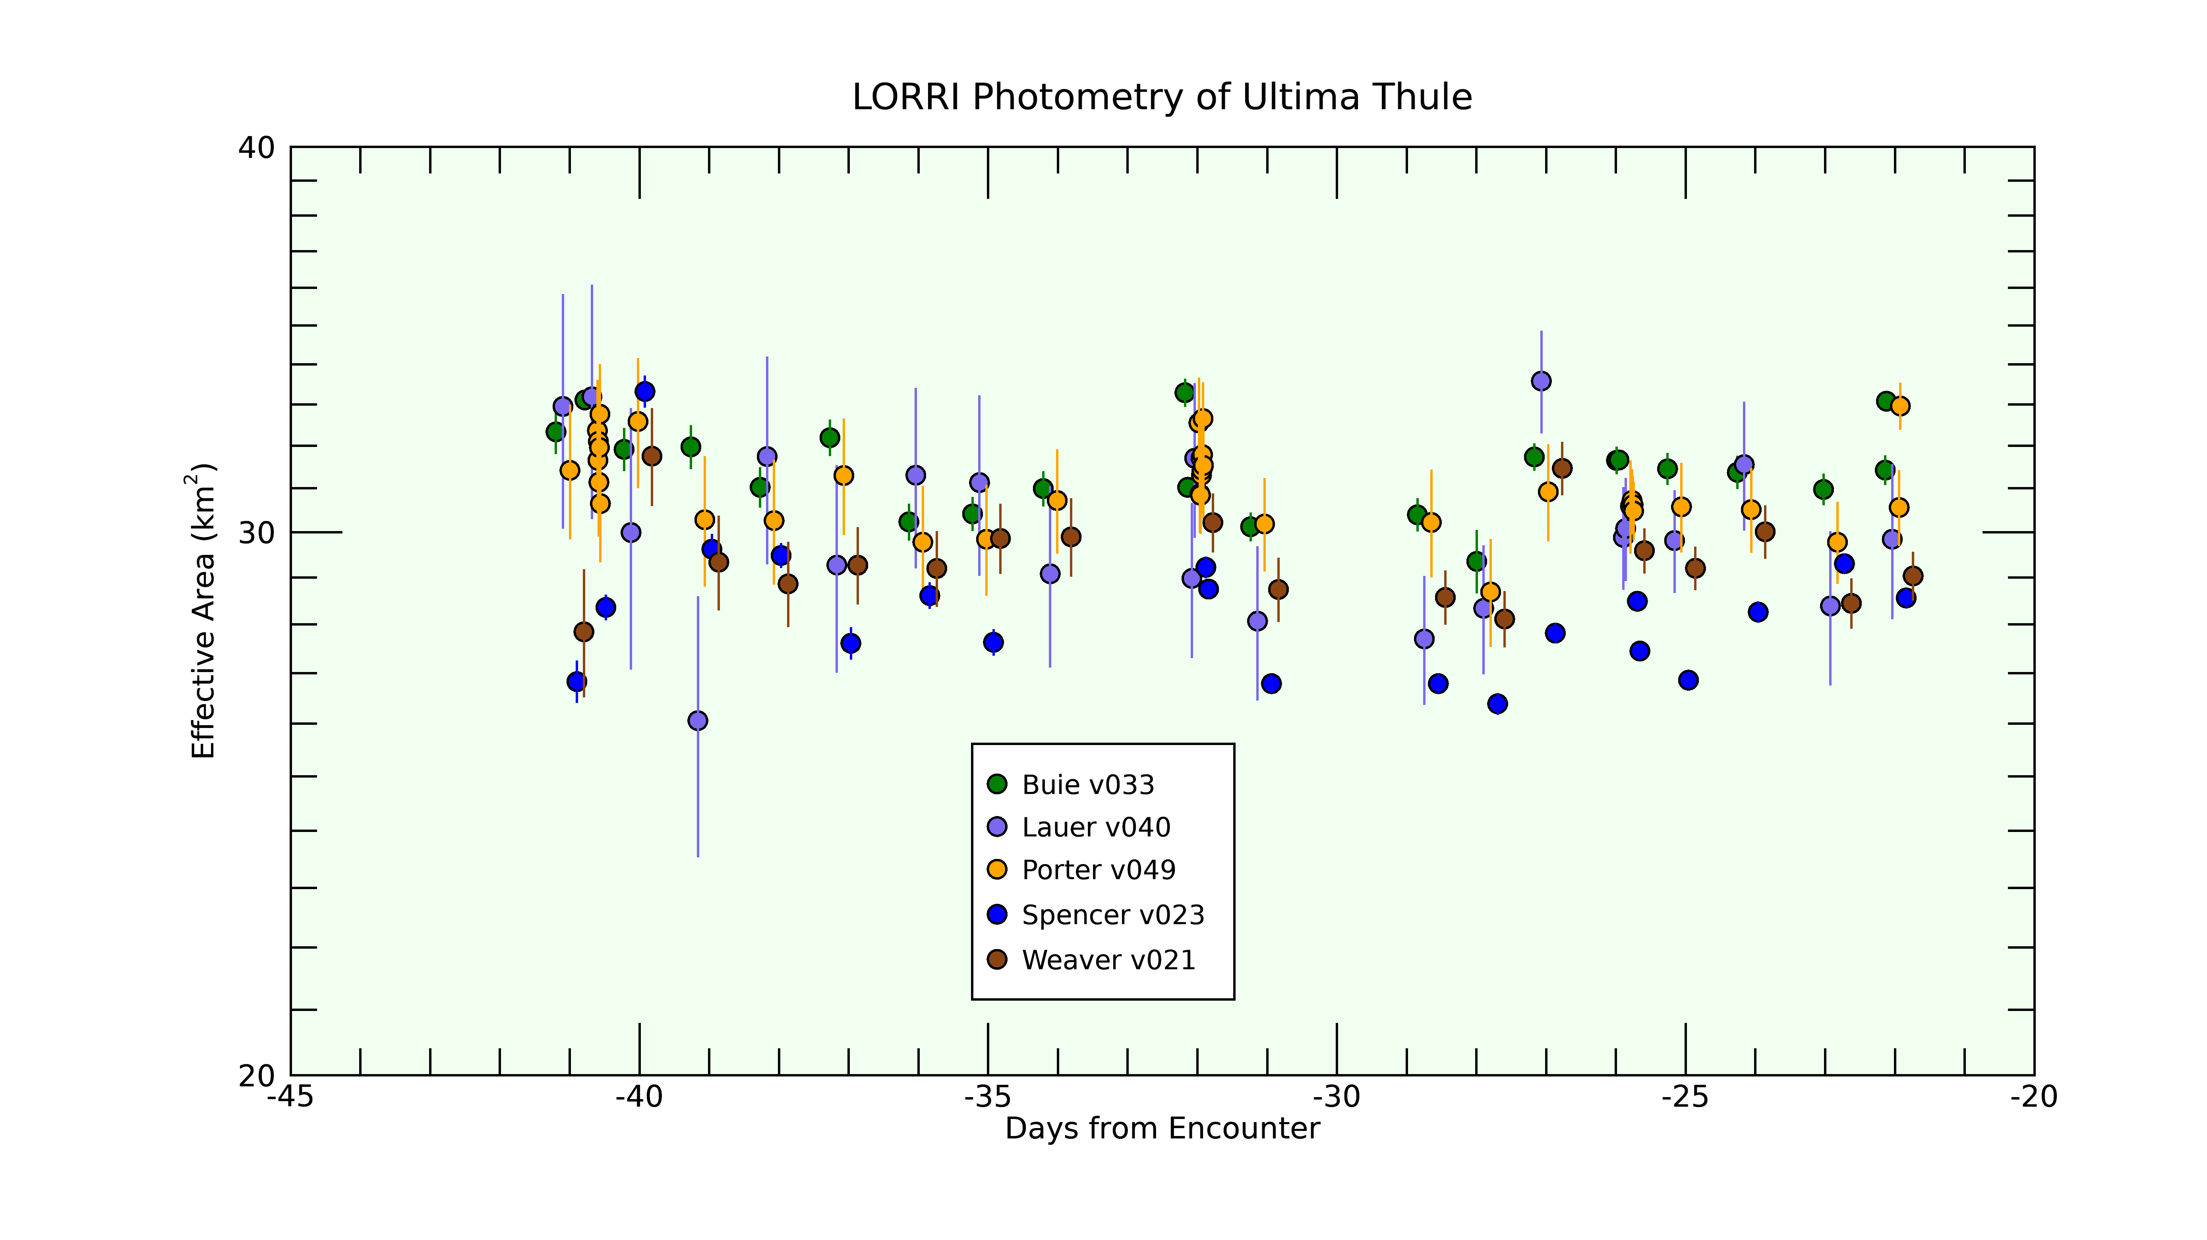
No light curve :(
NASA/SwRI/APL

Slide 22
First LORRI 1x1 (Dec 24, 2018)
NASA/SwRI/APL

Slide 23
Expectations….
NASA/SwRI/APL

Slide 24
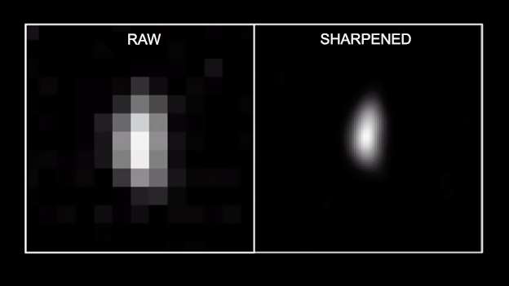
Broken PSF!! (Dec 31)
NASA/SwRI/APL

Slide 25
First Look (Jan 1)
NASA/SwRI/APL

Slide 26
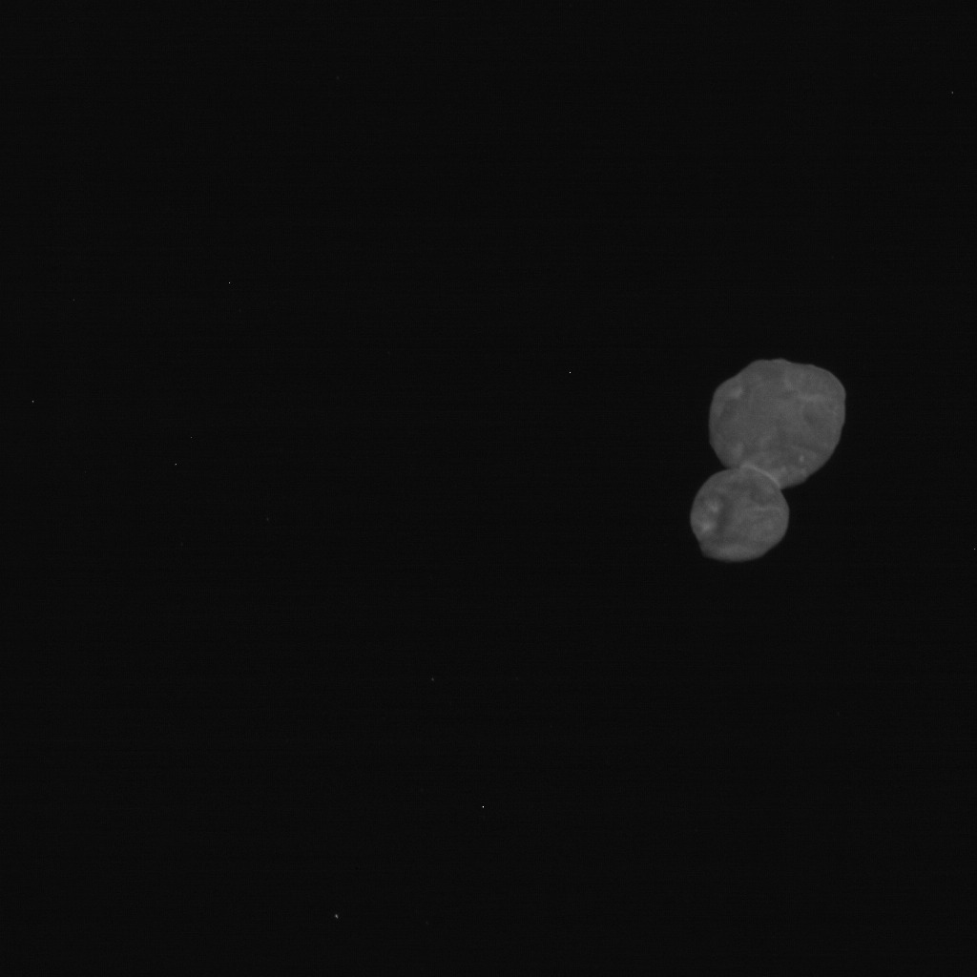
CA04 (Jan 2)
NASA/SwRI/APL

Slide 27
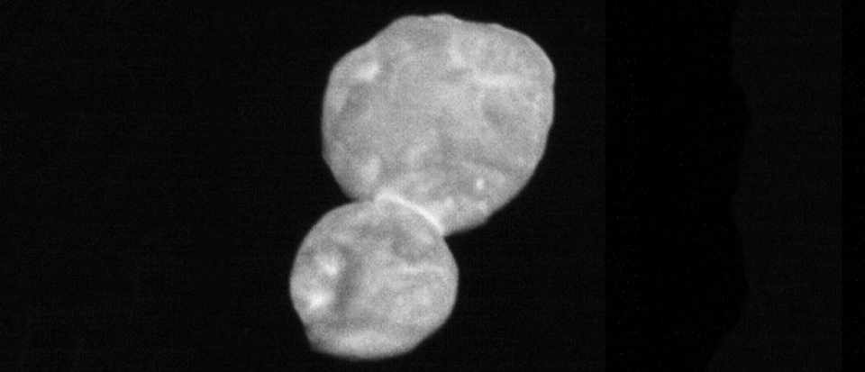
CA04 (Jan 2)
NASA/SwRI/APL

Slide 28
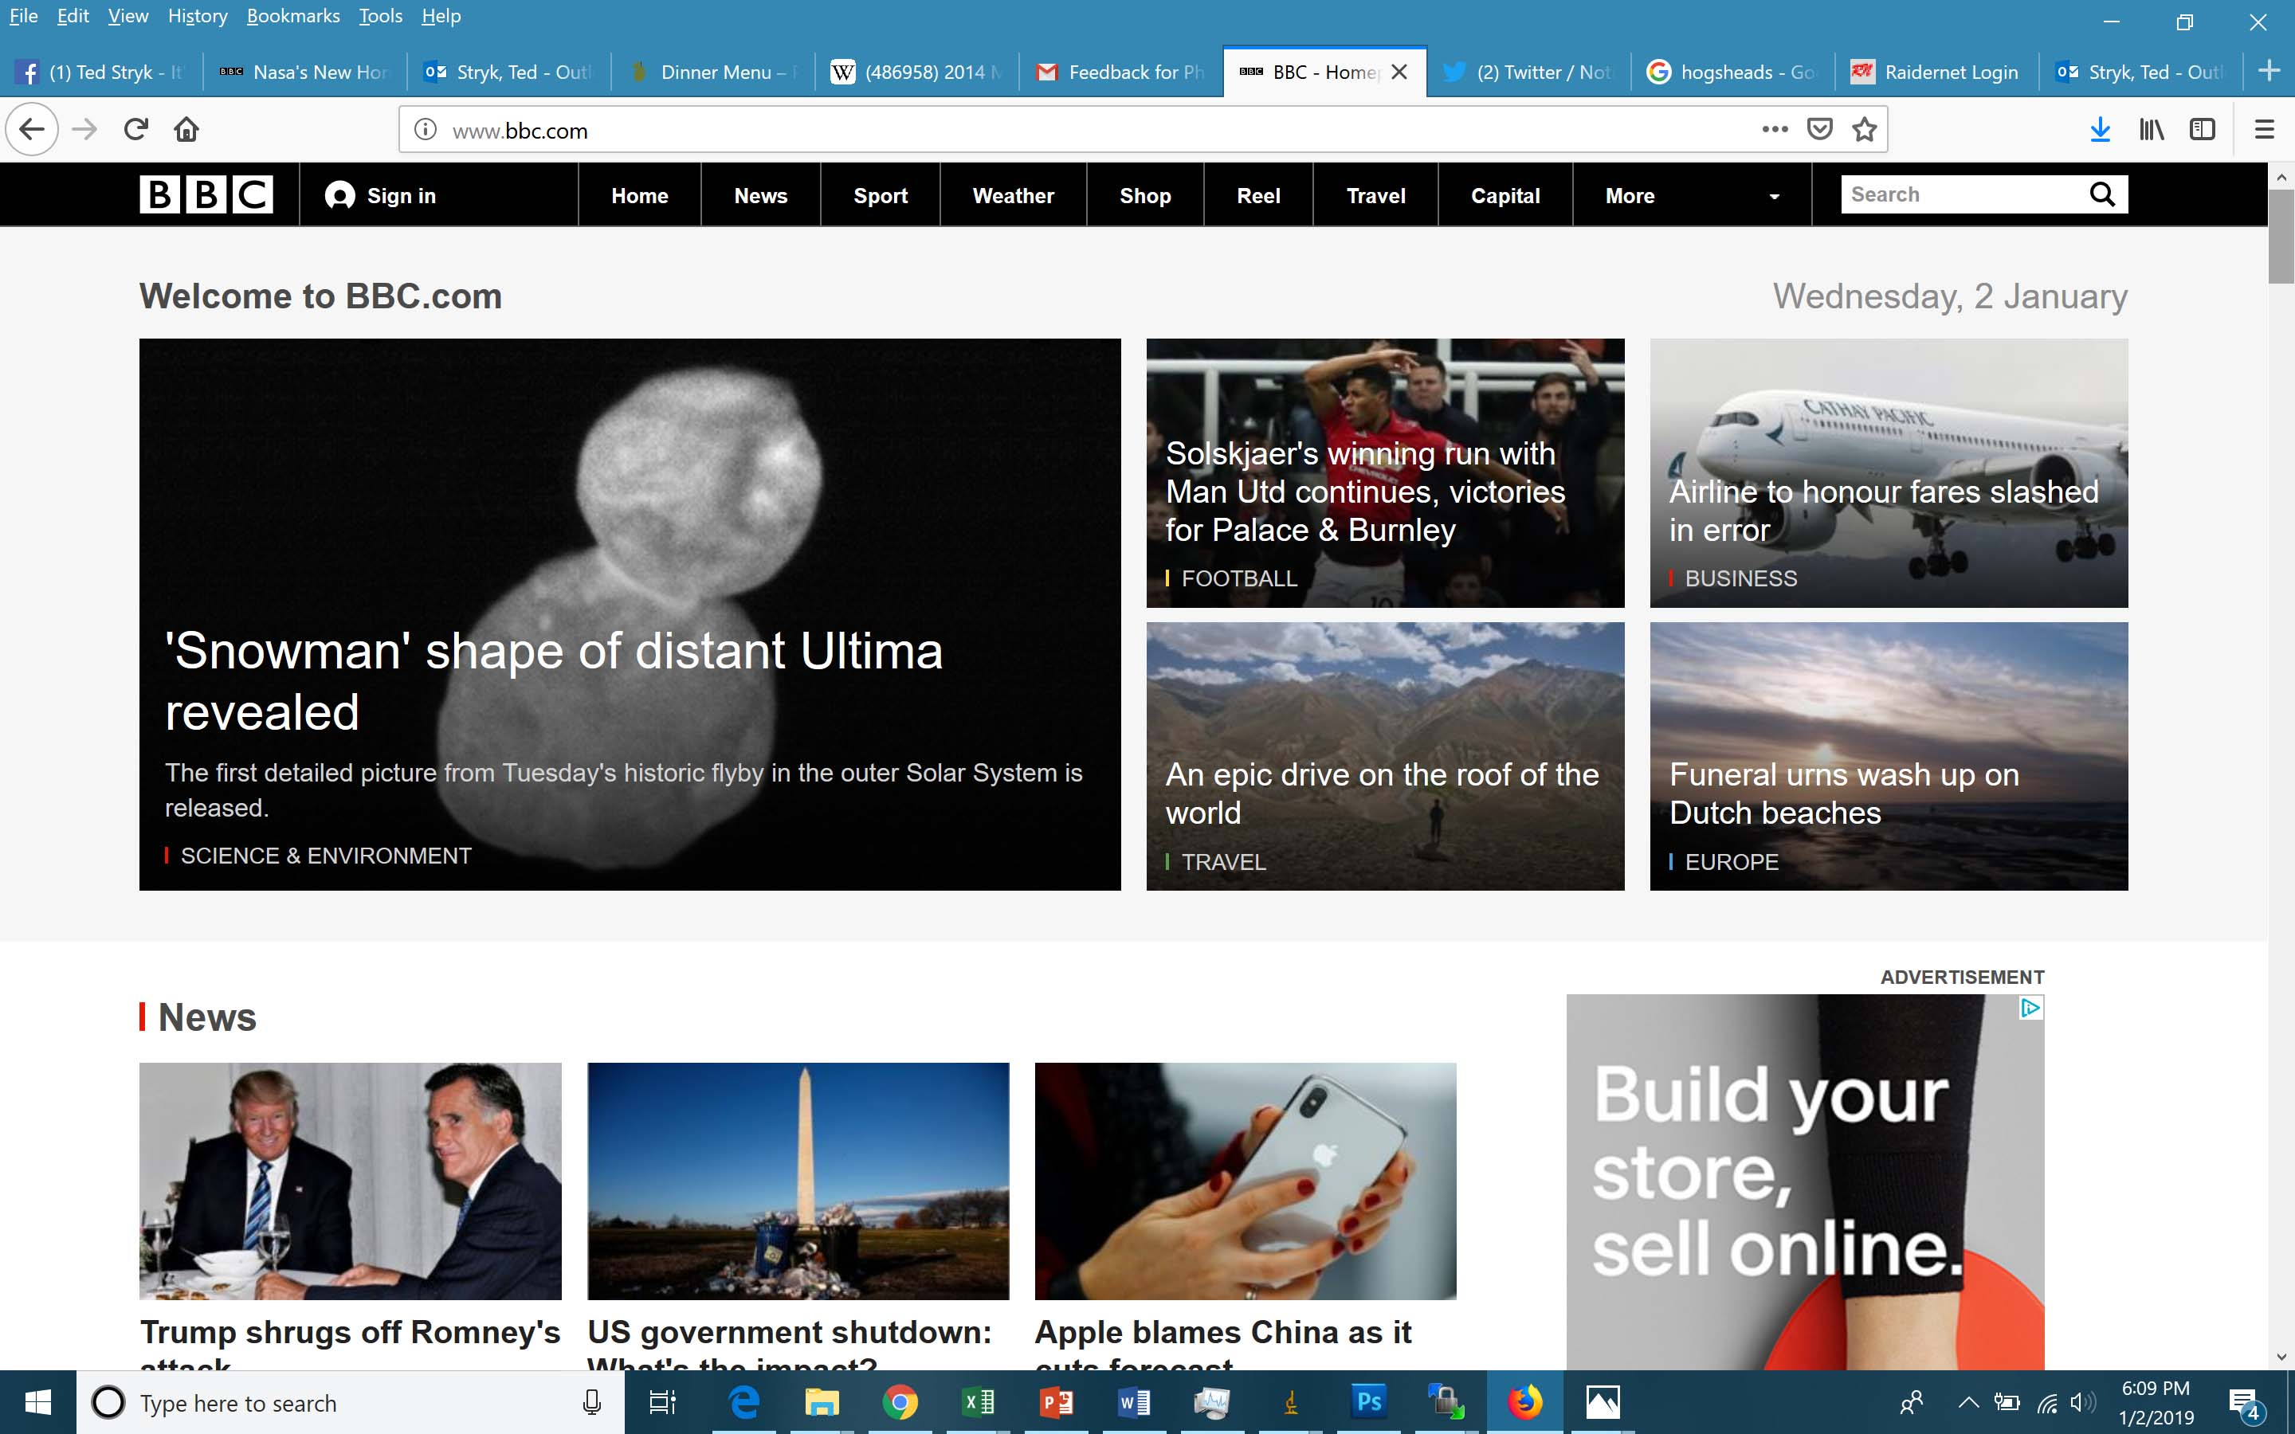
BBC News Cover

Slide 29
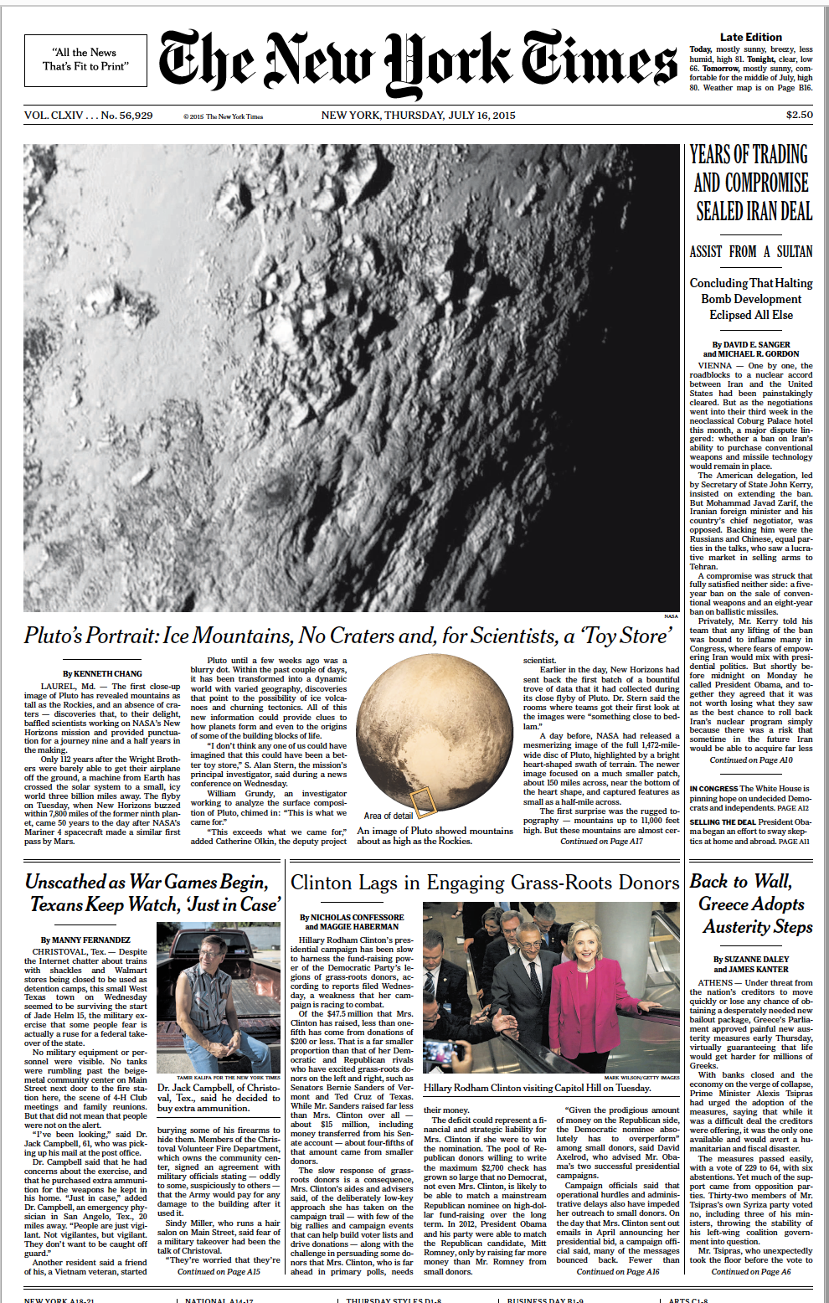
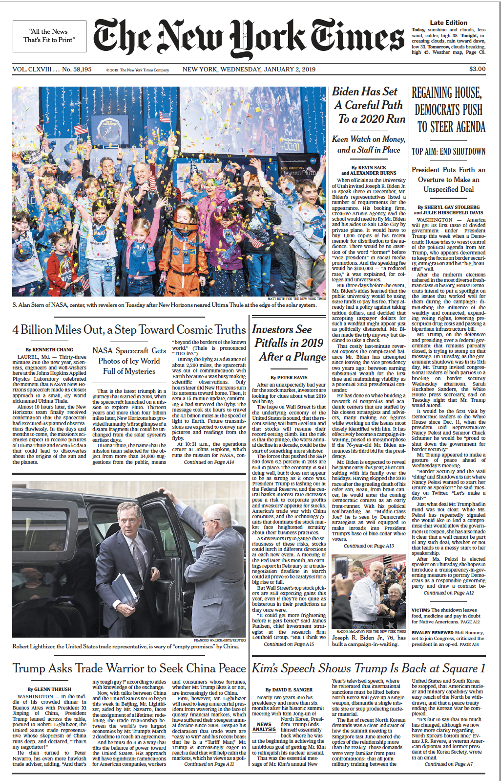
NY Times Covers (Pluto/UT)

Slide 30
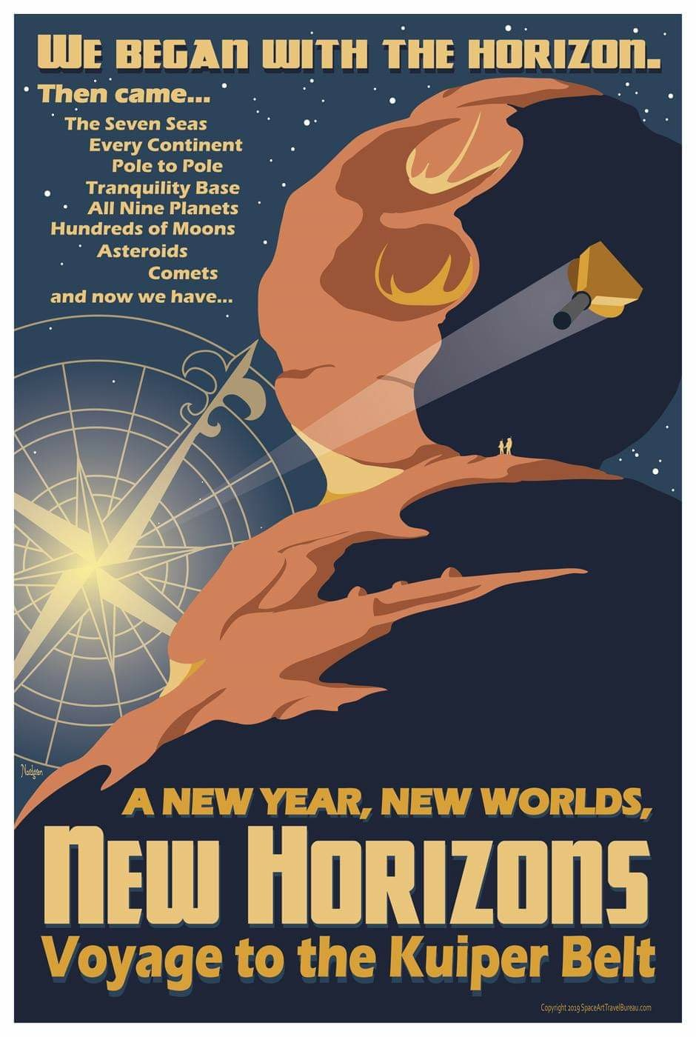
Artwork

Slide 31
Prickly City

Slide 32
Science team meeting
NASA/SwRI/APL

Slide 33
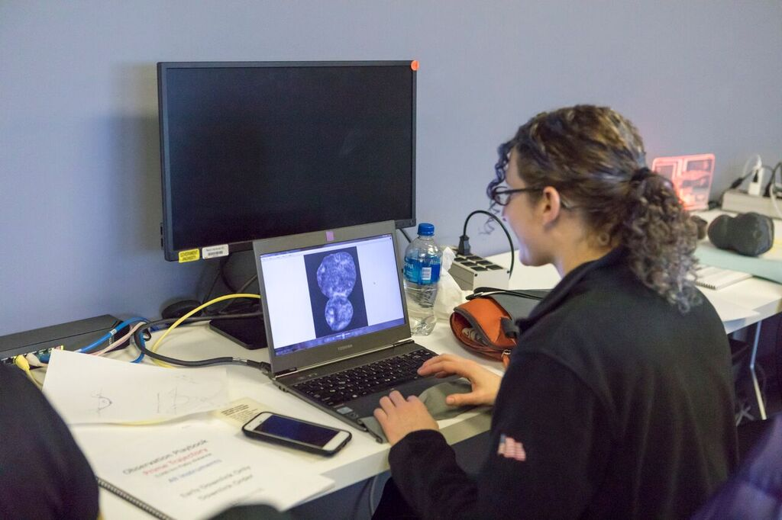
Where the real science happens
NASA/SwRI/APL

Slide 34
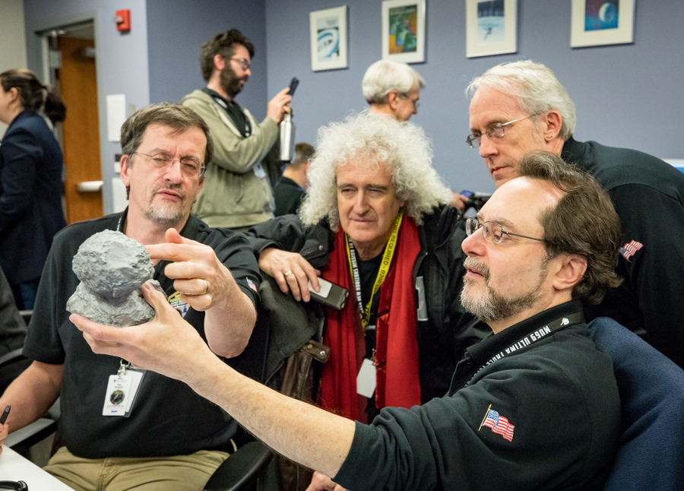
More real science
NASA/SwRI/APL

Slide 35
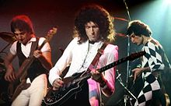
More real science (Brian May)
NASA/SwRI/APL

Slide 36
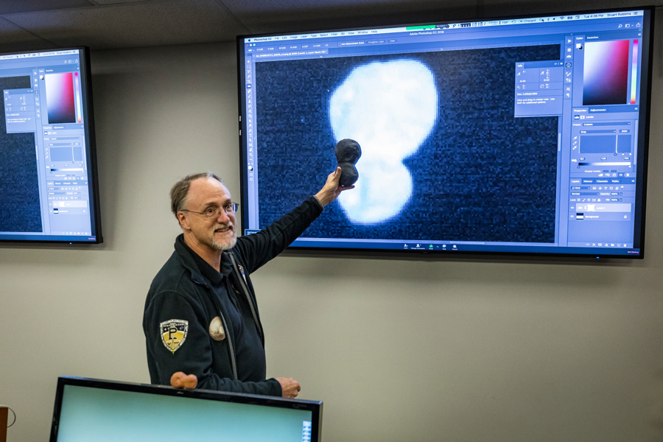
More real science (Marc Buie)
NASA/SwRI/APL

Slide 37
Winner: Occultations

Slide 38
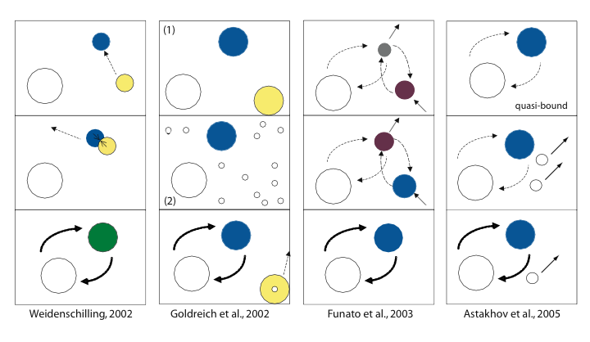
Proposed Binary Formation Models
Plenty o’ theories

Slide 39
… some better than others…

Slide 40
Ultima Thule is… red!
(Charon: Tholins)
(UT: space weathering)
(Tholins = CH₄, C₂H₆, NH₃, H₂O, HCHO, H2S)

Slide 41
More images…..
Altitude: 30,000 km - 3,500 km
Image credits: NASA/Johns Hopkins Applied Physics Laboratory/Southwest Research Institute/National Optical Astronomy Observatory

Slide 42
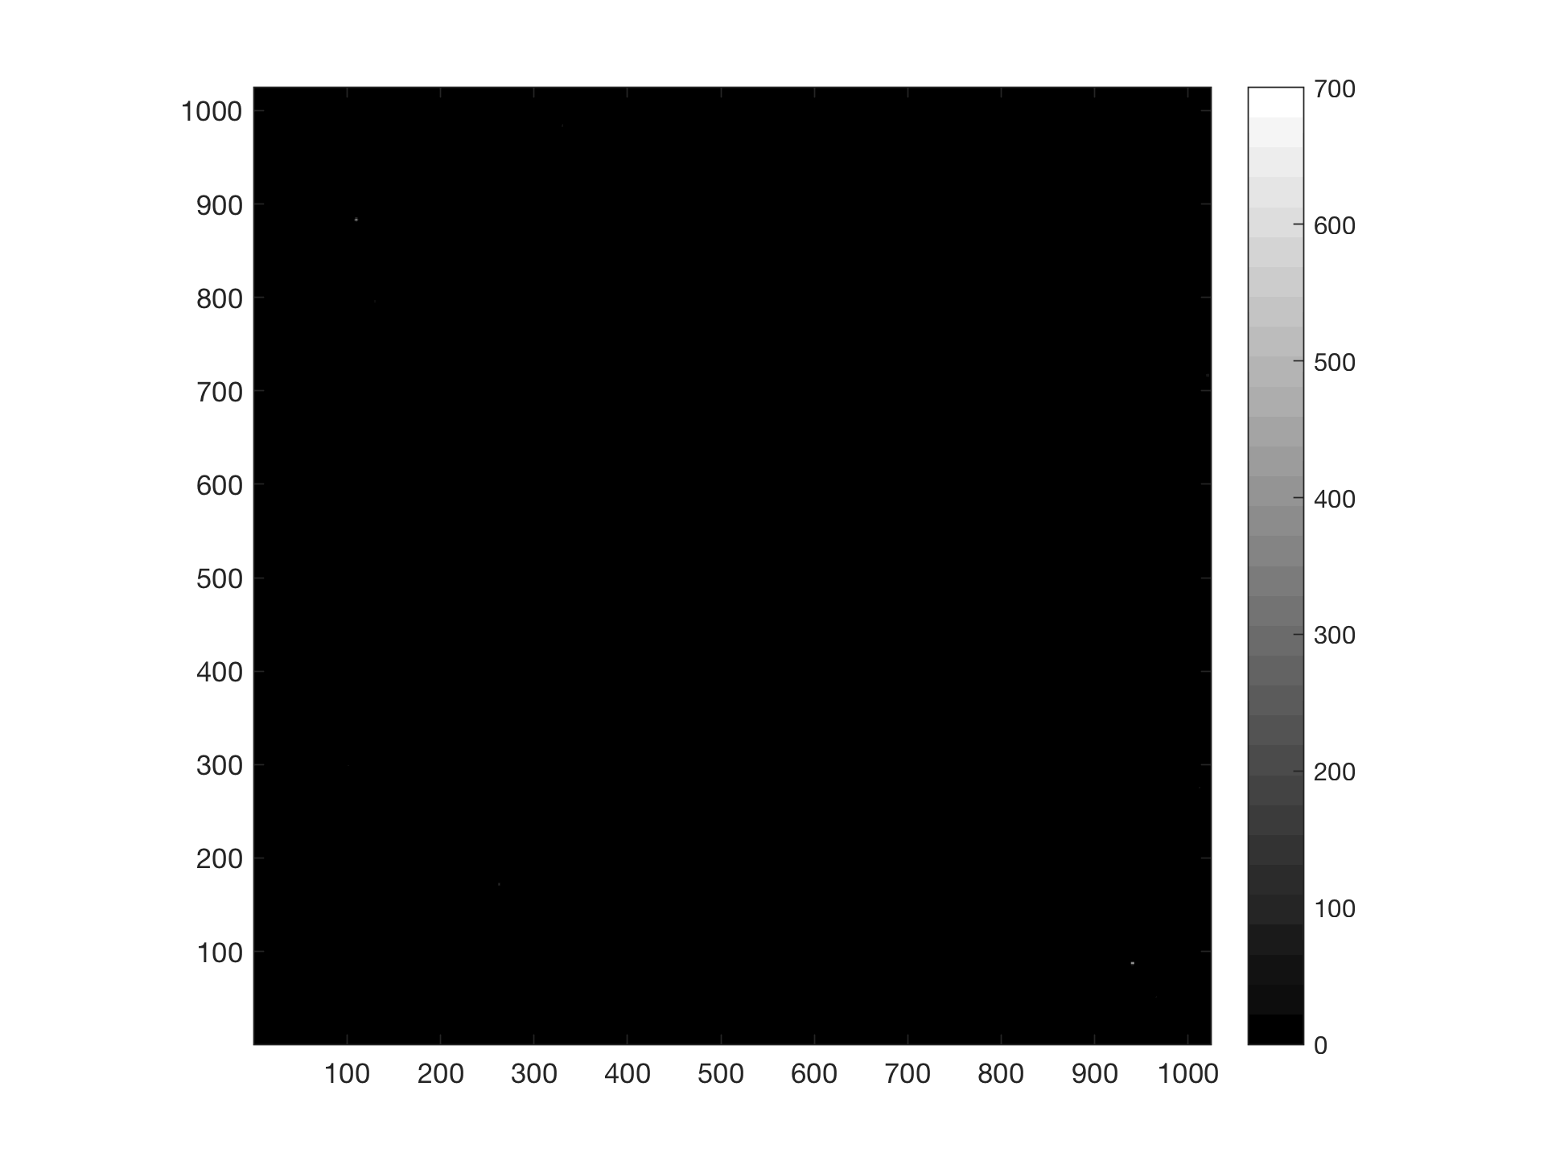
Simulated images (19059)
NASA/SwRI/APL

Slide 43
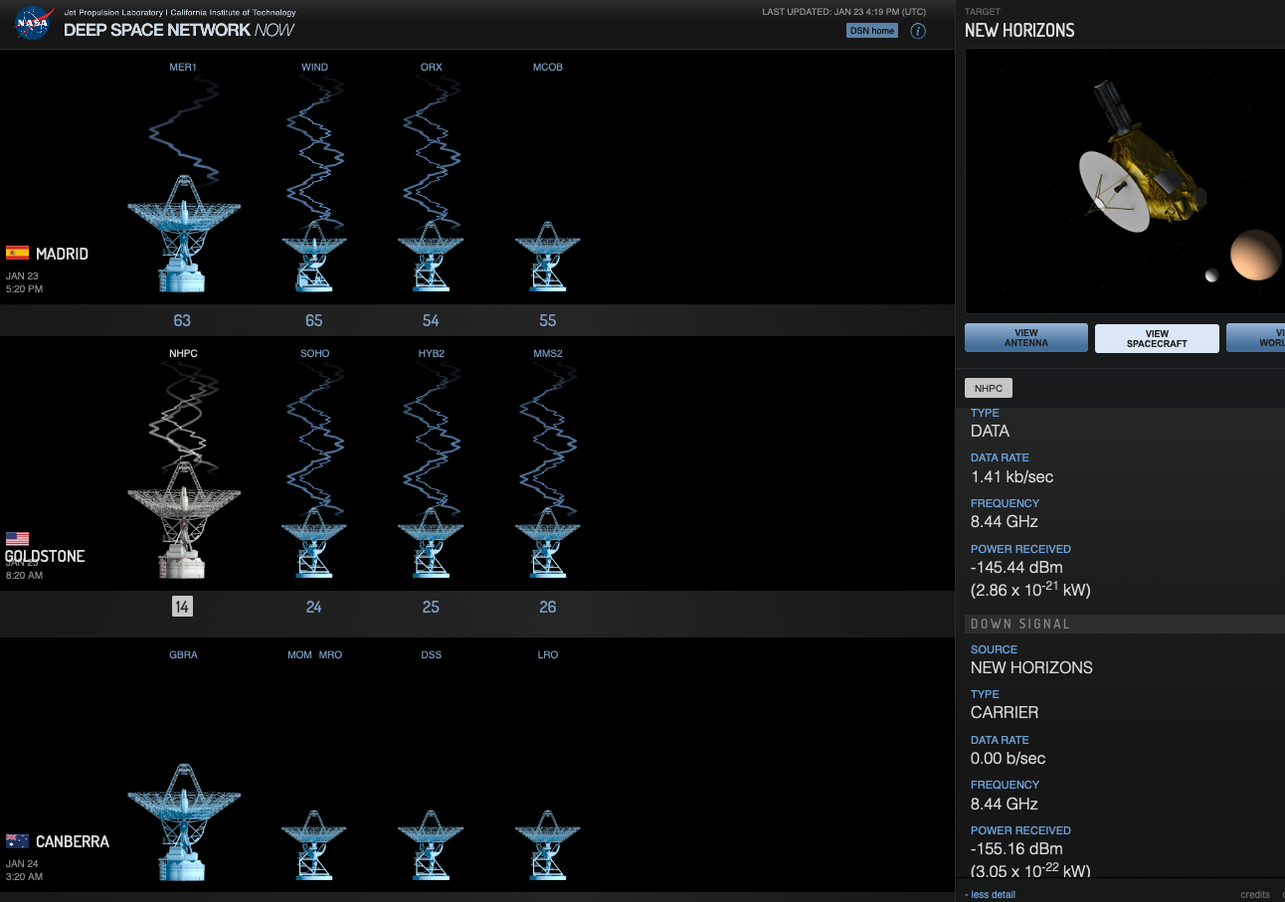
NASA Deep Space Network (DSN)

Slide 44
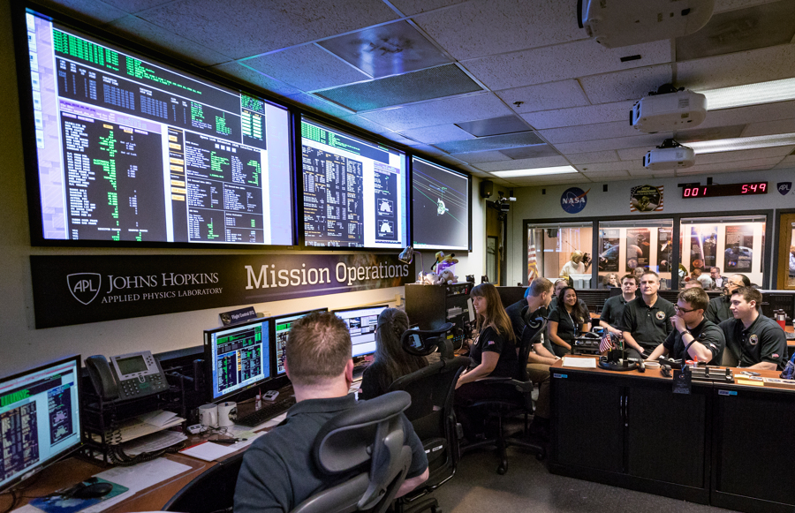
Mission Operations (Flight Controllers)
NASA/SwRI/APL

Slide 45
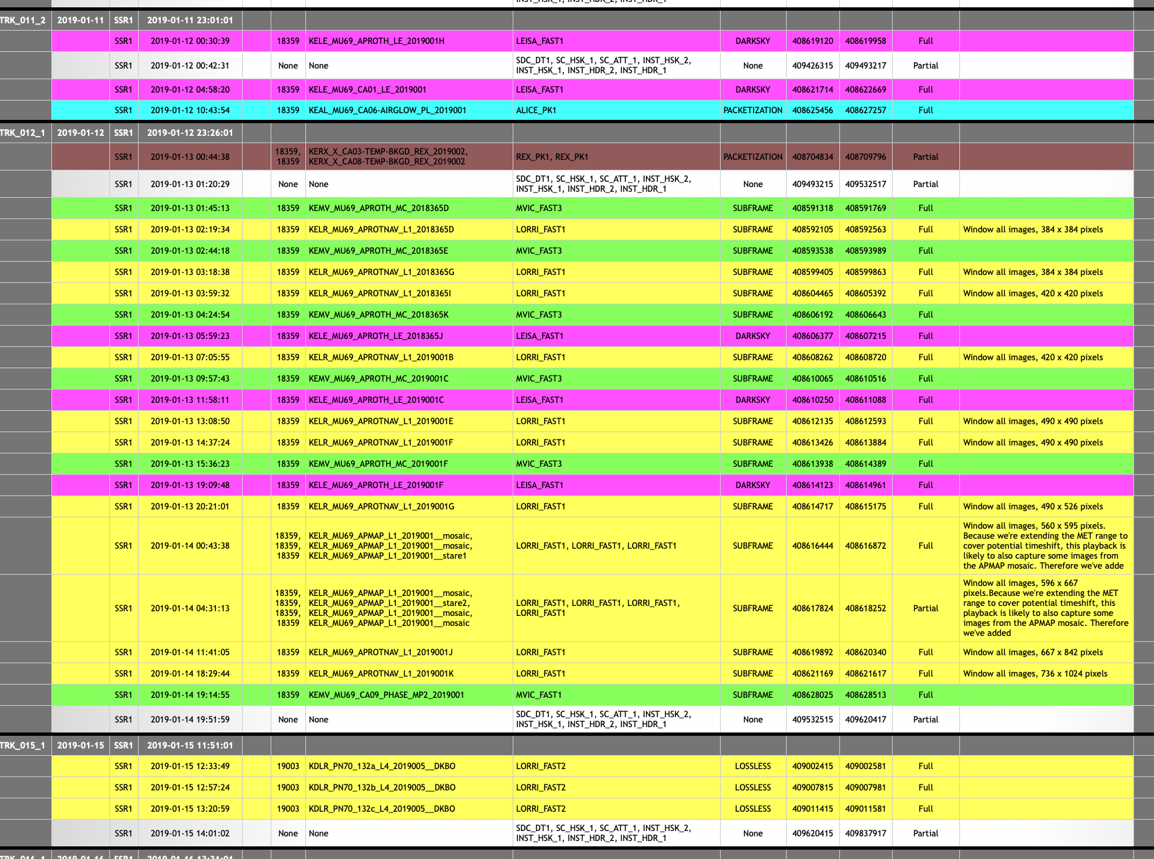
Data! More Data!!

Slide 46
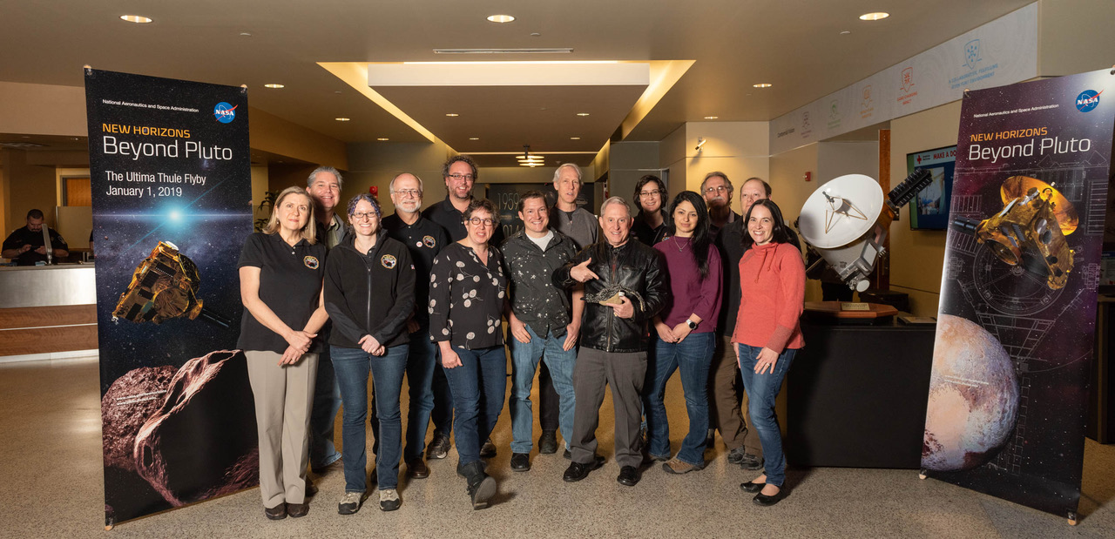
SwRI Team
NASA/SwRI/APL

Slide 47
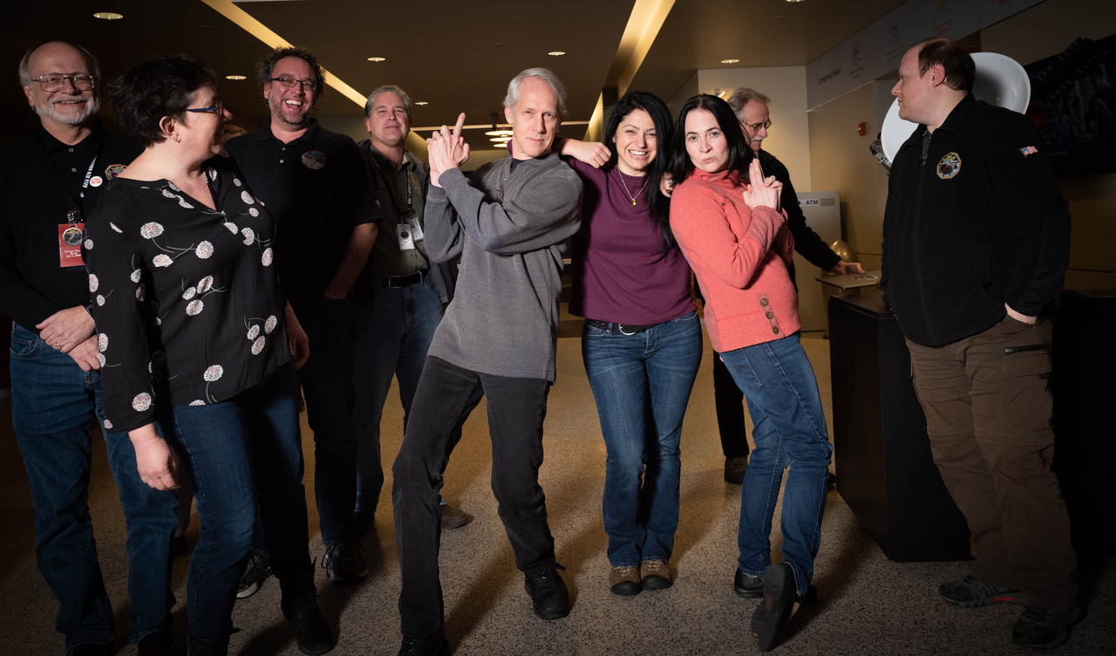
The real SwRI team
NASA/SwRI/APL

Slide 48
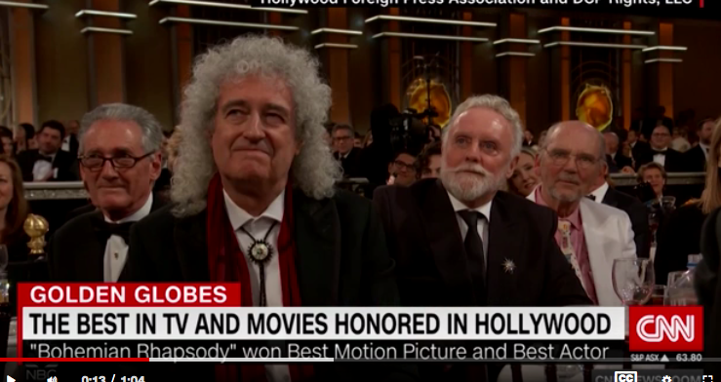
Brian May (He had a pretty good week)

Slide 49
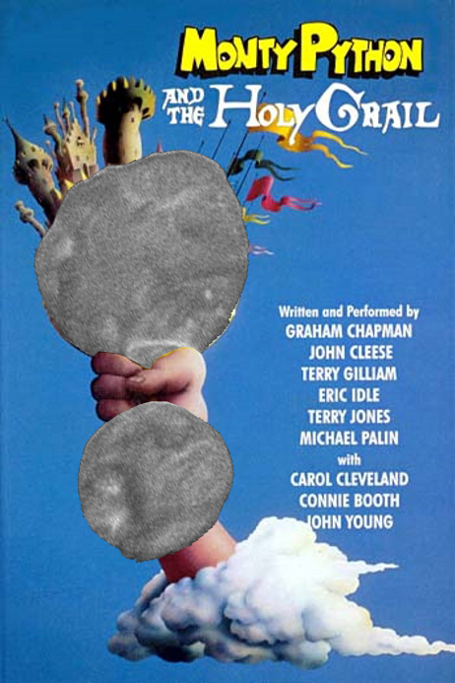
Stay tuned!

