Slide 1
Space Settlement
Creating a Genuine Space Economy
Brian Enke
Senior Space Research Analyst
Southwest Research Institute

Slide 2
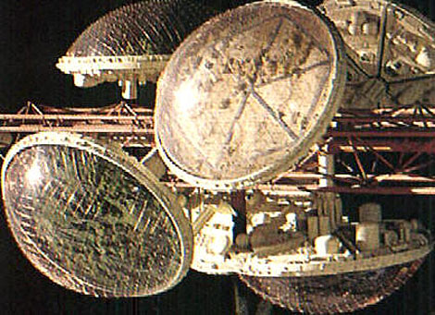
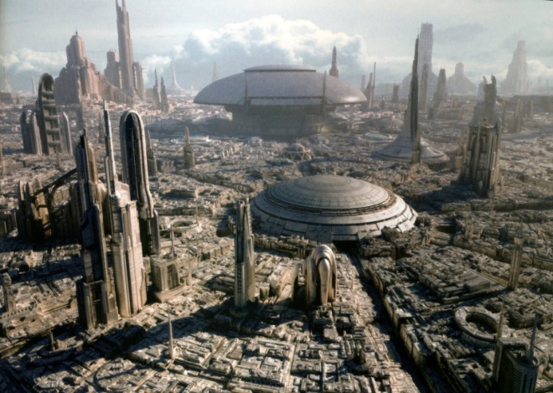
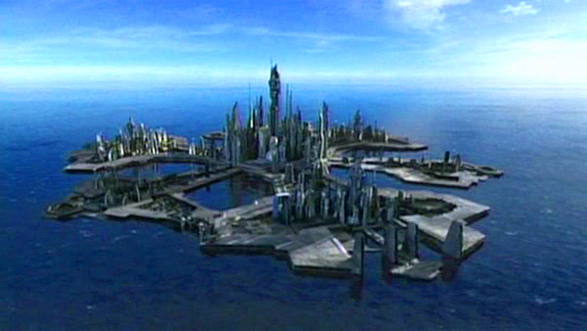
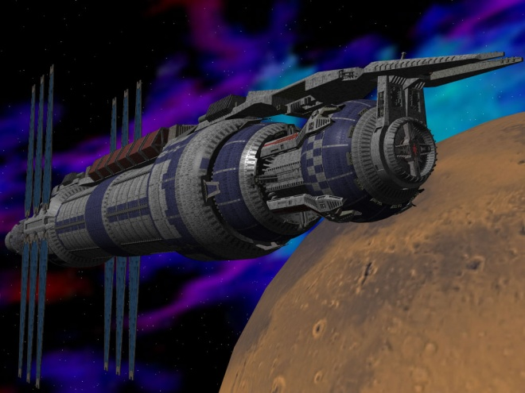
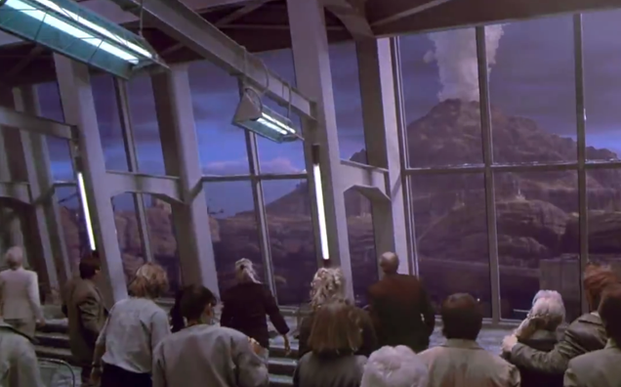
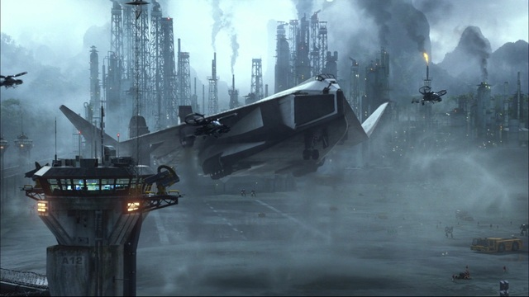
Science Fiction settlements

Slide 3

We need to change our thinking from this…

Slide 4
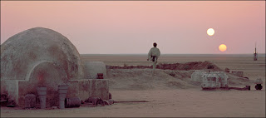
…to this

Slide 5
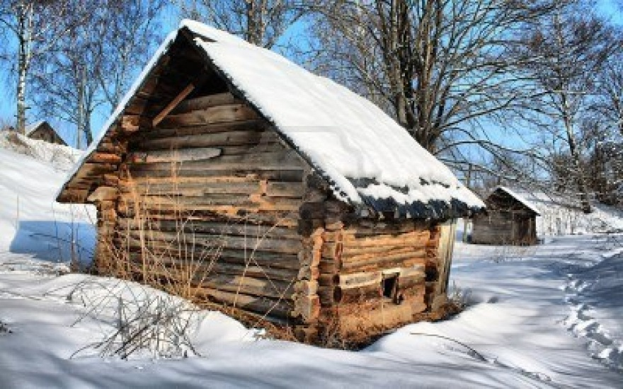
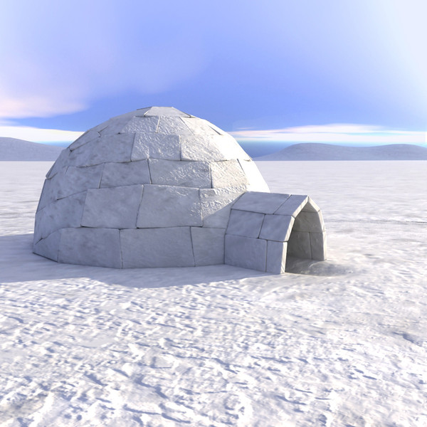
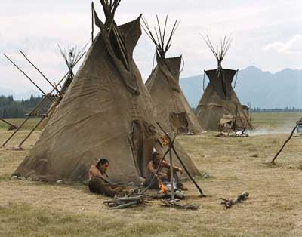
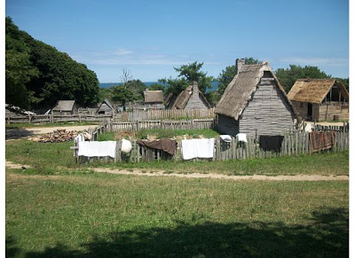
Earth
Settlements

Slide 6
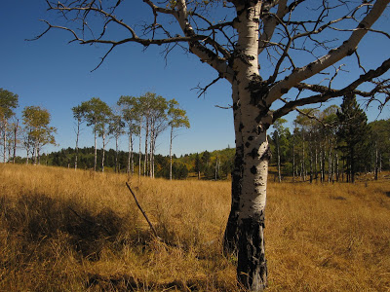
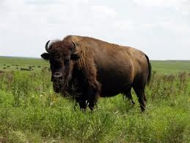
It’s not magic…
It’s intelligence

Slide 7
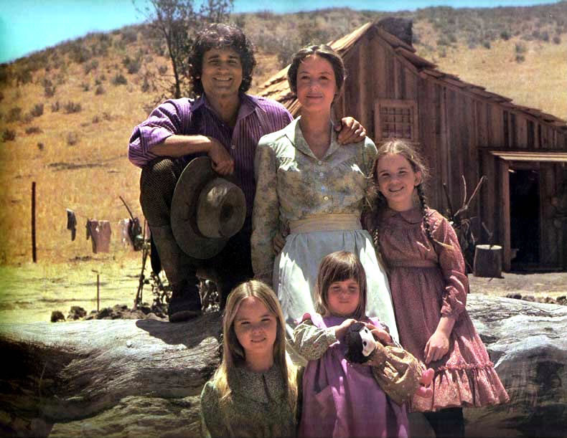
What do we need?
Settlers!
Families/Children
Skilled workers
Frontier work ethic

Slide 8
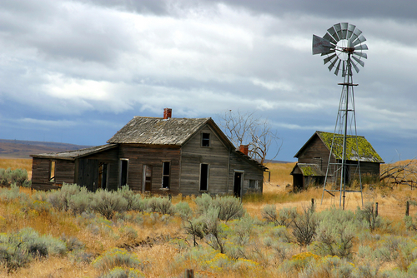
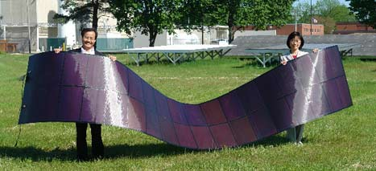
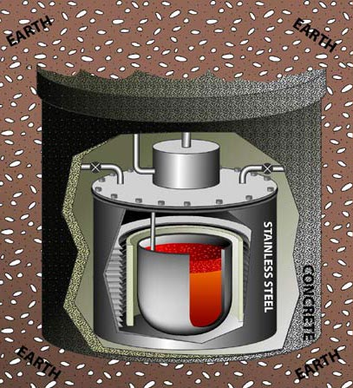
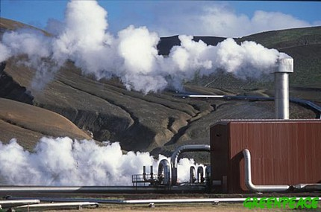
What else do we need?
Energy

Slide 9
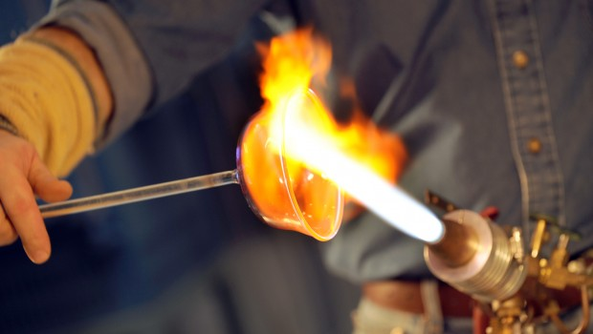
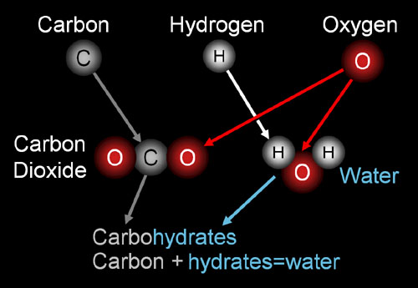
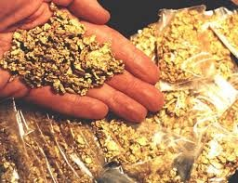
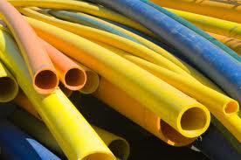
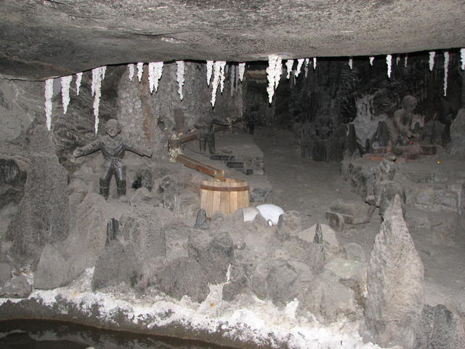
What else do we need?
Chemicals
Minerals
Resources

Slide 10
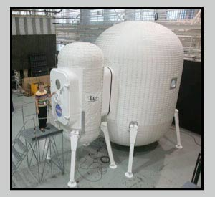
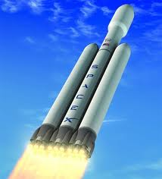
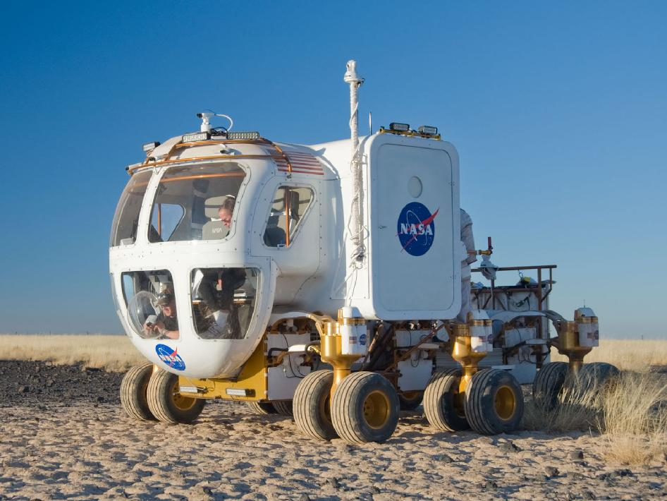
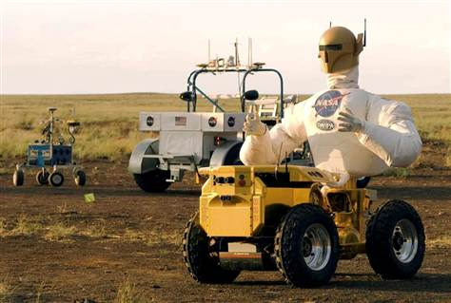
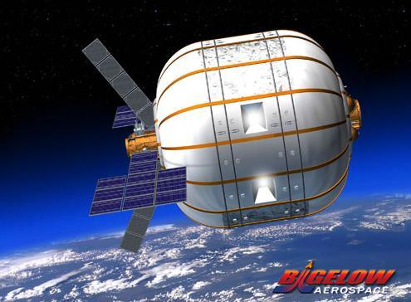
What else do we need?
Technology
Transportation

Slide 11
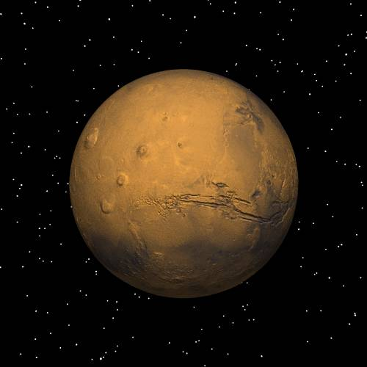
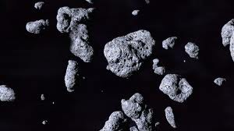
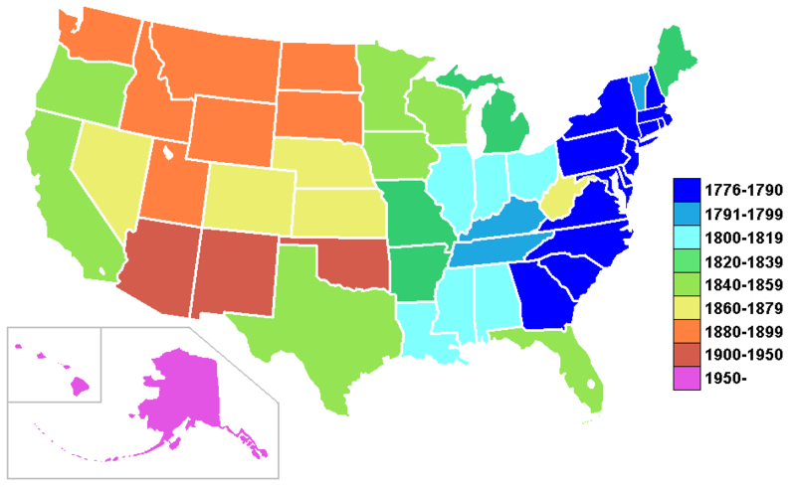
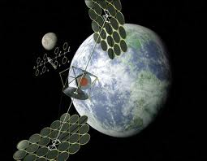
What else do we need?
Growth
Economic Potential

Slide 12
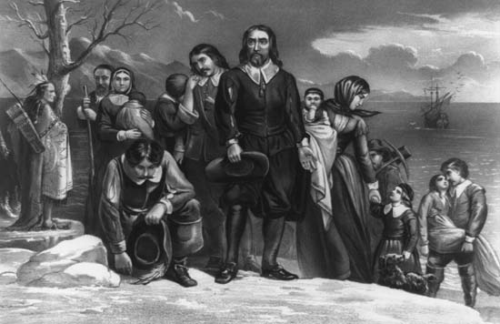
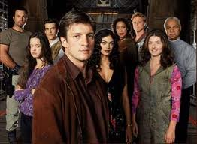
What else do we need?
Political/religious freedom

Slide 13
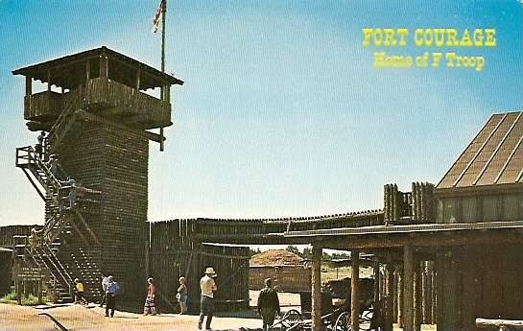
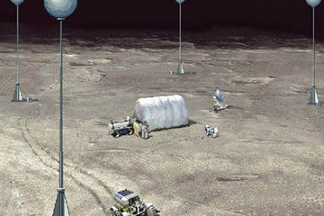
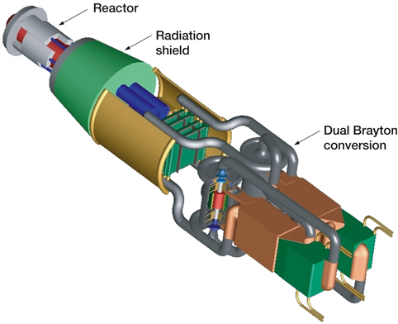
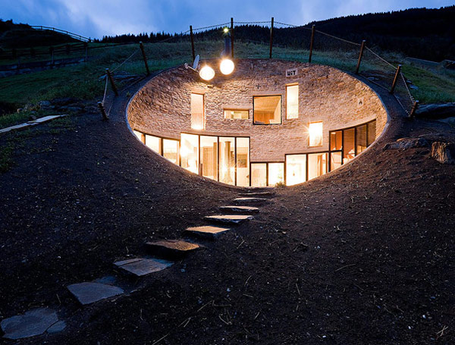
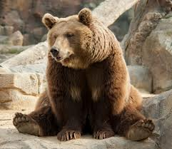
What else do we need?
Protection/shielding

Slide 14
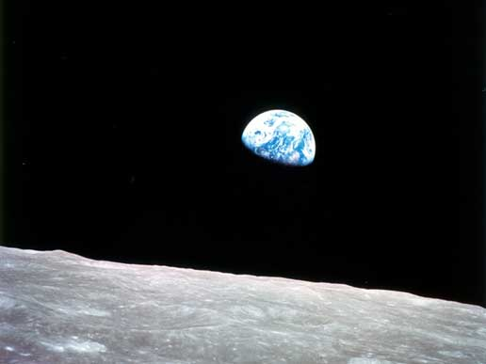
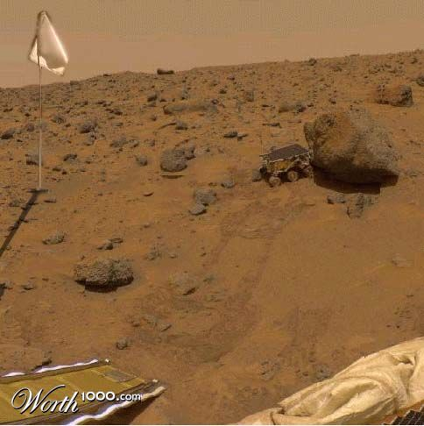
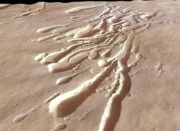
What else do we need?
Sports, Tourism
Curb appeal, Location

Slide 15
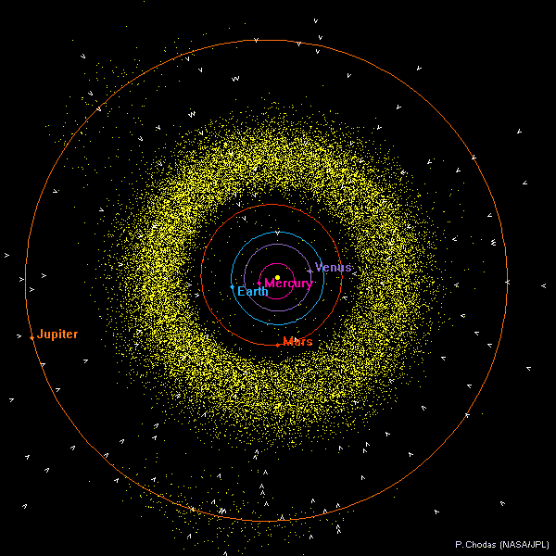
What else do we need?
Locations

Slide 16
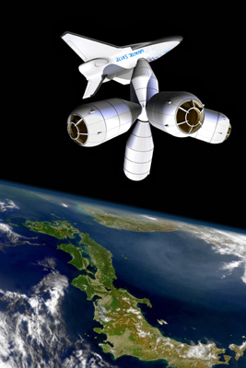
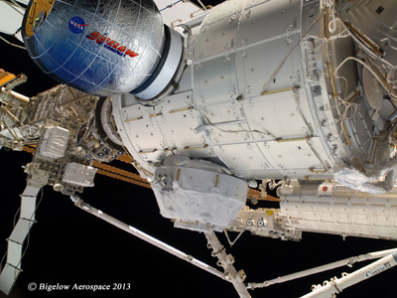
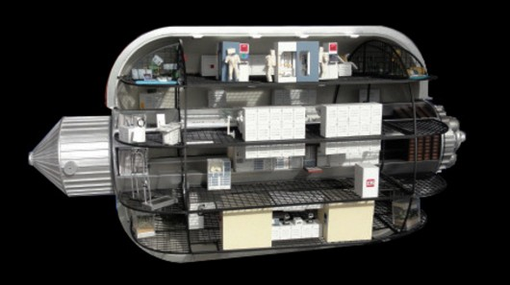
Possible Locations
Earth orbit
(dependent on Earth resources)
(strong economic potential)
(harsh environment)

Slide 17

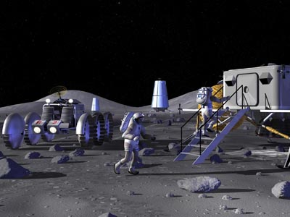
Possible Locations
Moon
(dependent on Earth resources)
(medium economic potential)
(harsh environment)

Slide 18
Possible Locations
Asteroids
(independent resources)
(vast economic potential)
(harsh environment)

Slide 19
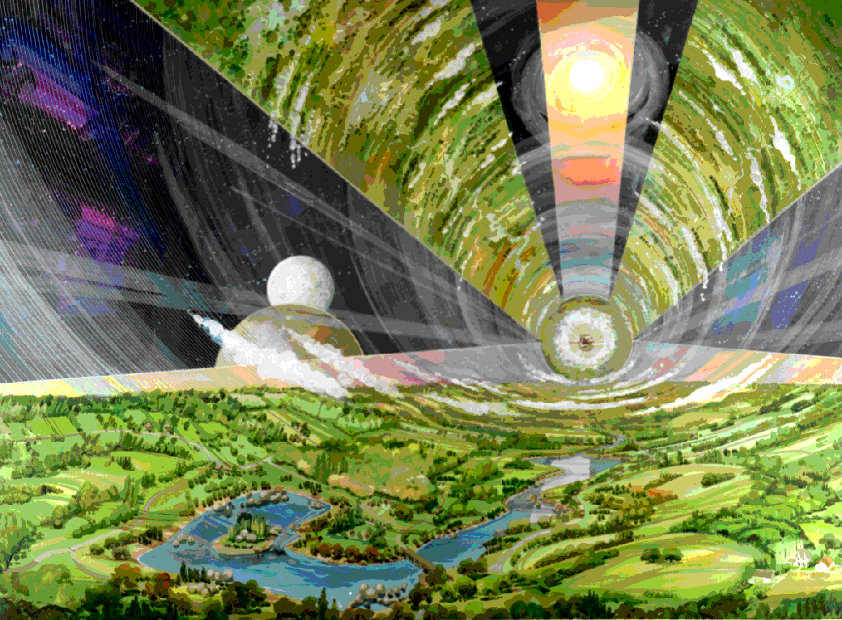
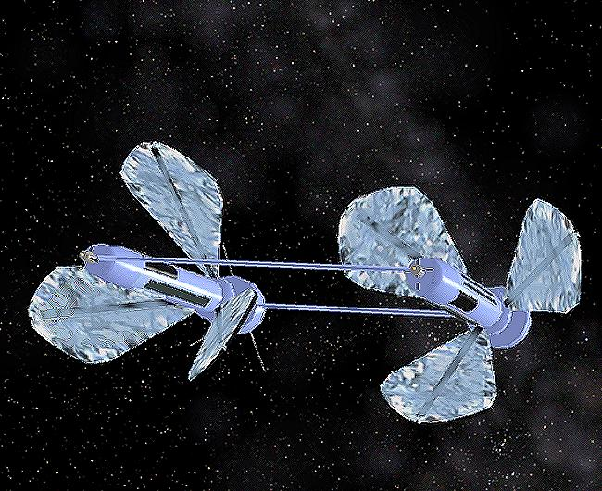
Possible
Locations
Lagrange Points
(no resources)
(weak economic potential)
(mild environment)

Slide 20
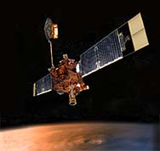

Possible
Locations
Mars
(vast resources)
(vast economic potential)
(mild environment)

Slide 21
Possible Locations
Everywhere
Else

Slide 22
Companies to watch
Bigelow
Galactic Suite
Golden Spike
Planetary Resources
Deep Space Industries
Mars-One
SpaceX
4Frontiers (EMMA)
Earth Orbit
Moon
Asteroids
Mars
All of the above

Slide 23


Mars Settlement
Site Selection
Equal day/night, seasons
(Energy)
Low altitude (landing, rad)
Water
Other resources (CHNOPS)
Safety (dust, radiation, etc)
Lava tubes
Scenery
Economic potential, growth

Slide 24
Mars-One Settlement
Site Selection
Many sites under consideration
Short timeframe increases importance of low altitude, low latitude, and water
My favorite site extends from Mie to Phlegra Montes
Backup sites include:
  Gale Crater
  Medusae Fossae

Slide 25

Mars Settlement
Site Selection

Slide 26
Conclusions
Settlers!
Energy
Chemicals, Minerals, Resources
Technology, Transportation
Protection (radiation)
Roadmap for growth, Economic potential
Political/religious freedom
Sports, Tourism
Curb appeal, Location
Realistic plans…..

Slide 27
To The
Future…

Slide 28

The Callahan Kids: Tales of Life on Mars
Kindle Alert!!!

Slide 29
4Frontiers Gen-II
Mars Settlement Study
(2006-2007)
NewSpace company
Outreach via edu-tainment
Serious settlement research

Slide 30


Slide 31

Who's Going To Mars?

Slide 32






Who Else Is Going To Mars?

Slide 33


Slide 34
Primary Issues
Bootstrapping
Location
Resources
Construction
Space Matrix
Shielding
Transportation
Power Gen
Crew Skills
Payload, EDL
Food
Psychology
Spacesuits
Communications

Slide 35

Bootstrapping
Initial Crew Size
6 – 6 – 9 or 9 – 9 – 3 ?
When? Where?
Crew Skills?
Modular Design
Balance Short-term with Expansion
Stay Alive vs Thrive

Slide 36
To build this, we need…. RESOURCES!!

Slide 37

Water Resources
Estimate ~180 tonnes over initial construction phase (mostly industrial).
Ice deposits
Aquifers
Hydrated minerals

Slide 38
Other Resources
Carbon
Iron – hematite (rebar and girders)
Sulfates (everywhere... Mars Stinks!!!)
Silica (windows and fibers) – might be rare
Aluminum
Note: orbiters cannot determine types of minerals or concentration well enough. Need people on the spot!!

Slide 39

Resources
4FC site is dark blue square while Opportunity landing site is yellow square.
Triangles are locations of high priority mining exploration sites for the following minerals:
chalcopyrite - light green, hematite - maroon, clay – orange (all ENE of site), anorthite – pink (NNE of site), gypsum - gray (NNW of site).
Hydrated minerals are found over the entire map viewed here at about 5% water by weight. Basalt is expected in the immediate vicinity of the 4FC site and in the debris field of the large impact crater to the NW of the site.
The horizontal and vertical arrows are 100 km long. The distance between the 4FC site in blue and the Opportunity landing site is 78.5 km.

Slide 40
Construction
Rolling mills – large and massive – notice all the workers!!

Slide 41

Gen-I Space Matrix
Gen-I architecture

Slide 42


Shielding
Gen-I architecture
Regolith
Removable greenhouse cover?

Slide 43
Transportation
4FC site is dark blue square while Opportunity landing site is yellow square.
Triangles are locations of high priority mining exploration sites.
The horizontal and vertical arrows are 100 km long. The distance between the 4FC site in blue and the Opportunity landing site is 78.5 km.
Closed-container trailer-trucks to prevent boil-off and dust contamination during transit.
Paved roads around settlement to minimize dust.
Warning: Ejecta near craters!

Slide 44

Power Generation
Three CO2 coolant nuclear reactors (4 megawatts each)
Mix of electric and thermal power
Remote power for mining
Industry options:
  Small reactors?
  Hyperion?

Slide 45
Crew Skills
In the initial crew of nine:
10 nuclear engineers
4 agriculture experts
4 geologists
2 doctors
5 engineers
5 construction specialists
Solution: tele-robotics and AI???

Slide 46

Cargo Delivery (iv)

Slide 47
Payload Take-Home Messages:
This is hard (in case you didn’t know)
We recommend:
  Small payloads
  Mixed-fleet LVs
      Use what is available, advantages/disadvantages to each
      Keep the LV issue out of cost-of-entry considerations
  Crew size/vehicle = 3 each, maximum!
      Otherwise, EDL difficult if not impossible
      Launch in formation if necessary
Critical path:
  EDL is the most significant choke point, and needs the most attention

Slide 48


Mars Entry Descent and Landing
11 metric tonnes!!!

Slide 49



Figure 2. Cutaway View of a Non-Transparent Greenhouse Containing an Aquaponics Set-up (not to scale)
The walls and dome are opaque, and the entire operation is electrically lit using LEDS.
The “floor” Immediately to either side of the central concrete walkway and above the fish tanks set 1.5 m below ground are actually floating panels that will hold leafy plants while the roots dangle into the water containing fish. This water will also be used to “feed” other leafy crops on each of the two shelves on either side of the walkway.
Heated water to warm tanks
1.5M

Slide 50

Open
Greenhouses

Slide 51
Main fish tank
LED lights
cage rails
Inner atmosphere injector
oxygen generator
phytoplancton
sediments
biofilter
automated feeders
solids removal
Plankton, Fish, Nitrobacteria strains
Key theme: waste re-use
Integration with agriculture & waste mgmt

Slide 52
Psychology

Slide 53

Spacesuits?

Slide 54



Spacesuits!

Slide 55

Communications

Slide 56

“Hey, where did everyone go??”

Slide 57
The Callahan Kids: Tales of Life on Mars
Kindle Alert!!!

Slide 58


Mars-One
Goal: a human settlement on Mars in 2023
Funding: ~$5 billion/10 yrs, via entertainment

Slide 59

2014-2016
Astronaut selection
First supply mission

Slide 60

2018
Rover/trawler mission
Locate best site

Slide 61

2021
Blitz: 6 landers
4 habs
Another rover/trawler
Another supply container

Slide 62

2022
Base integration
Greenhouse prep
‘Go’ for human launch?

Slide 63

2023
First landing!
Capsule connections, power, food
Five more cargo units, including another rover

Slide 64

2025
Second crew of four lands
Five more cargo units, including another rover

Slide 65
2030…

