Slide 1
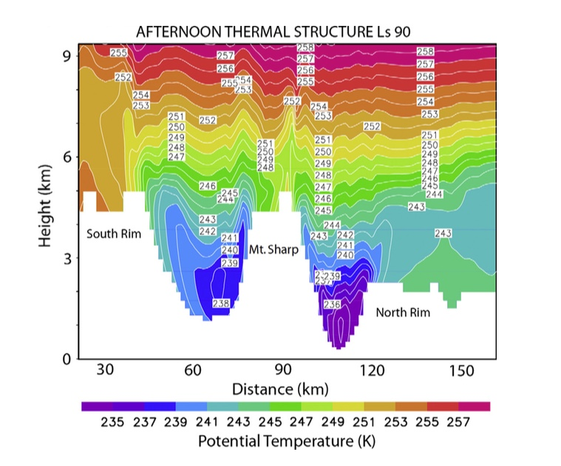
Suppressed PBL in Gale crater, but...

Slide 2
... atmospheric circulation is strongly 3-D!

Slide 3
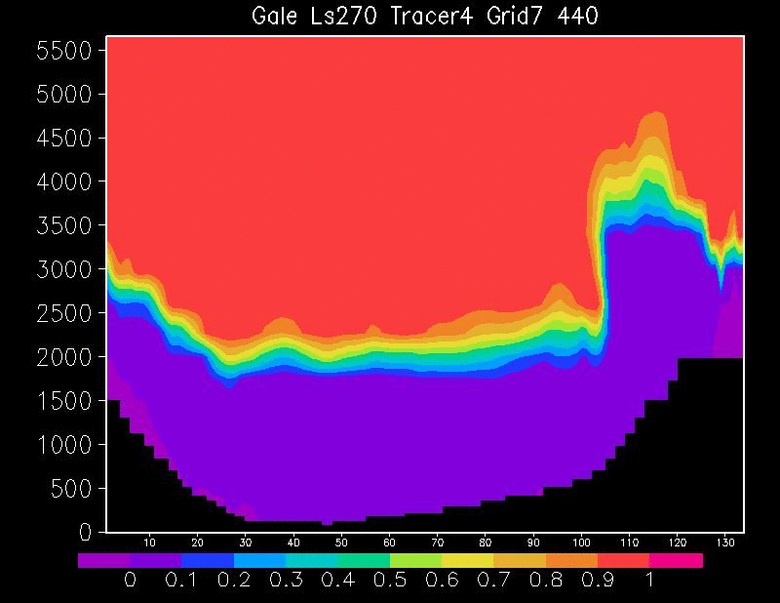

Slide 4
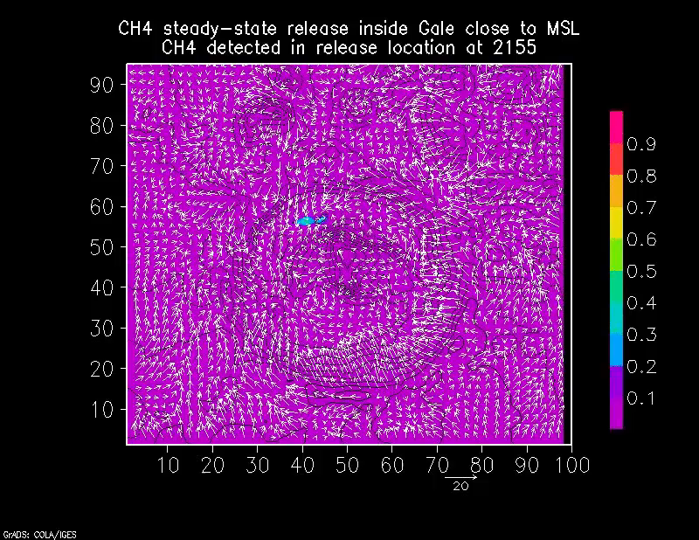
Steady-state methane release (~140 km²) inside Gale close to MSL
MRAMS CH4abundance in release location at
LMST
CH4
ppb
E

Slide 5
During nighttime downslope winds converge
and contain methane close to the point where it is released

