Slide 1
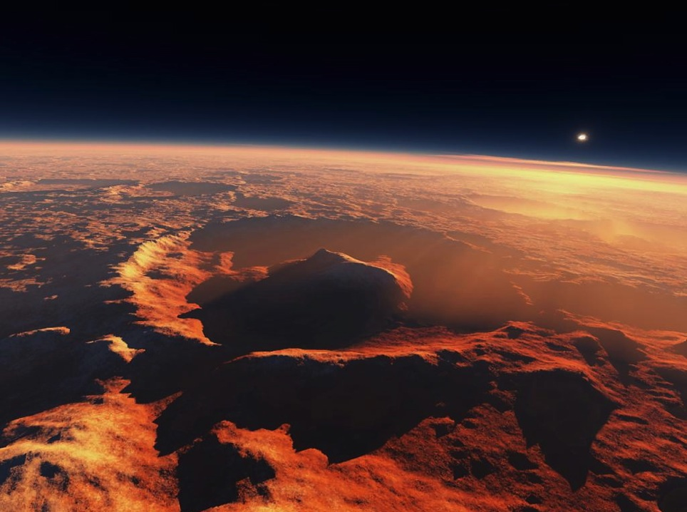







Constraining the MSL-SAM Methane Detected Source Location Through Mars Regional Atmospheric Modeling System (MRAMS)
Jorge Pla-García^{1,2,3} ,Scot C.R. Rafkin²
¹Centro de Astrobiología (CSIC-INTA), Madrid, Spain
²Space Science Institute, Boulder, CO, USA
³Southwest Research Institute, Boulder, CO, USA
jpla@cab.inta-csic.es
MSL Science Team Meeting
MSL sol 1590 (Ls305), January 25th 2017
Notes:
In an effort to better address the potential mixing and remaining questions, atmospheric circulation studies of Gale Crater were performed with MRAMS mesoscale model, ideally suited for this investigation using tracer fields to simulate the transport of CH4 and to understand the mixing of air inside and outside the crater throughout the Martian year. The simulated tracer abundances are compared to gas abundances measured by SAM. Ls270 was shown to be an anomalous season when air within and outside the crater was well mixed by strong, flushing, northerly flow and large amplitude breaking mountain waves: air flowing downslope at night is cold enough to penetrate all the way to the surface. At other seasons, the air in the crater is more isolated from the surrounding environment: the air flowing down the crater rims does not easily make it to the crater floor. Instead, the air encounters very cold and stable air pooled in the bottom of the crater, which forces the air to glide right over the colder, more dense air below. Thus, the mixing of near surface crater air with the external environment is potentially more limited at seasons other than around Ls270. The rise in CH4 concentration was reported to start around Ls336, peaked shortly after Ls82, and then dropped to background values prior to Ls103. Two scenarios are considered in the context of the circulations predicted by MRAMS. The first scenario is the release of CH4 from somewhere outside the crater. The second is a release of CH4 within the crater. In both cases, the release is assumed to take place near the season when the rise of concentration was first noted Ls336. This is a transitional time at Gale, when the flushing winds are giving way to the more isolated crater scenario. The objective is to establish the amount of mixing during the limited mixing epochs and to test whether CH4 releases inside or outside of Gale crater are consistent with observations by SAM.

Slide 2
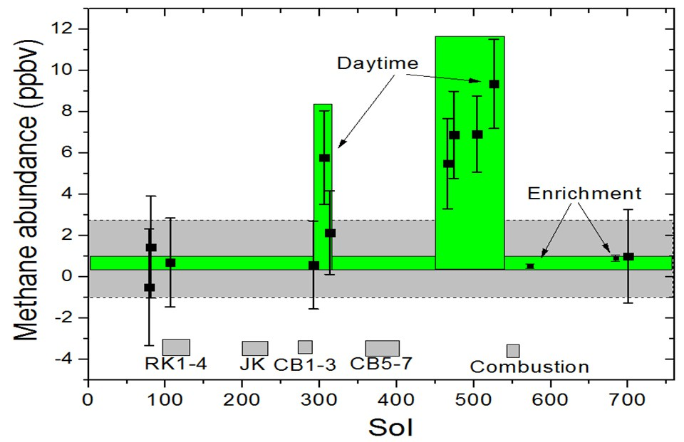
Ls82
Ls336
Mars methane detection and variability at Gale crater
(Webster et al., 2015)

Slide 3
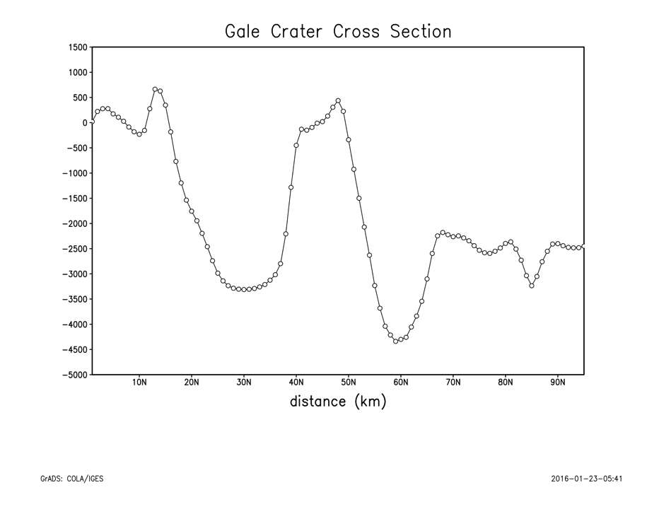
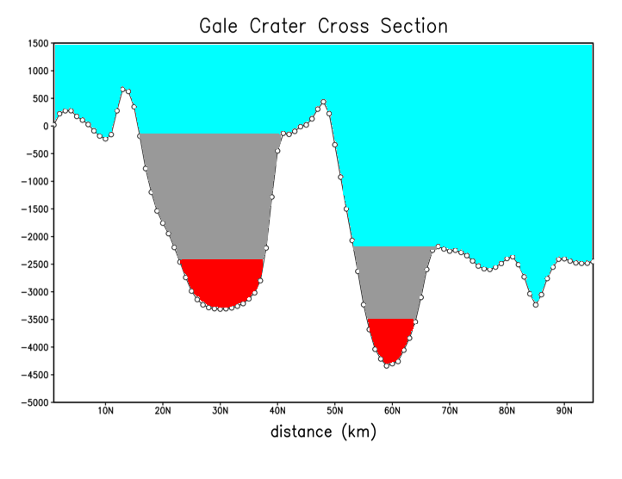
Tracer 1 (methane): < 200 meters
Tracer 2: 200 – 500 meters
Tracer 3: 500 – 2000 meters
Tracer 4: elsewhere
MSL landing site
South
North
Scenario 1: four gas tracers included into Gale crater
atmospheric simulations

Slide 4
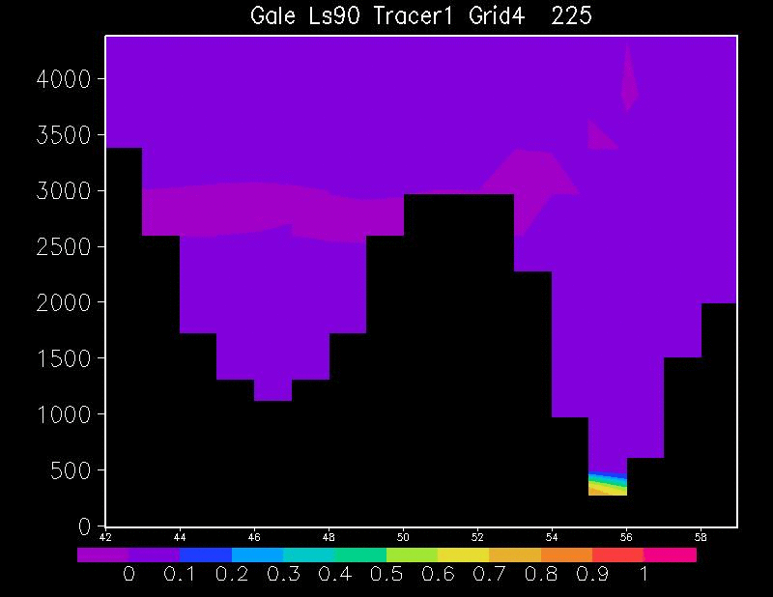
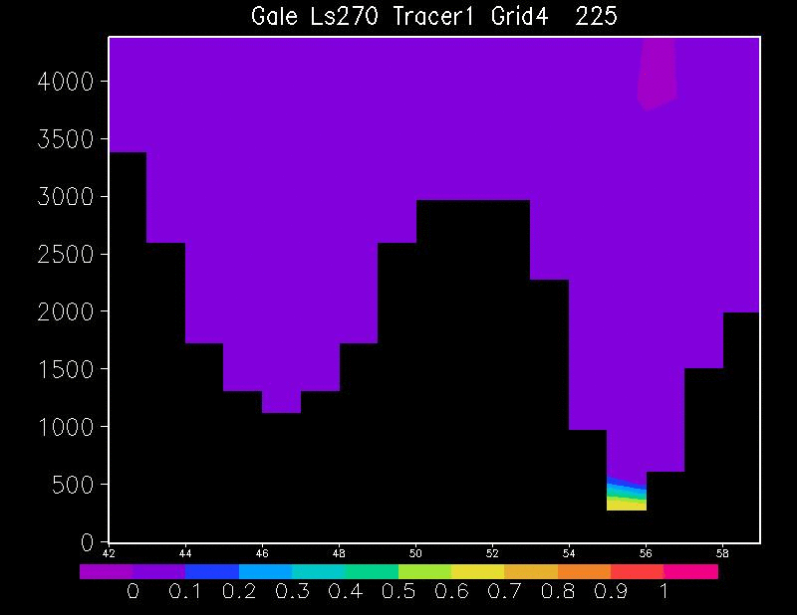
Crater mixing timescale
Ls90. Winter equinox. Tracer #1 fraction
Ls270. Summer equinox. Tracer #1 fraction
S
N
S
N
Almost all tracer1 mass is gone from crater after 10 hours
Almost all tracer1 mass is gone from crater after 8 hours

Slide 5
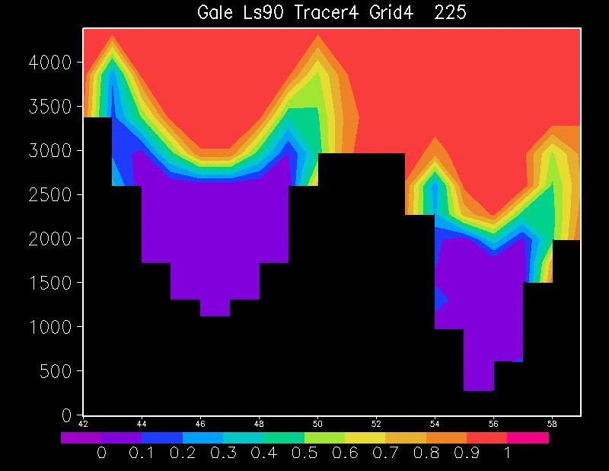
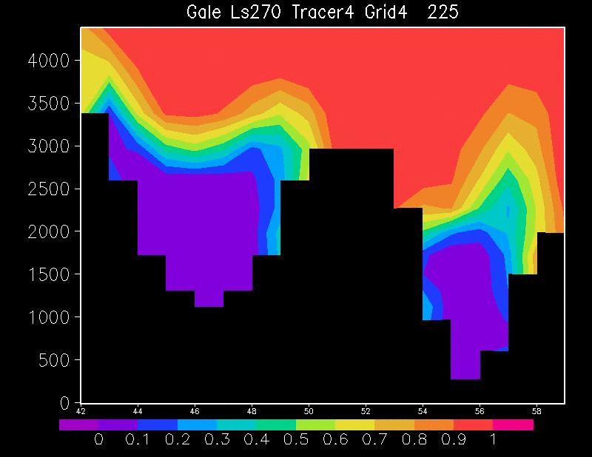
Crater mixing timescale. Grid4 (9 km resolution)
Ls90. Winter equinox. Tracer #4 fraction
Ls270. Summer equinox. Tracer #4 fraction
S
N
S
N
~50% of mass stays in crater after 10 hours
Almost all mass is gone from crater after 10 hours

Slide 6
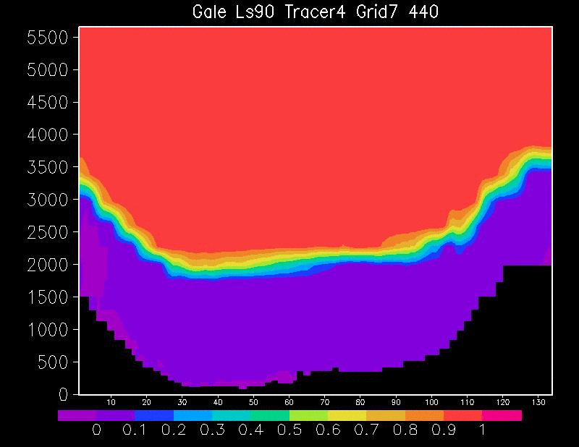
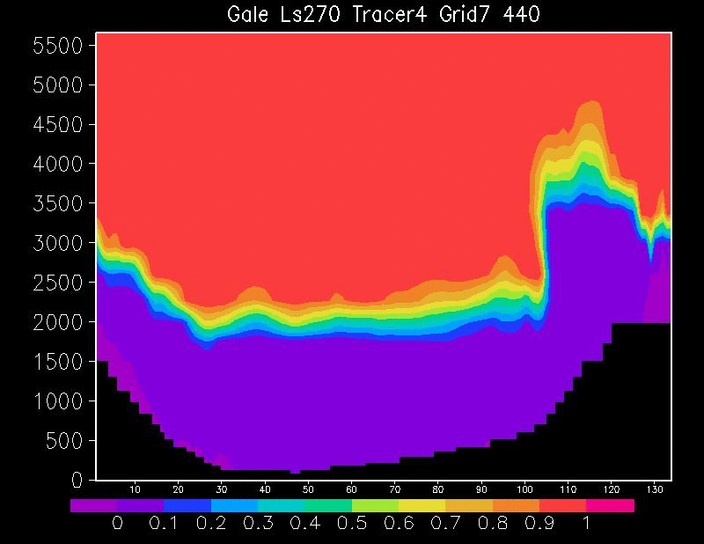
Crater mixing timescale. Grid7 (330m resolution)
Ls90. Winter equinox. Tracer #4 fraction
Ls270. Summer equinox. Tracer #4 fraction
Mixing is rapid in all seasons but faster during Ls270

Slide 7
Tracer 1 (methane): < 200 meters
Tracer 2: 200 – 500 meters
Tracer 3: 500 – 2000 meters
Tracer 4: elsewhere
MSL landing site
South
North
Scenario 2: three gas tracers included into Gale crater
with tracer 1# outside the crater (north rim).

Slide 8
Dispersion of a local methane release outside the crater
Initial release
After 12 hours
Log10 of tracer 1 (methane)
Log10 of tracer 1 (methane)
Methane tracer diluted by approx. 6 orders of magnitude inside crater after 12 hours, regardless of the season

Slide 9
Conclusions
Timescale of mixing in MRAMS simulations is on the order of sols regardless of season
Timescale of observed peak in SAM observations is on the order of 100 sols
Therefore, either:
  1.) There is a continuous release inside the crater or
  2.) The methane is widely distributed or
  3.) A local release outside the crater have to be continuous and very large magnitude
Ongoing work:
  Impose a sink on the tracers proportional as a proxy for destruction
  Introducing a continuous release of methane inside and outside the crater
  Using a 3D plotting model for tracers (VAPOR)

Slide 10
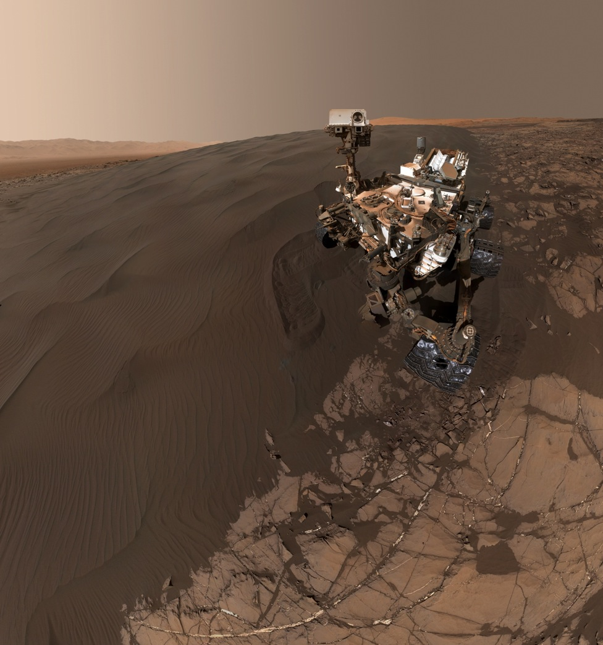
Thanks! jpla@spacescience.org

Slide 11
Backup Slides

Slide 12
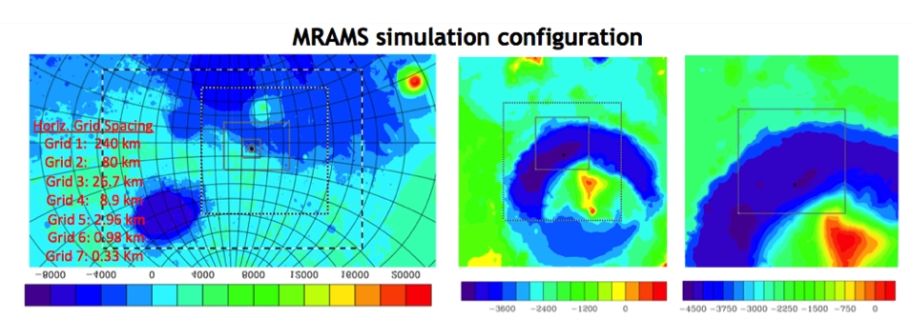
MSL landing site
MSL landing site
Altitude in meters (MOLA instrument)
The simulation is configured with 7 grids. The model is run for 3 sols with 5 grids and then the 2 additional grids are added and run for at least 3 more sols.
Horizontal Grid Spacing: Grid 1 (240km), Grid 7 (330m)
Vertical Grid Spacing: 50 points, 51km model top, 14.5m first layer, 30m initial grid spacing, 2500m maximum grid spacing, 1.12 stretch factor

Slide 13
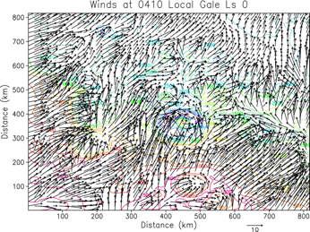
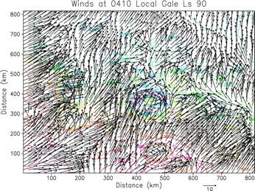

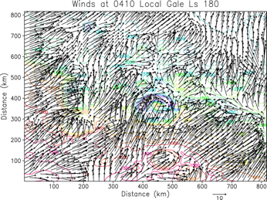
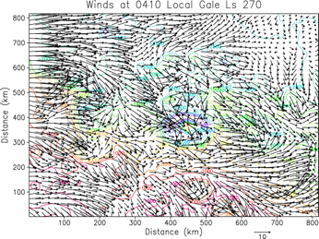
Regional scale (dichotomy). Nighttime
Hadley
Cell
Dichotomy
Downslope
Dichotomy
Downslope
Hadley
Cell
FIGHT
Dichotomy
Downslope
Dichotomy
Downslope
Gale crater circled. Strong Influence of Topographic Dichotomy Except Ls=270
Southerly Regional Winds Except at Ls=270: Hadley Cell winds WIN!!
(Pla-Garcia et al. 2016; Rafkin et al. 2016)

Slide 14
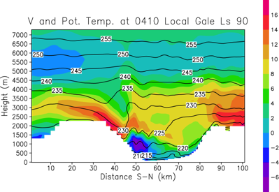
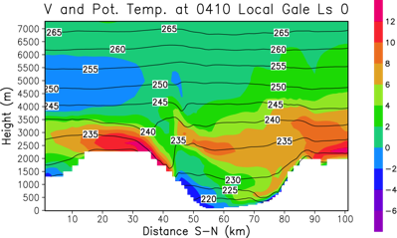
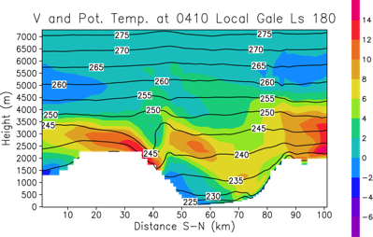
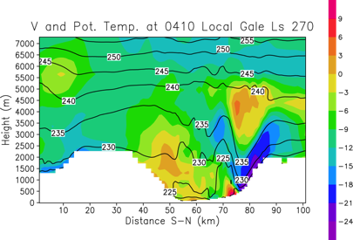
Cross-Sections: meridional winds and potential temperature
Warm, capping inversion at all seasons but Ls=270: stronger vertical mixing. Warm air tends to override crater air mass at other seasons. Mountain wave at Ls=270. Strong downslope winds AND MIXING at Ls=270 along north rim.
(Pla-Garcia et al. 2016; Rafkin et al. 2016)

Slide 15
?
?
?
Mars methane variability and mixing epochs at Gale crater
(Pla-Garcia, Rafkin et al. in preparation 2017)

Slide 16
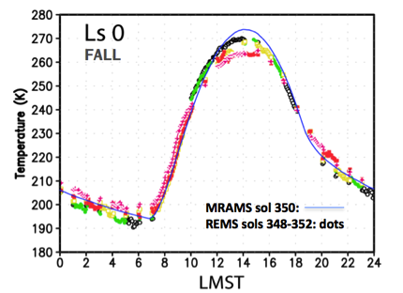
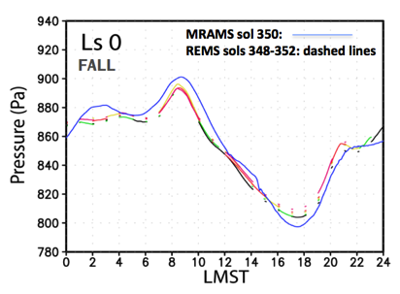
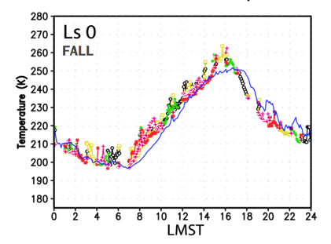
Model validation: MRAMS vs REMS
Ground temperature
Pressure
Air temperature
More details at
Pla-Garcia et al. 2016

Slide 17
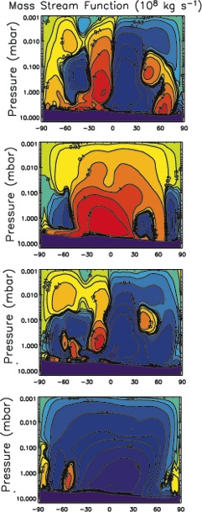
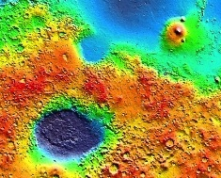
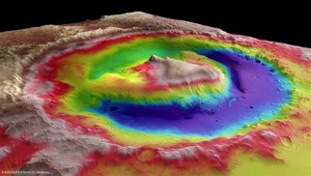

Local Weather is the Sum of Different Scale Circulations
Global Mean Circulation
Regional Topographic
Dichotomy Circulation
Local Topographic Circulations
at Gale crater
Day
N
Ls 0
Fall
equinox
Gale
S
N
S
Day
Ls 90
Winter
solstice
Night
N
S
N
Gale
Ls 180
Spring
equinox
S
Night
S
N
Ls 270
Summer
solstice
Circulations interact in complex, nonlinear ways to produce observed weather at any give location.
S
Gale
N

Slide 18
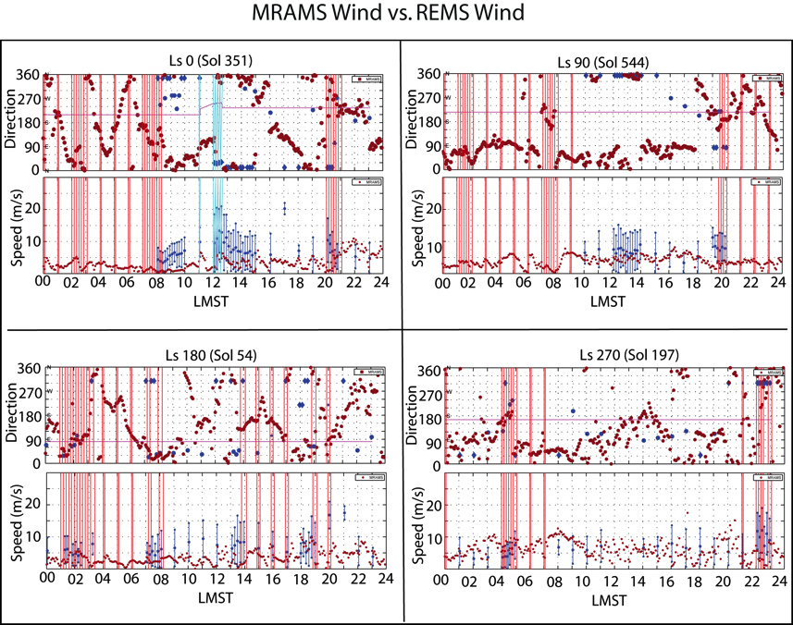
The blue lines show periods when the rover was moving.
The red lines highlight periods with electronic noise in the sensor.
The magenta line indicates the direction in which the rover is pointing.
MRAMS simulations are shown with solid red circles.
REMS data are shown with solid blue circles.
Blue diamonds indicate winds coming from behind the rover, and should be treated very cautiously.

Slide 19
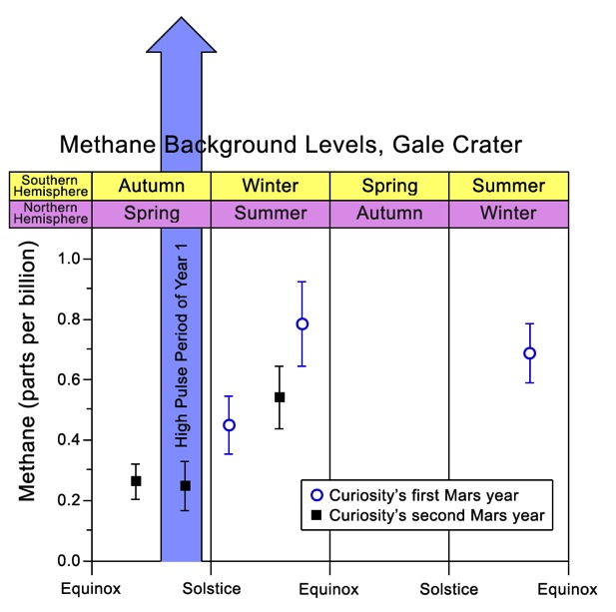

Slide 20
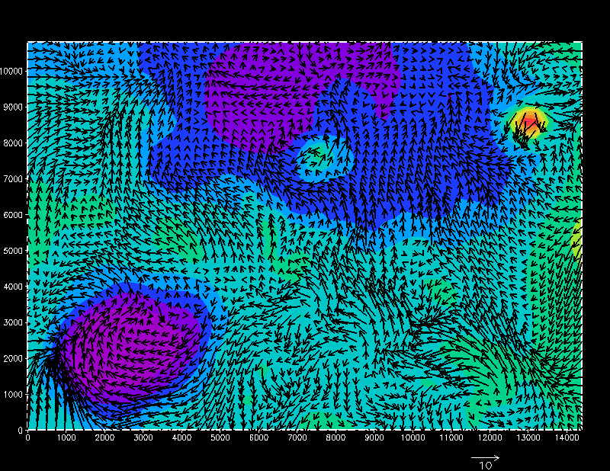
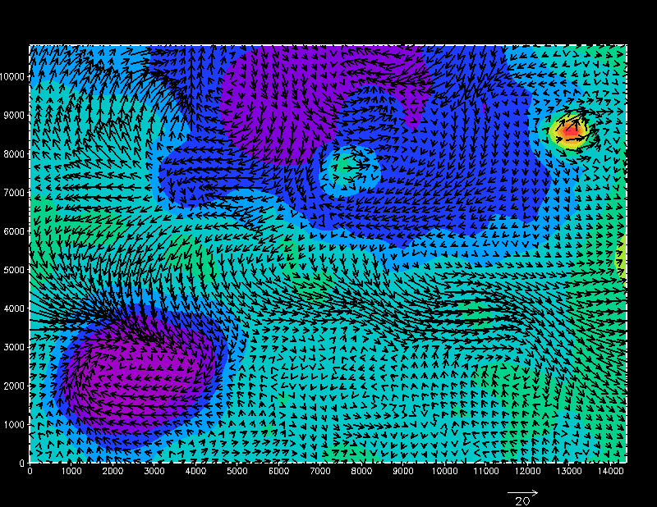
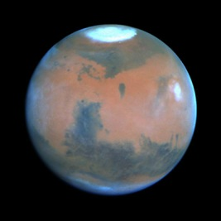
Global scale circulation
Mean Winds Ls 90
Mean Winds Ls 270
Seasonal Reversal of
Mean Circulation

