Slide 1
Mars 2020 SwRI Status 09 October 2015
Scot Rafkin
Jorge Pla-Garcia

Slide 2
MCS-GCM Comparisons
GCM output is on sigma-p surfaces
GCM output is at a fixed absolute time
MCS is on pressure (or z) surfaces.
MCS is at a fixed local time.
MCS is zonally averaged.
It is not a trivial exercise to reduce the GCM data to a data set that can be meaningfully compared to MCS

Slide 3
Comparison Technique
GCM output is 3-D temperature field valid at a fixed time, with 16 output times per sol.
Each GCM output was interpolated to constant pressure surfaces (1000 – 0.01 Pa).
10 sols of GCM data were sampled into 24 local time bins.
The data in each local time bin were averaged over 10 sols.
The data for a given local time bin were zonally averaged.

Slide 4
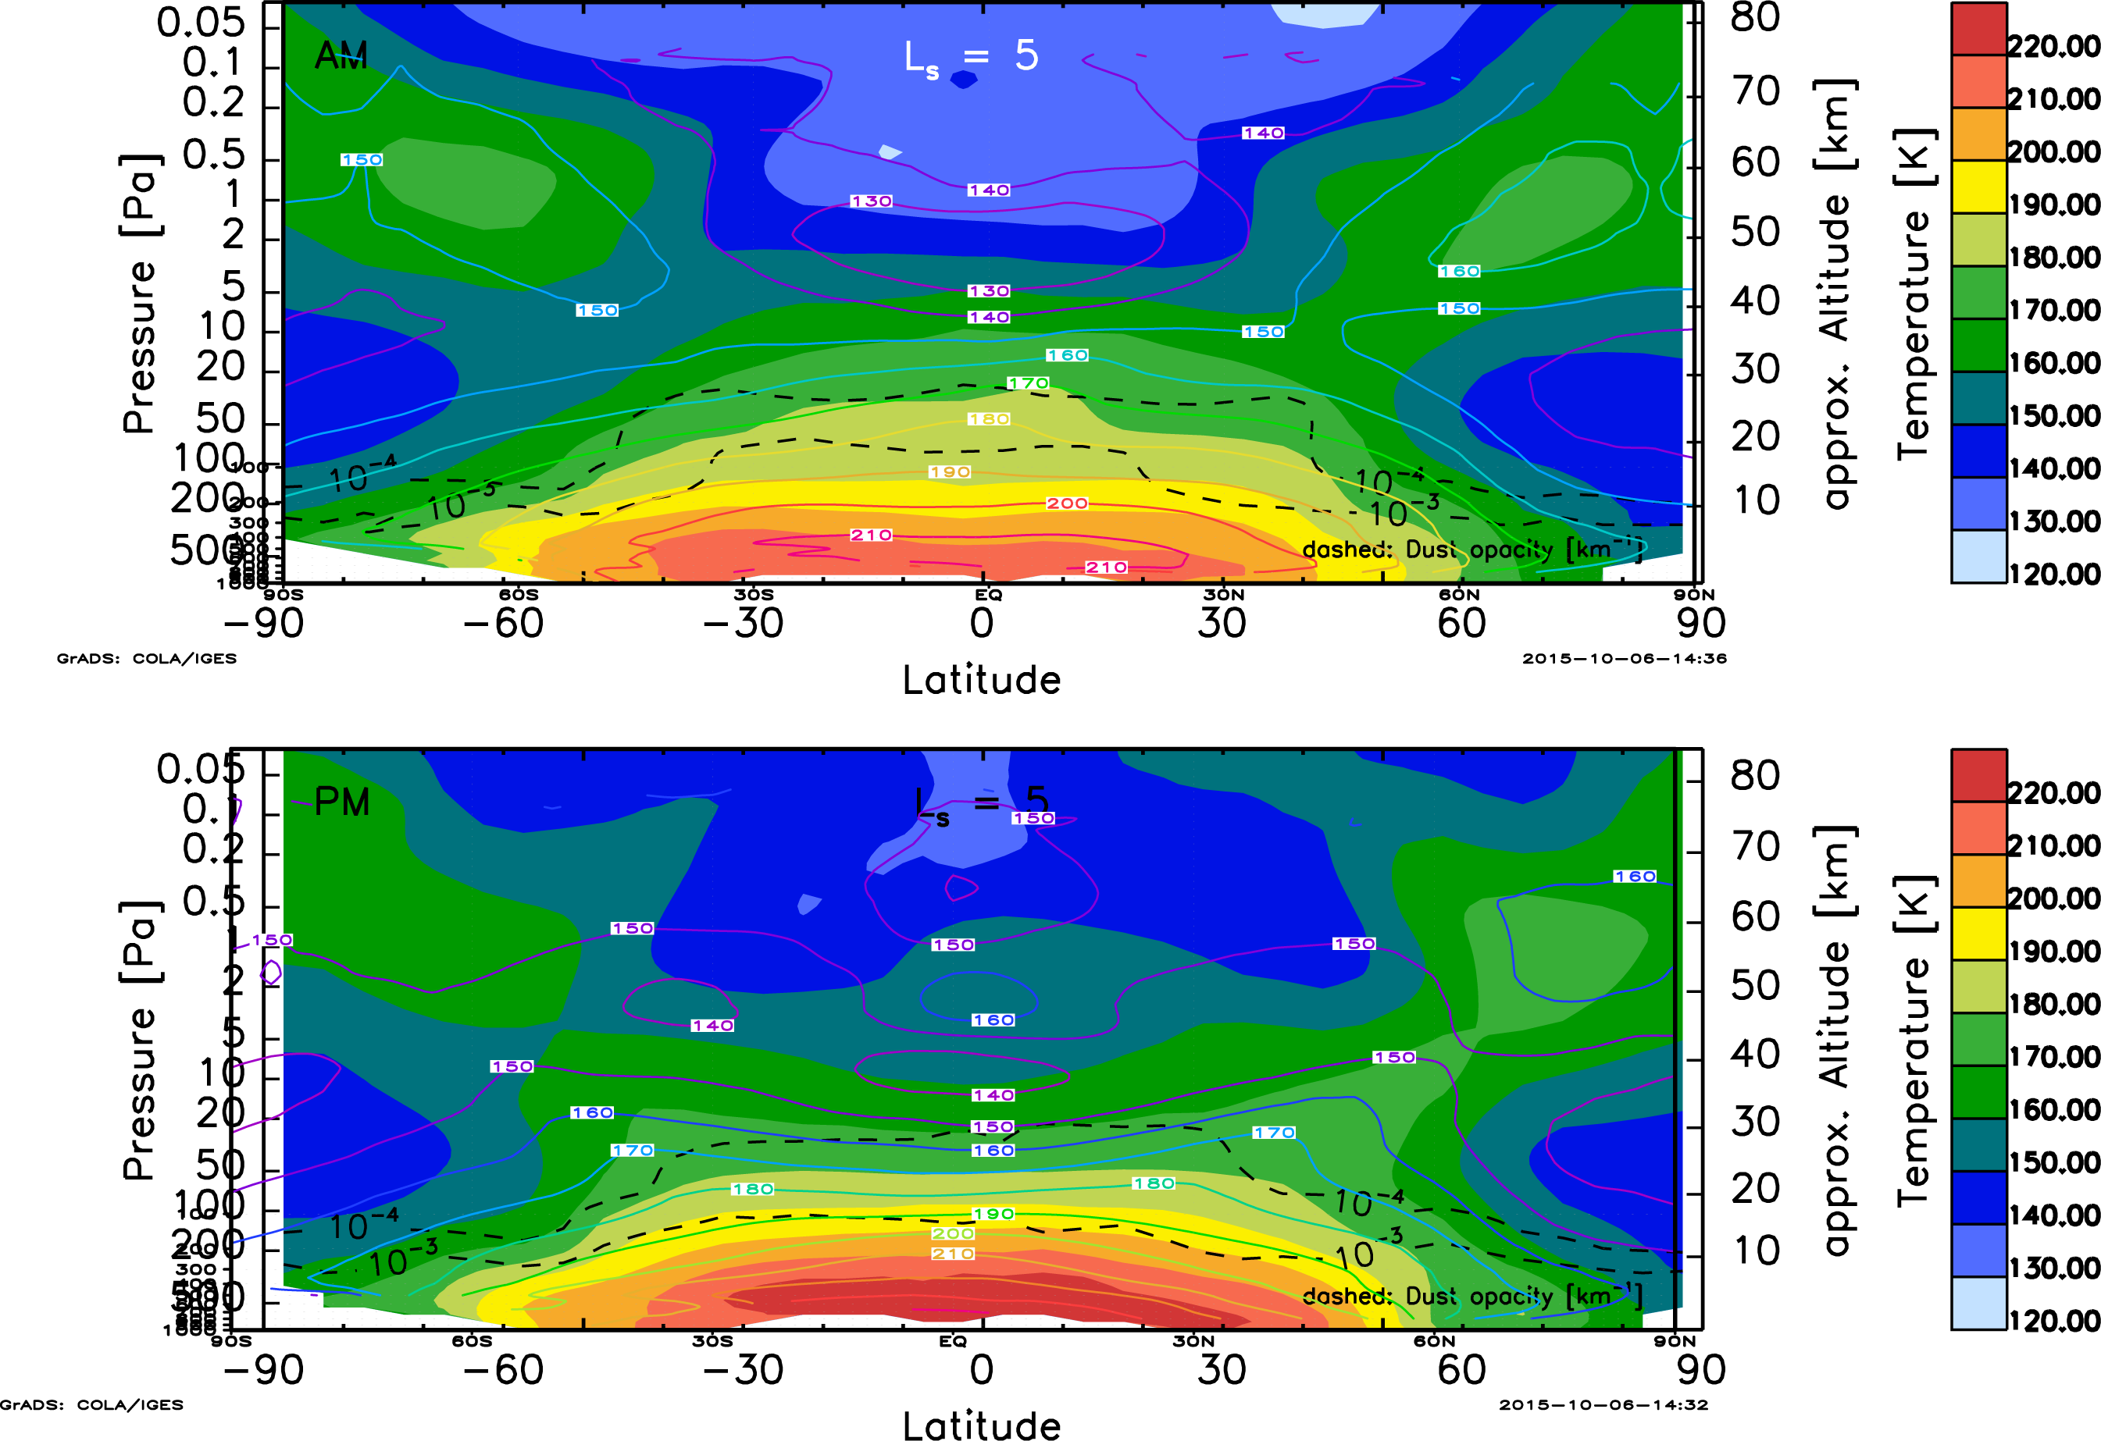
Shaded: MCS MY25 stolen from previous D. Tyler presentation
Contoured: SwRI Ames GCM results.

Slide 5
Results are mostly as known/expected.
Too cold in the tropical middle atmosphere (10-1 Pa).
Too warm in the tropical upper atmosphere (< 1 Pa), especially in p.m.
Polar warming and polar vortex are reasonable.

Slide 6
Tropical temps might be helped by increasing depth of dust
OR
Adding radiatively active ice clouds
OR
Some combination of the two.

