Slide 1
Dust Storm Effects at Syrtis and Jezero
Scot Rafkin
Jorge Pla-Garcia

Slide 2
Syrtis and Jezero
Very similar grid configurations and results
Will analyze only Jezero for illustrative purposes
Both data sets are available for the project
Comparison of simulations with radiatively active lifted dust and no (passive) dust
Simulation starts at ~19 UTC = ~ 0000 local
Dust lifting starts at ~16 UTC = ~2100 local
Almost one full diurnal cycle without dust
Phases
sol1: spin-up; sol2: dust lifting start
sol3: dust lifting mature; sol4: dust decaying
Analysis primarily on Grid 3 (~26.7 km spacing)
Finer grids are mostly or wholly within storm
Grid 3 has locations inside and outside
Analysis through mature phase of storm (sol3) and decaying (sol4).

Slide 3
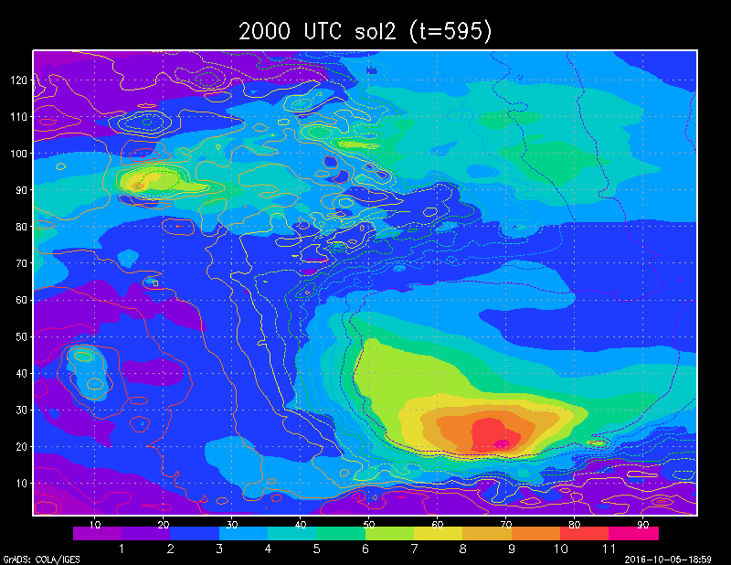
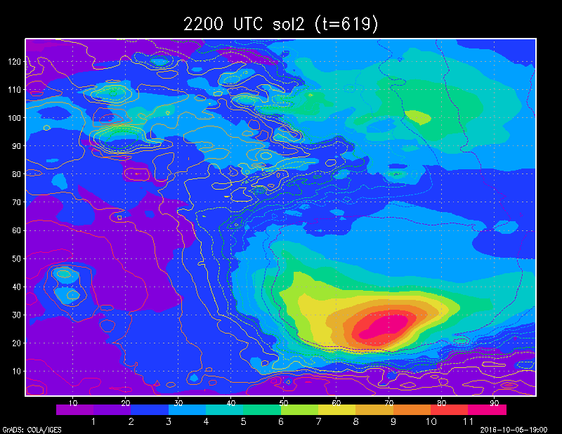
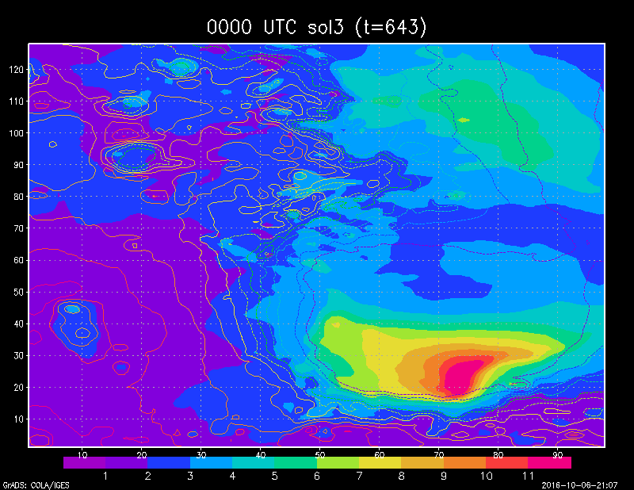
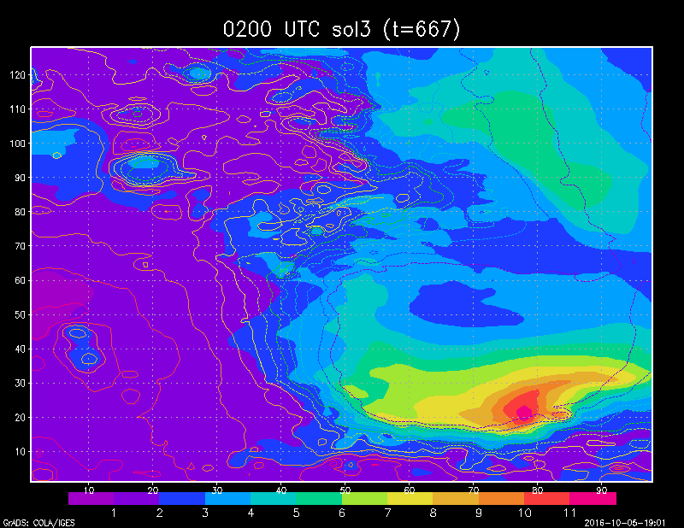
Summary of sol3 (dust lifting)

Slide 4
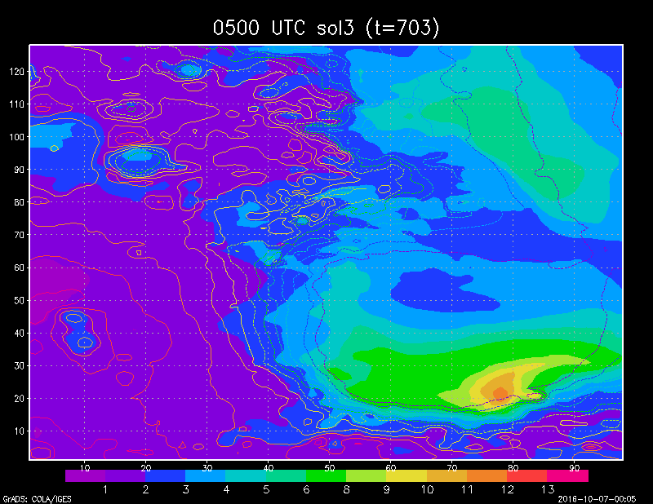
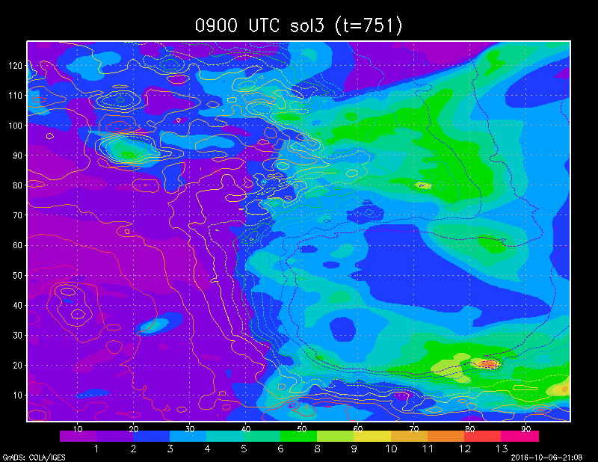
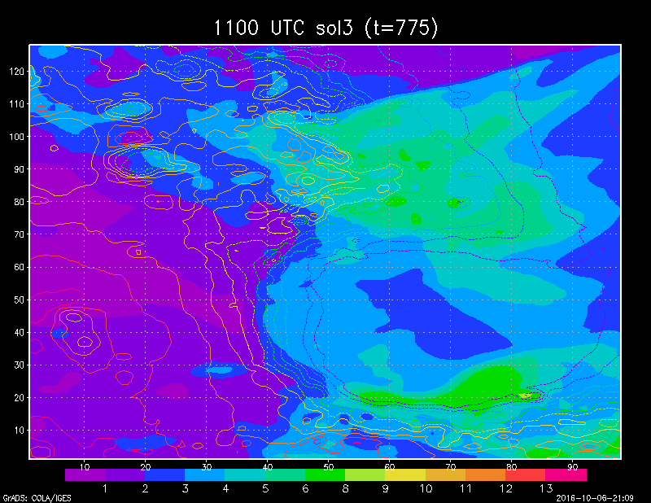
Evolution Through Afternoon of sol3 (dust lifting)

Slide 5
Evolution Through Afternoon of sol3 (dust lifting)
Dust storm self-organize diagonally.
Dust slowly settled down

Slide 6
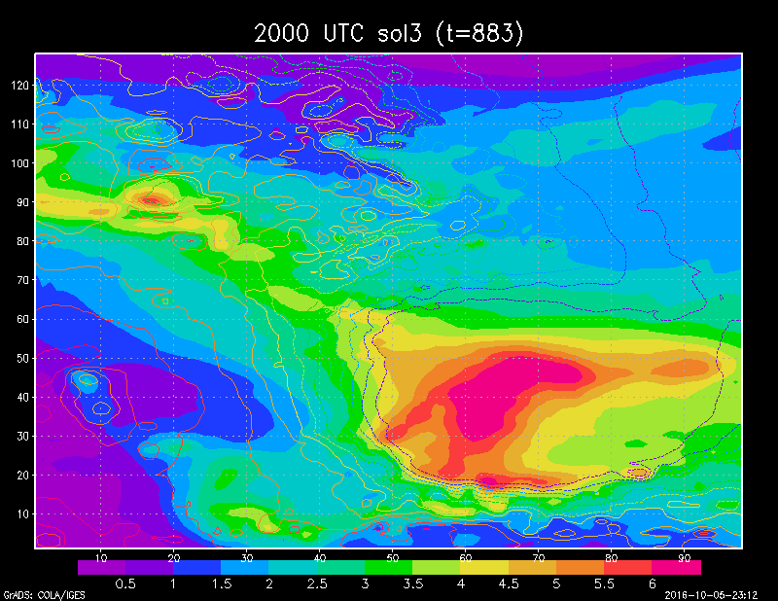
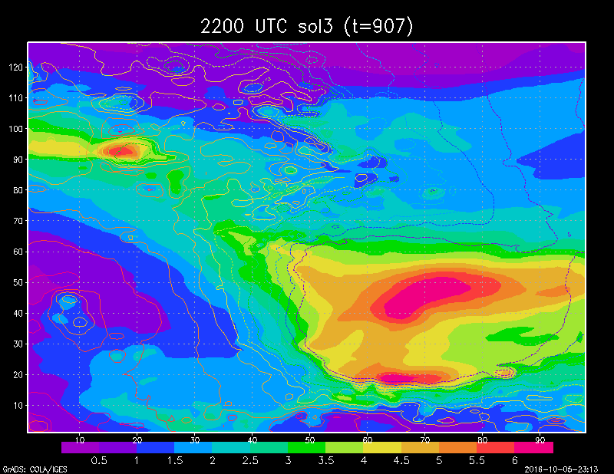
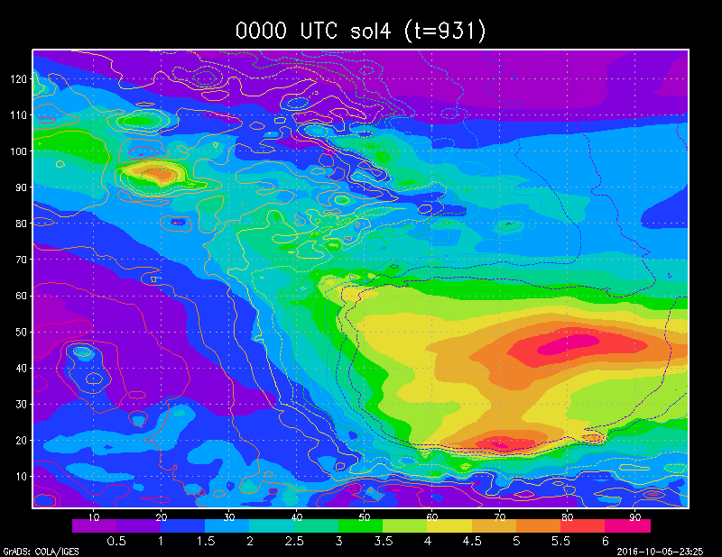
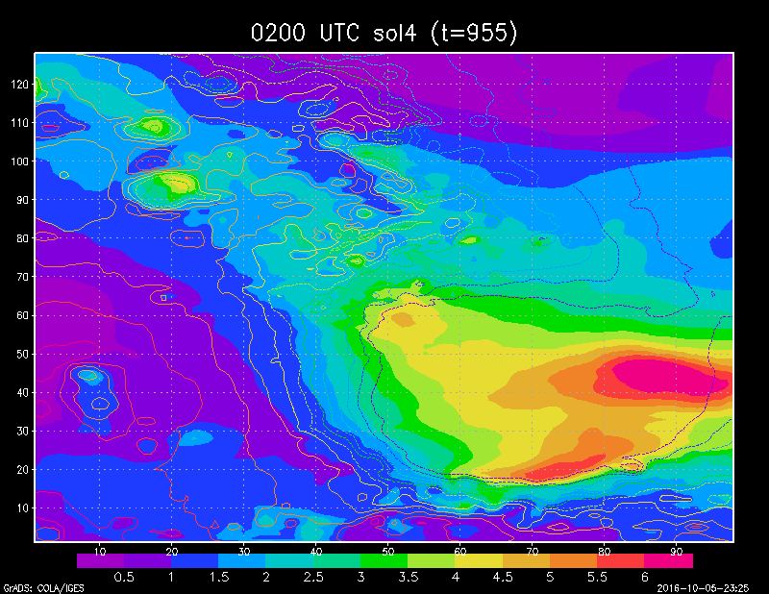
Summary of sol4 (dust decaying)

Slide 7
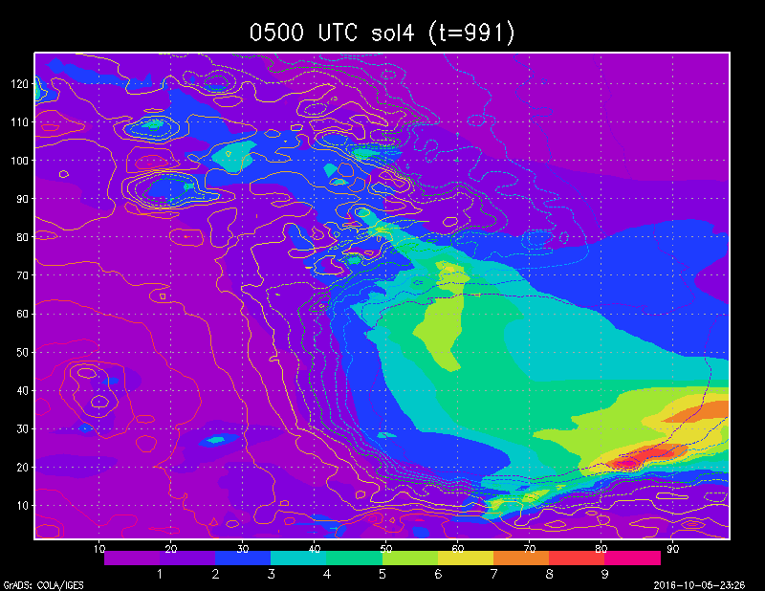
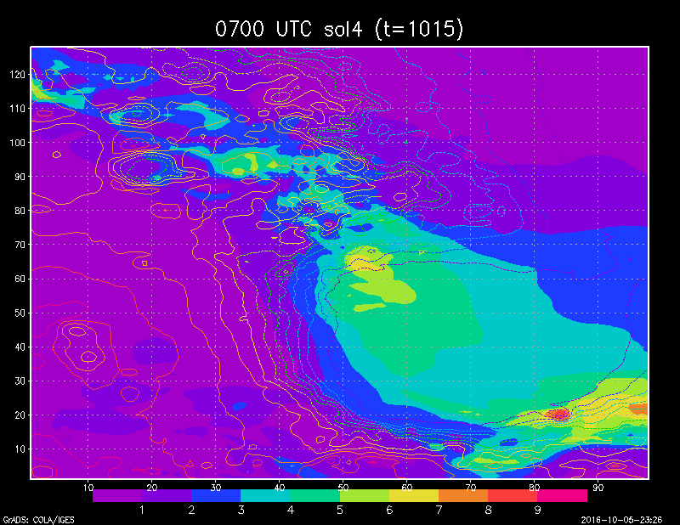
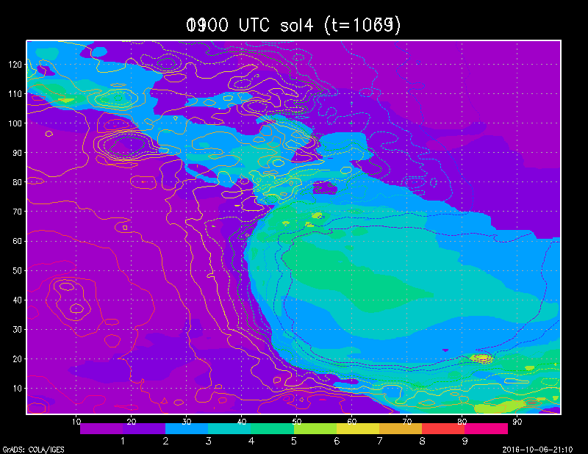
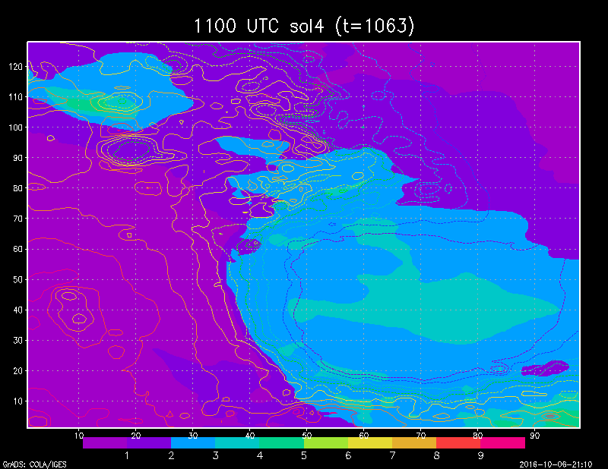
Evolution Through Afternoon of sol4 (dust decaying)

Slide 8
Evolution Through Afternoon of sol4 (dust decaying)
Dust slowly settled down

Slide 9
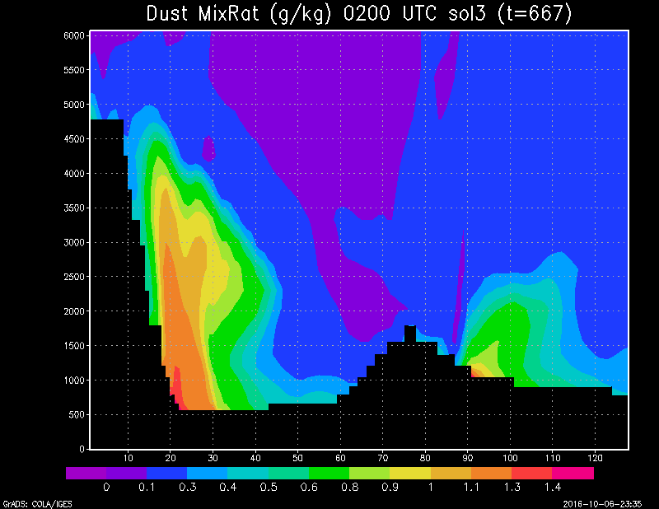
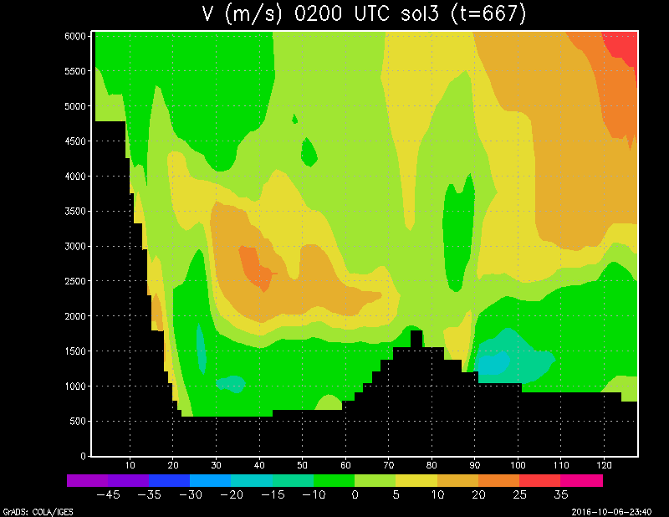
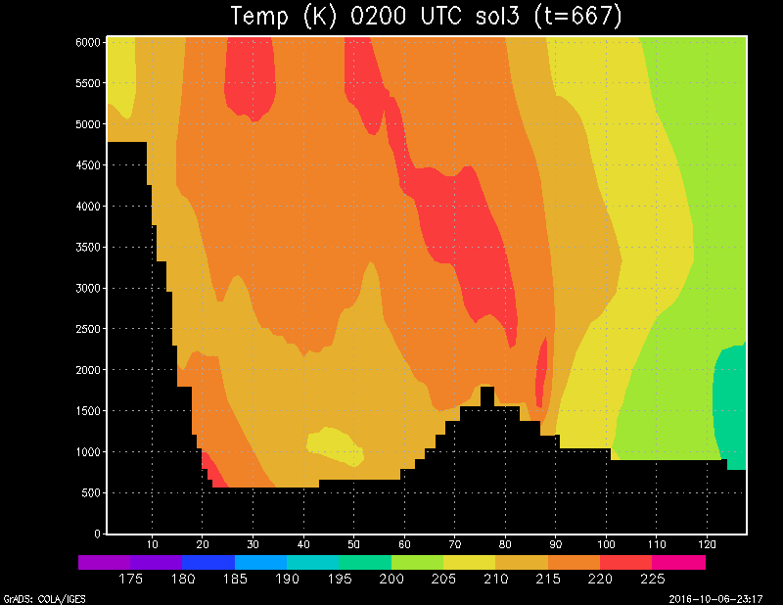
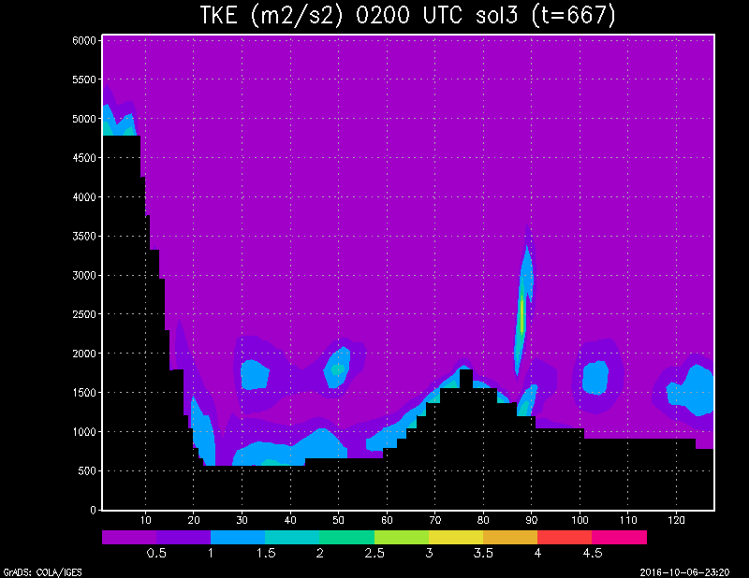
Vertical Structure of Central-East System (Slice along X=79) of sol3 (dust lifting)

Slide 10
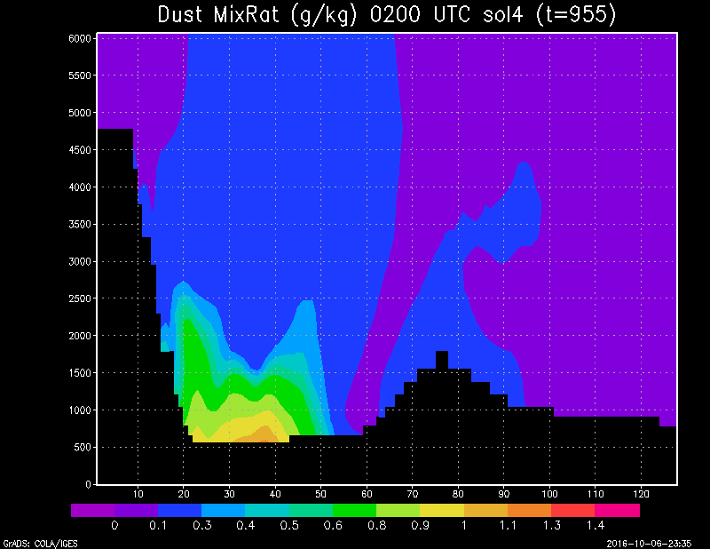
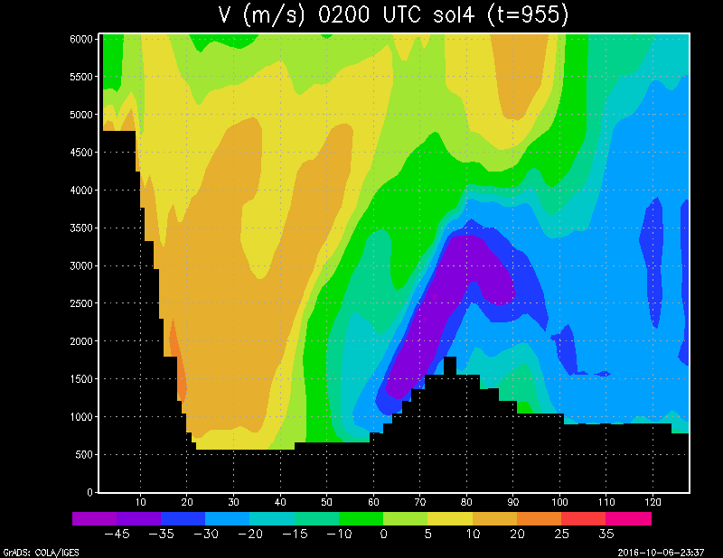
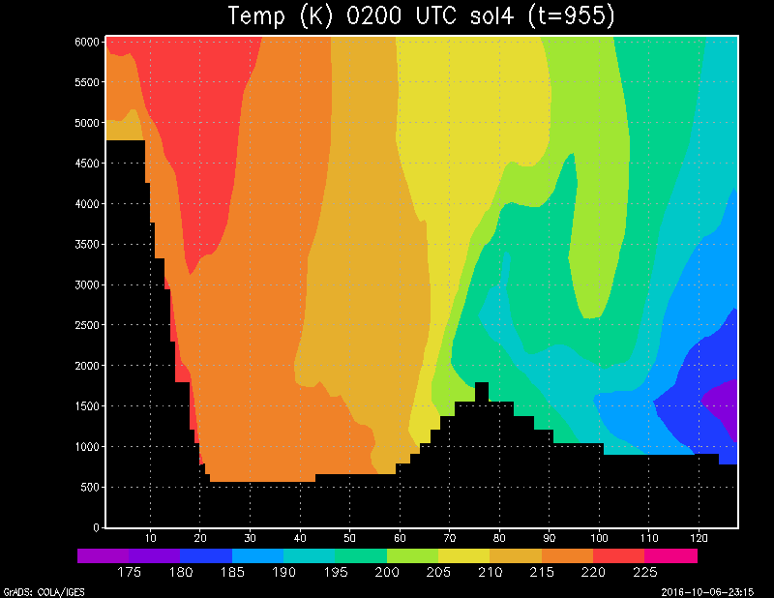
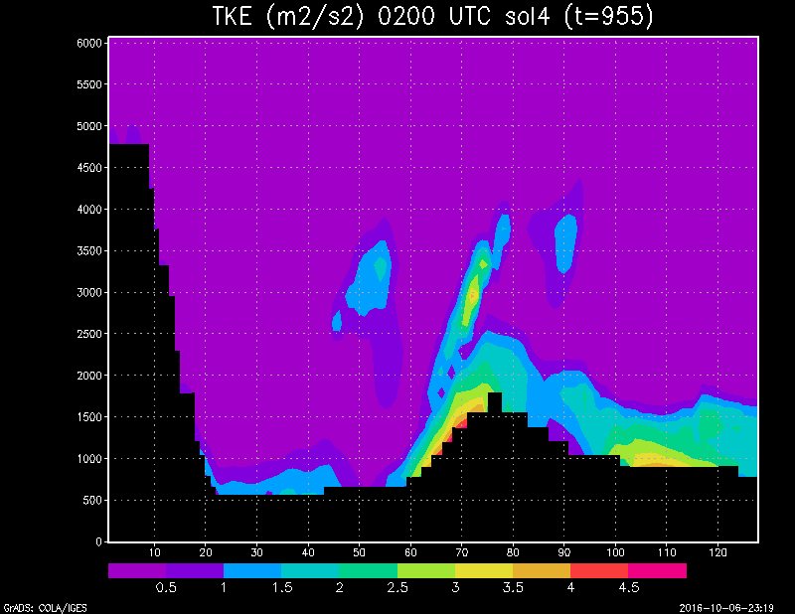
Vertical Structure of Central-East System (Slice along X=79) of sol4 (dust decaying)

Slide 11
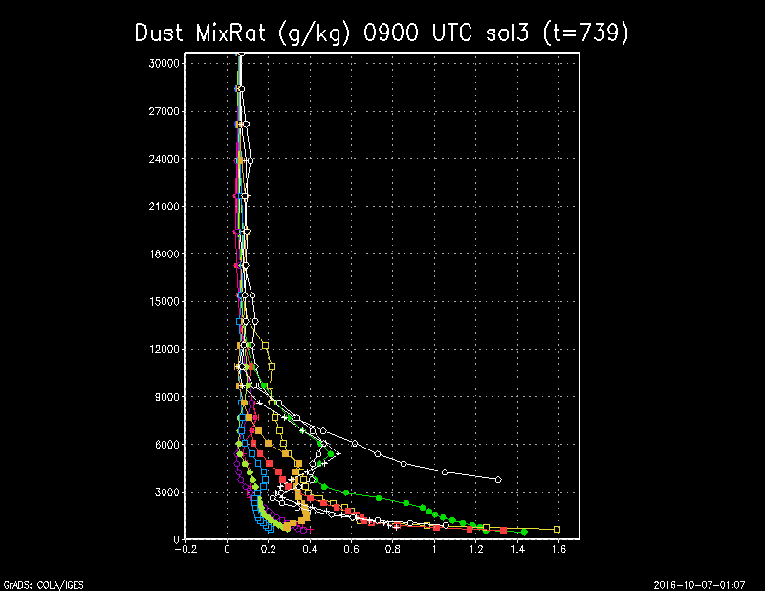
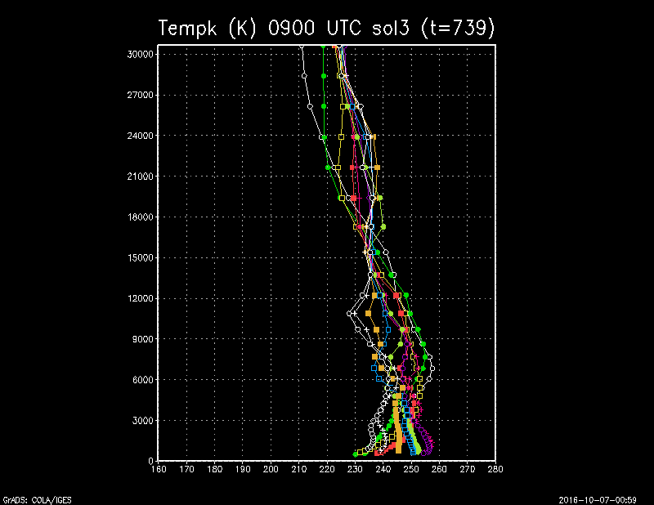
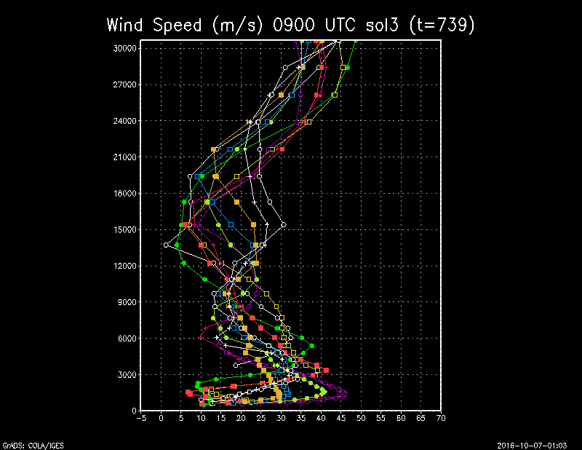
Profiles at Near Landing Time (y=15->y=65) of sol3 (dust lifting)
High dust load lower layers
Near isothermal in lower layers
Large spatial variability on winds

Slide 12
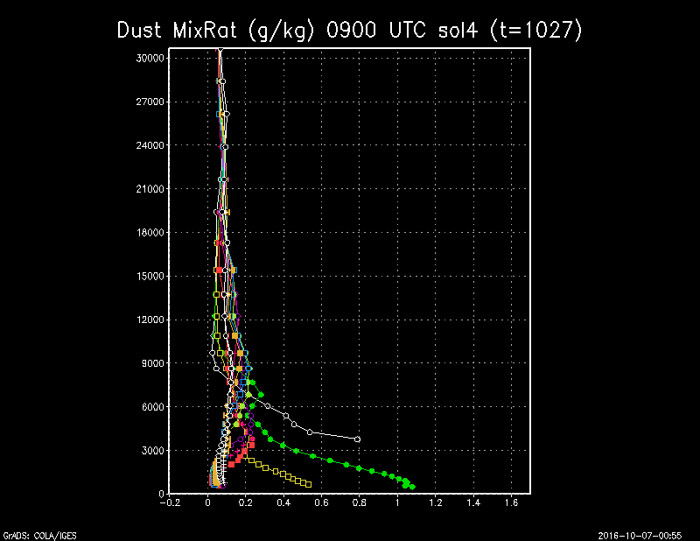
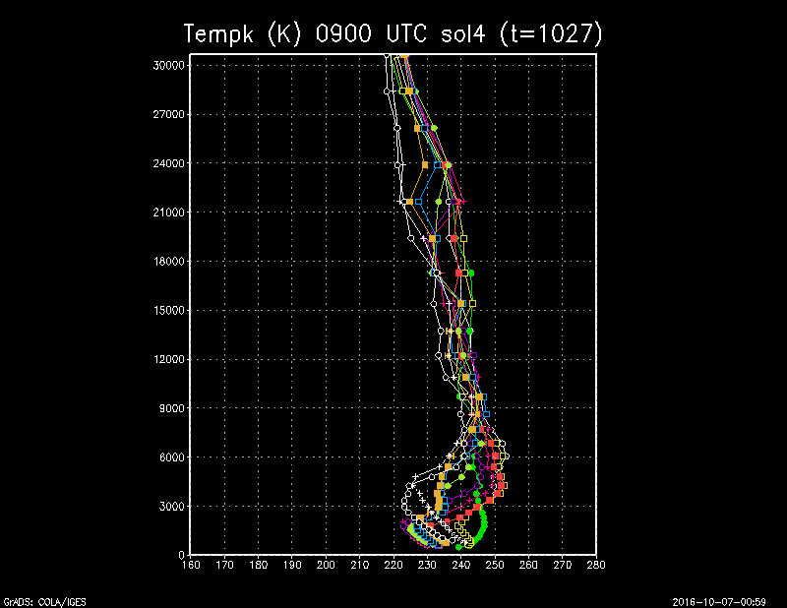
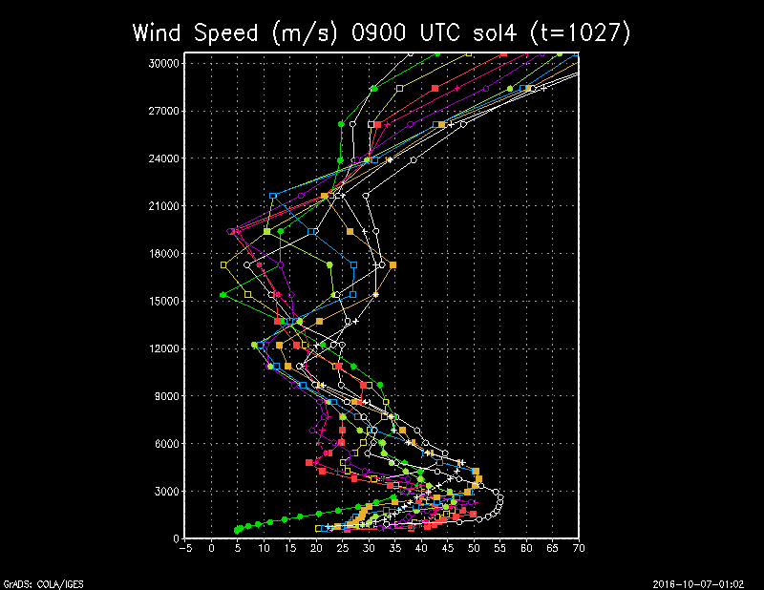
Profiles at Near Landing Time (y=15->y=65) of sol4 (dust decaying)
Lower dust load in lower layers
Near isothermal
Large spatial variability on winds

Slide 13
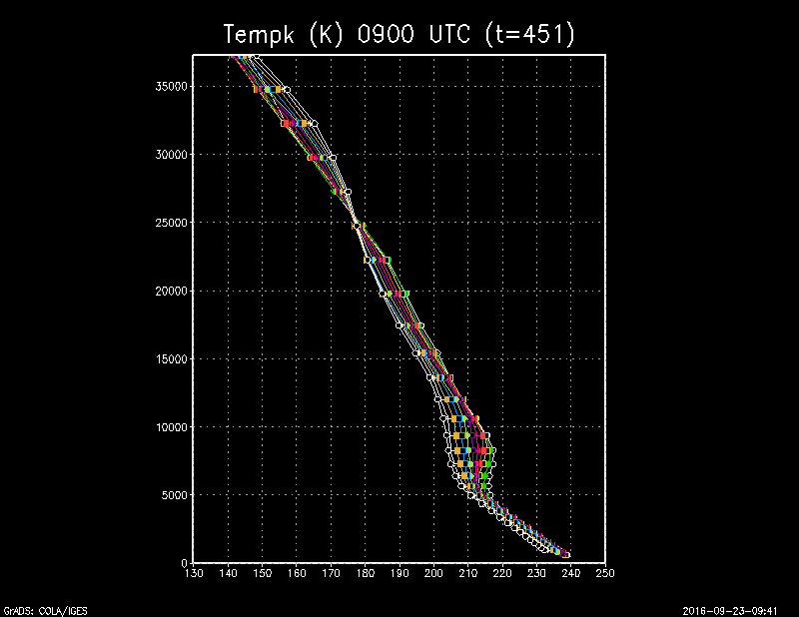
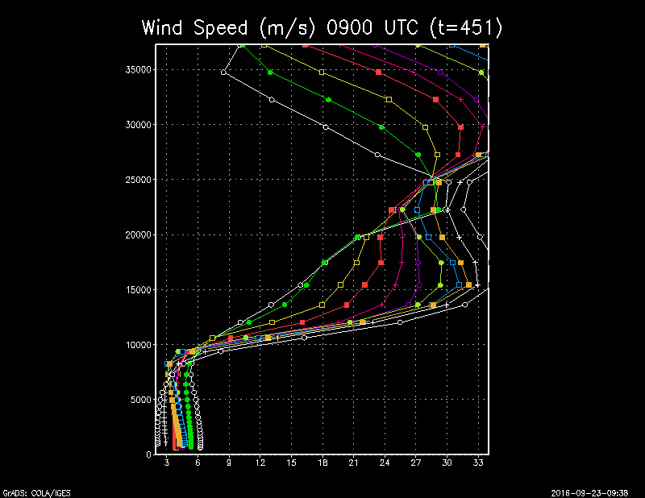
Profiles without Dust Lifting
Nearly uniform temperatures across cross-section.
Winds change methodically, especially aloft, along cross-section.
Much less variability than with dust.

Slide 14
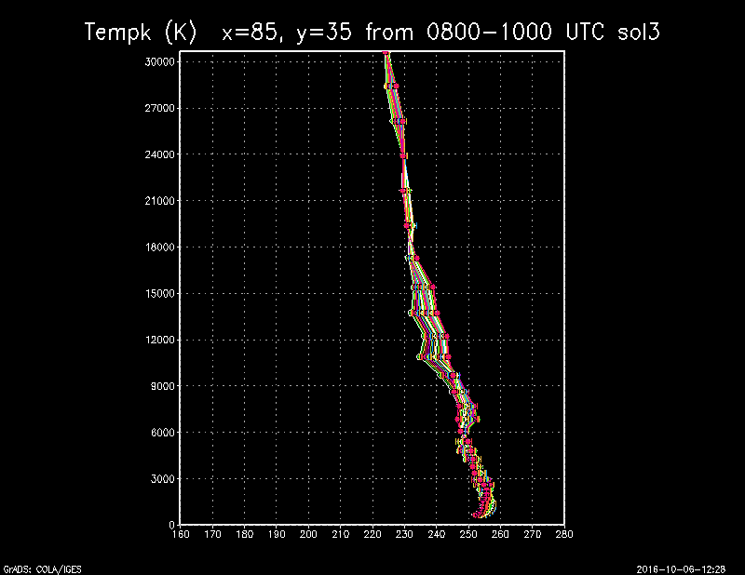
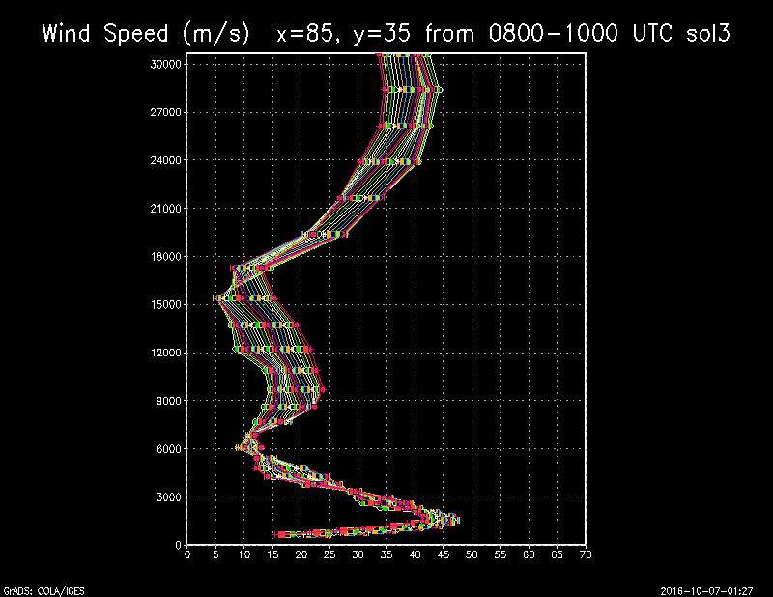
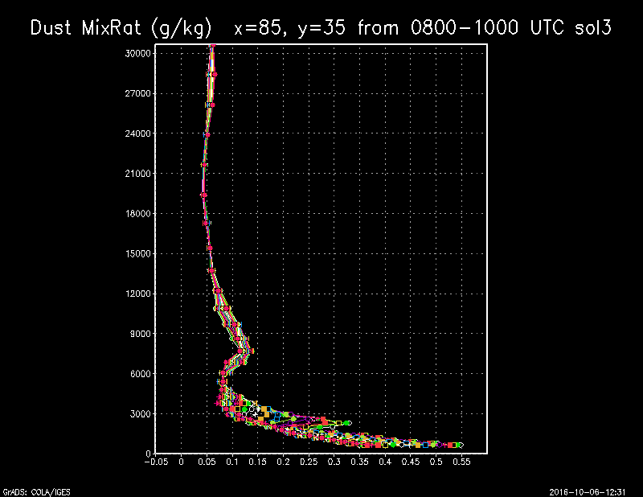
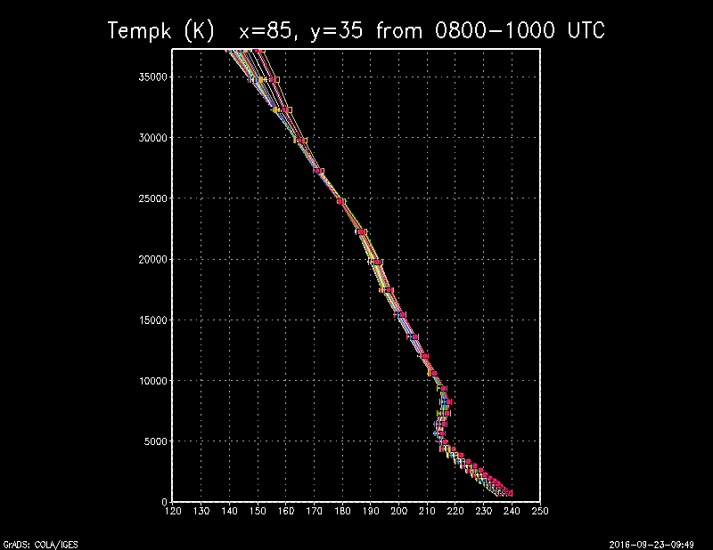
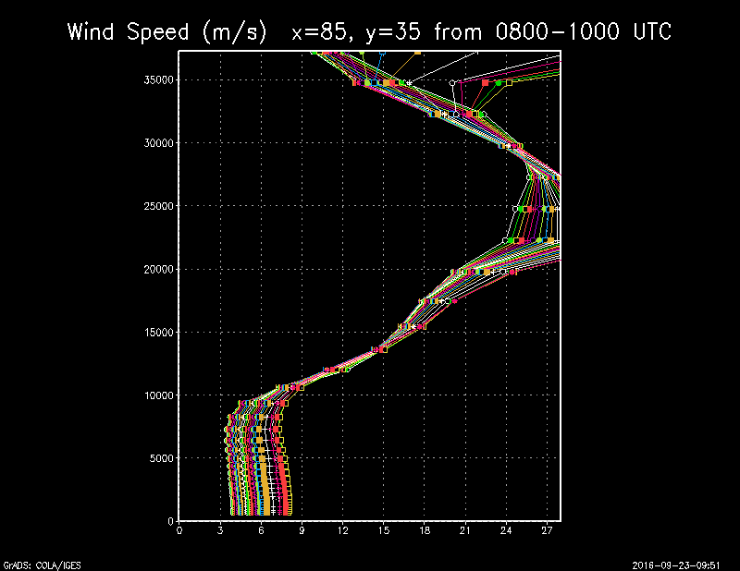
Profiles Bounding Landing in Time of sol3 (dust lifting)
More stable than the non dusty case
Very strong low level jet
Concentration of dust close to surface while lifting

Slide 15
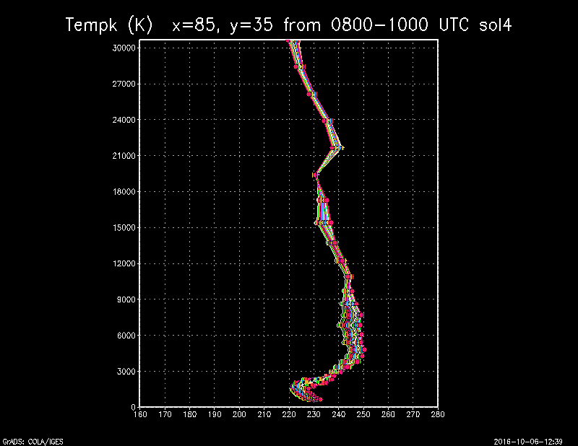
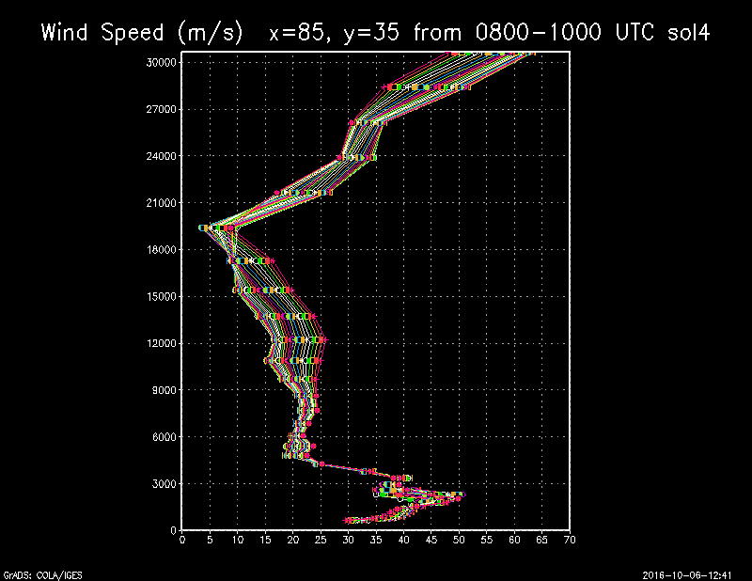
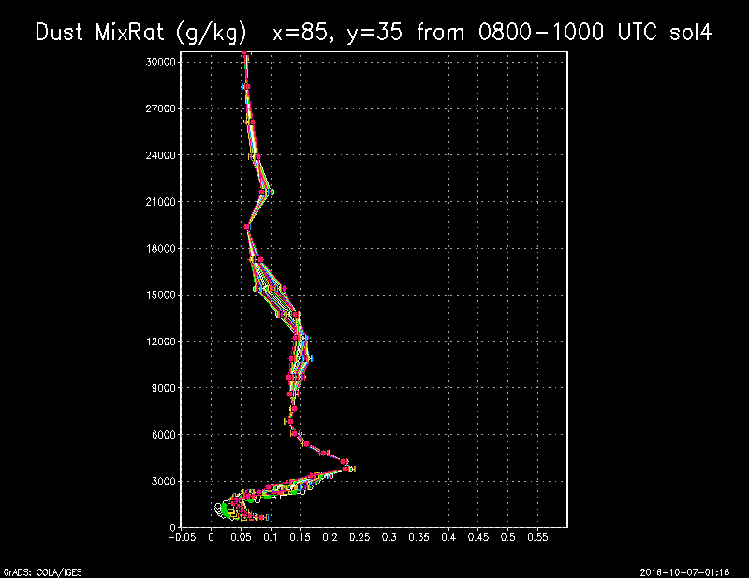
Profiles Bounding Landing in Time of sol4 (dust decaying)
Development of very shallow mixed layer capped by an inversion
Decrease of dust at low levels

Slide 16
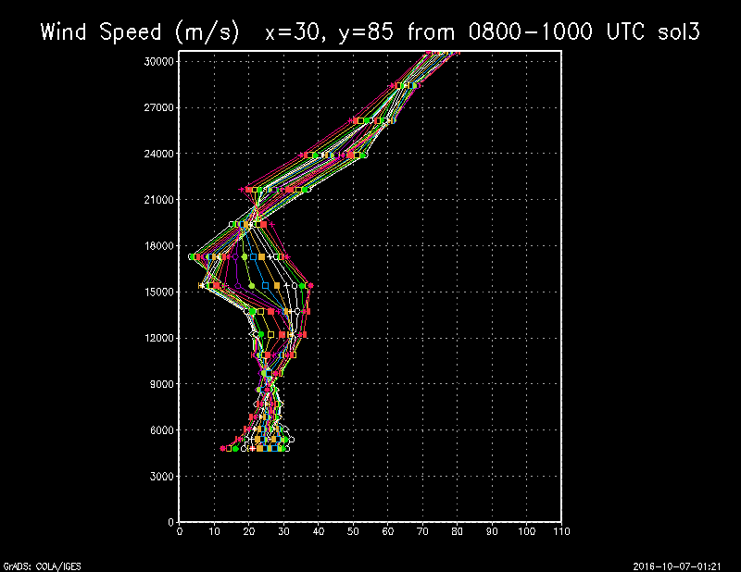
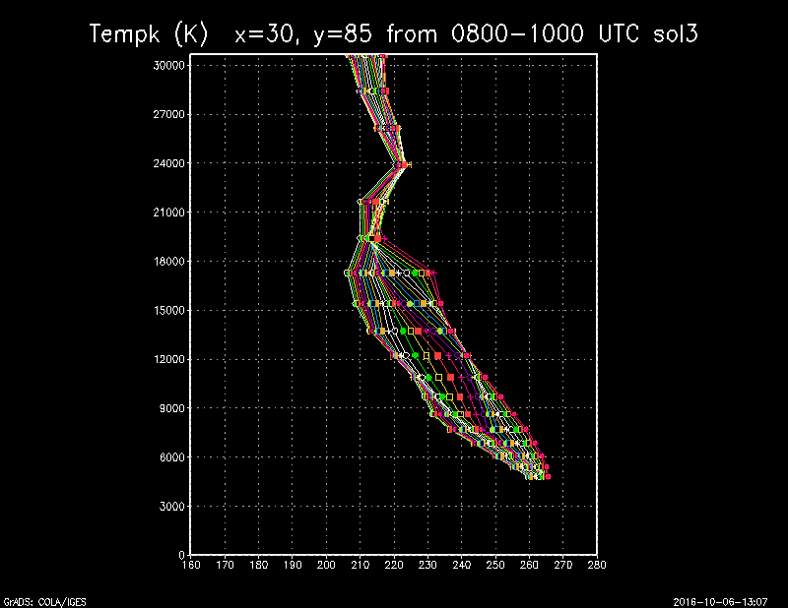
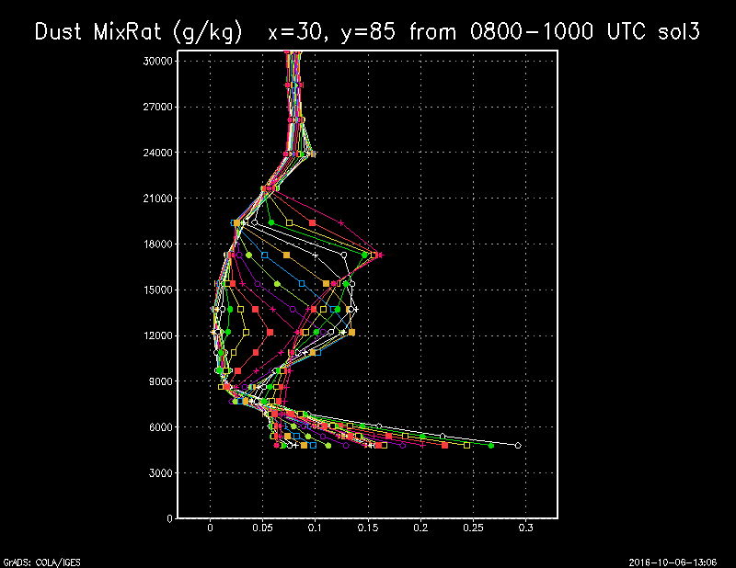
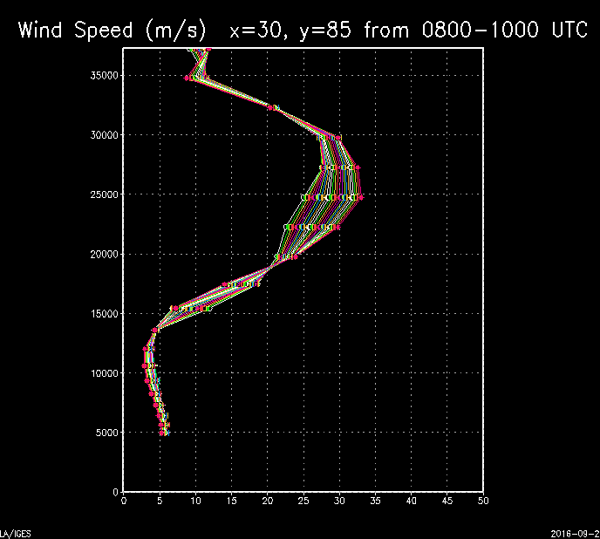
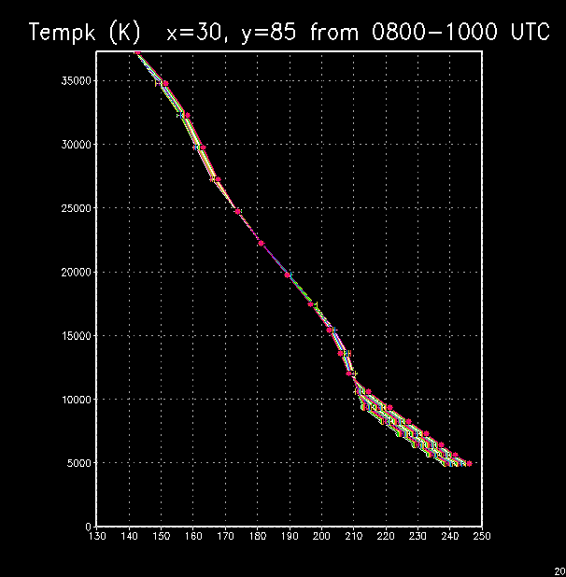
What About Locations Farther From Storm of sol3 (dust lifting)?
Overall steeper lapse rate
Large difference in winds compared to non dusty case

Slide 17
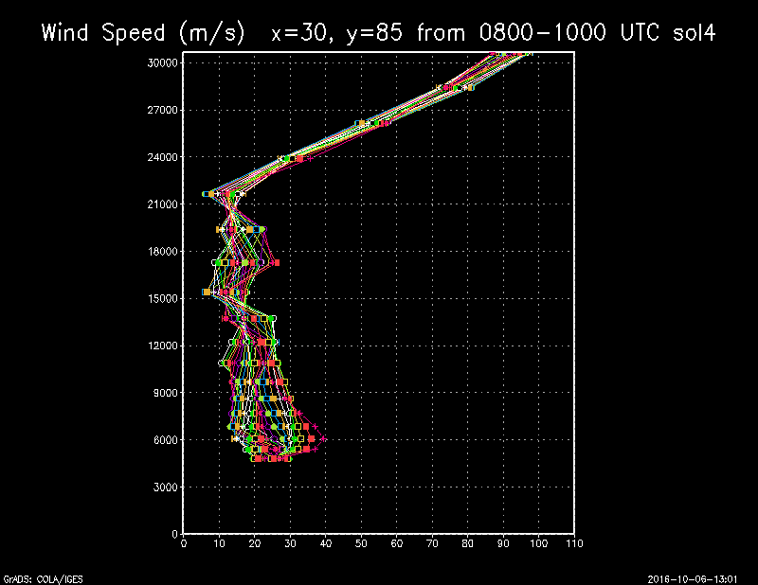
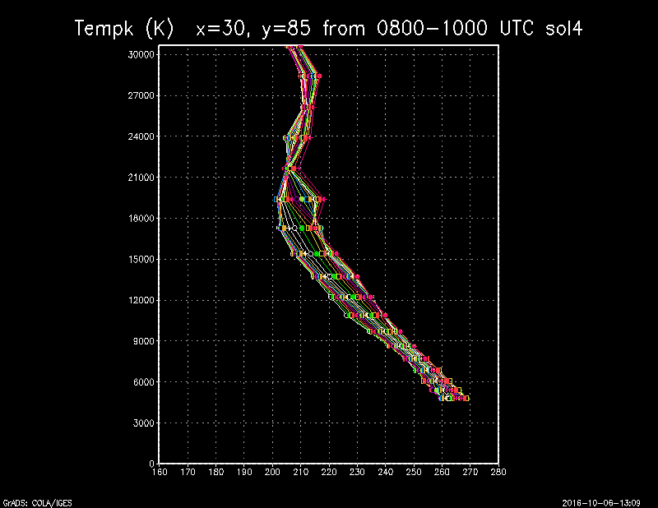
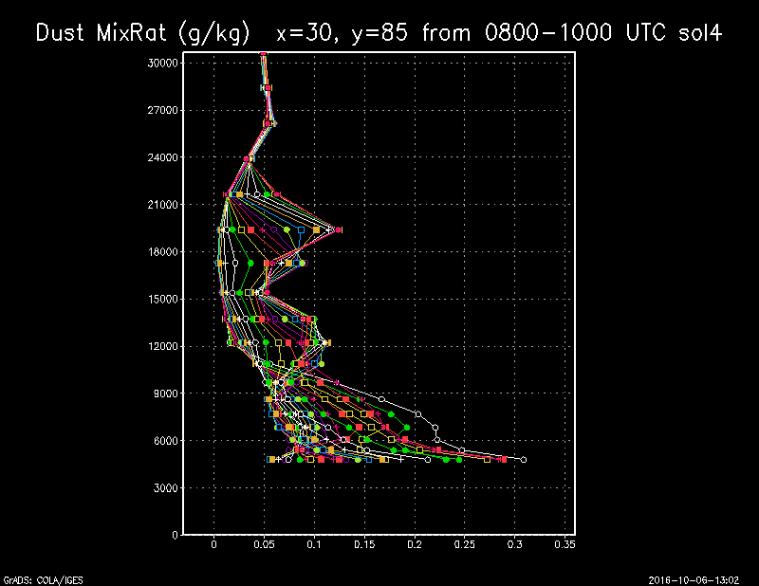
What About Locations Farther From Storm of sol4 (dust decaying)?
Overall steeper lapse rate
Large difference in winds compared to non dusty case

