Slide 1

Mars2020
SwRI Status
3rd June 2016
Scot Rafkin
Jorge Pla-Garcia

Slide 2
Dust storm experiment
“Ideal” scenario
  DUST_JEF = 3.5e-3 → Dust lifting "efficiency" factor
  DUST_JTH = 0.0008 → sfc stress lifting threshold
  DUST_JBG = ’76500. s → Time that dust is injected
Ideal not_active_dust vs Ideal active_dust (slides 3-5)
Ideal not_active_dust vs Ideal active_dust CROSS SECTIONS (slides 6-8)
Active_dust lifting on sol 1# and decaying on sol 2# (slides 9-11)

Slide 3
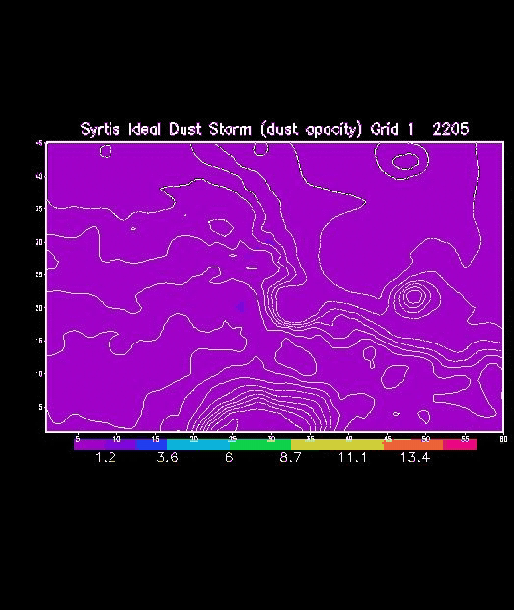

Not_active_dust vs active_dust lifting
Grid 1# (240km horizontal grid spacing)

Slide 4
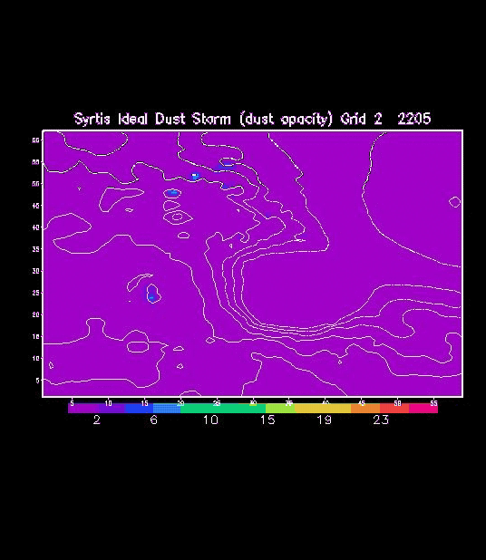
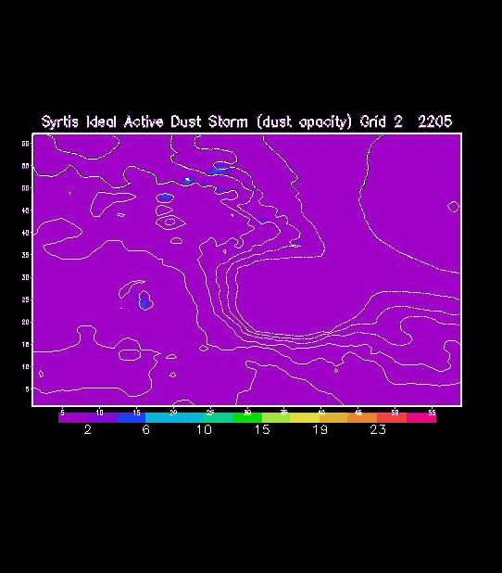
Not_active_dust vs active_dust lifting
Grid 2# (80km horizontal grid spacing)

Slide 5
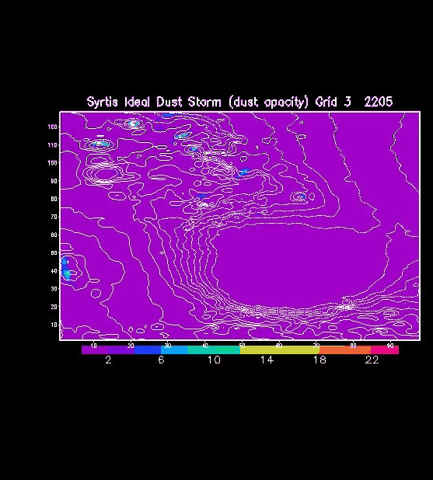

Not_active_dust vs active_dust lifting
Grid 3# (26.7km horizontal grid spacing)

Slide 6
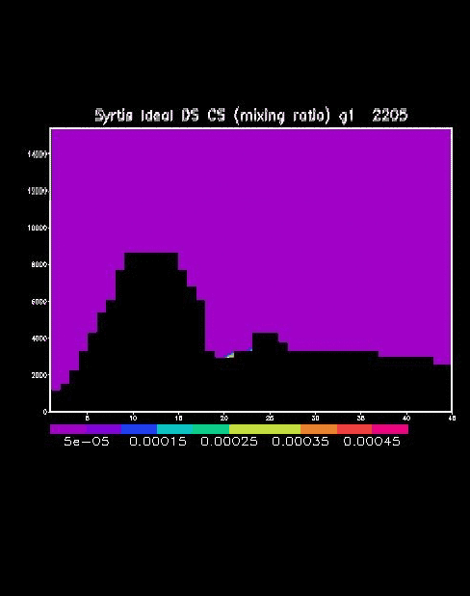
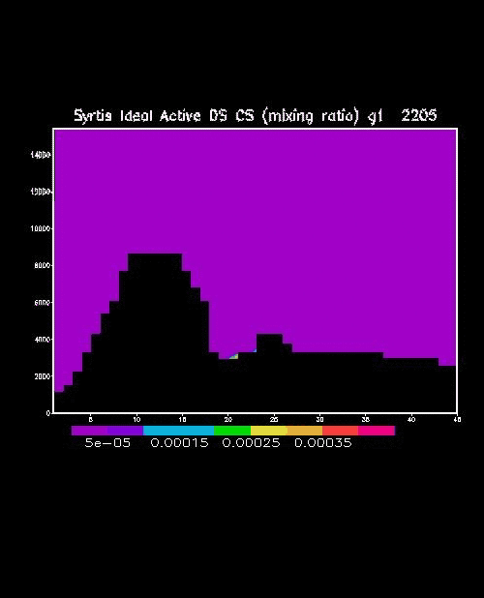
Not_active_dust vs active_dust lifting
Cross Section. Grid 1# (240km horizontal grid spacing). X=34
S
N
S
N

Slide 7
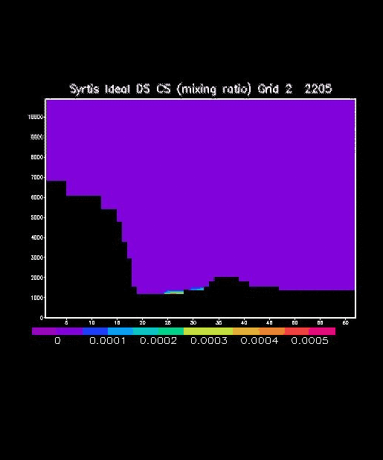
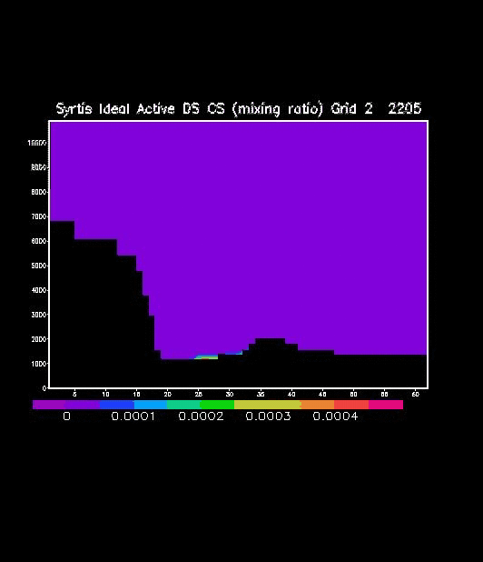
Not_active_dust vs active_dust lifting
Cross Section. Grid 2# (80km horizontal grid spacing). X=40
S
N
S
N
S
N
S
N

Slide 8
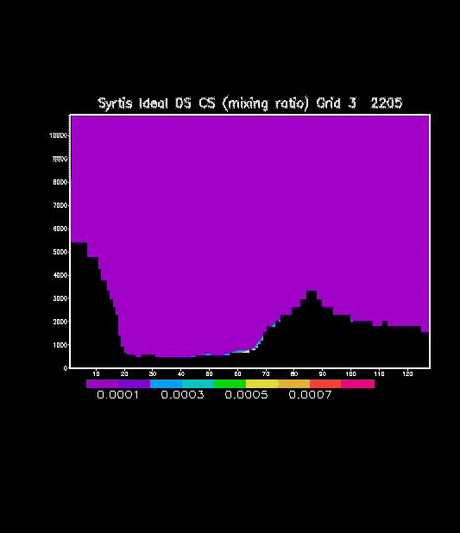
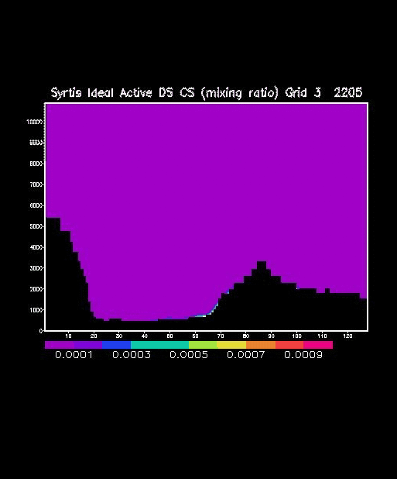
Not_active_dust vs active_dust lifting
Cross Section. Grid 3# (26.7km horizontal grid spacing). X=59
S
N
S
N
S
N
S
N

Slide 9
Active_dust lifting on sol 1# and decaying on sol 2#
grid1

Slide 10
Active_dust lifting on sol 1# and decaying on sol 2#
grid2

Slide 11

Active_dust lifting on sol 1# and decaying on sol 2#
grid3

