Slide 1
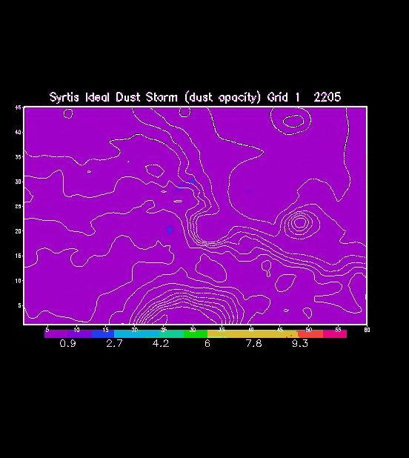

Dust lifting on sol 1# vs dust (active) lifting on sol 1#

Slide 2
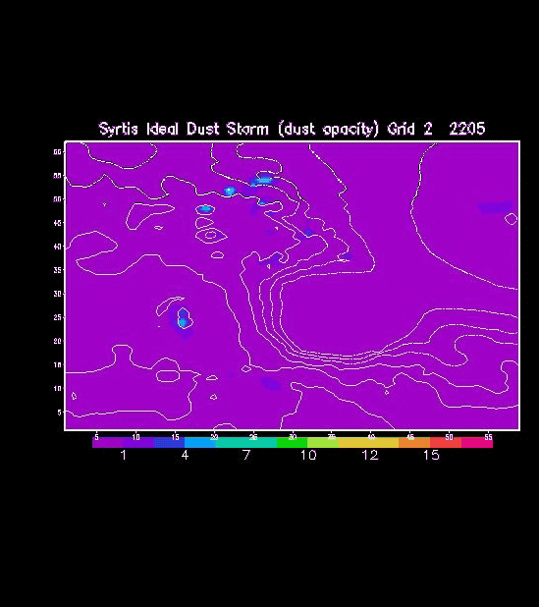
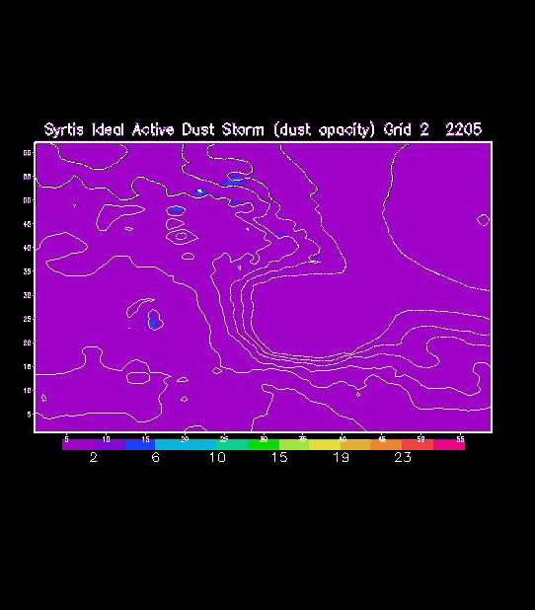
Dust lifting on sol 1# vs dust (active) lifting on sol 1#

Slide 3
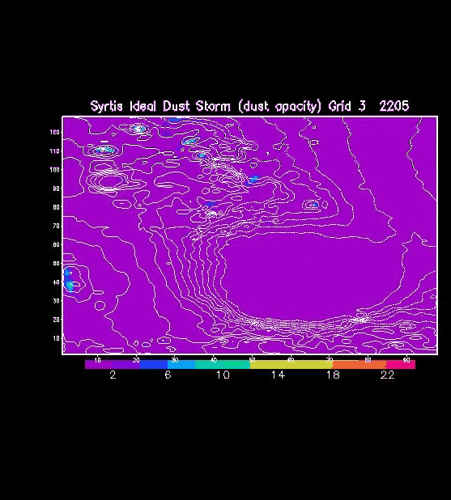

Dust lifting on sol 1# vs dust (active) lifting on sol 1#

Slide 4
Dust (active) lifting on sol 1# and decaying on sol 2#

Slide 5
Dust (active) lifting on sol 1# and decaying on sol 2#

Slide 6
Dust (active) lifting on sol 1# and decaying on sol 2#

