Slide 1
CheMRAMS CAB Status 21rd June 2016
Daniel Viúdez
Jorge Pla-Garcia

Slide 2
Preliminary Conservation Tests
MRAMS installation on CSIC cluster (Trueno) already started
Daniel and Jorge user accounts on Trueno already created
Test1 and test2 have been properly simulated (slides 4 and 5)
Test1
Just 1 grid with one tracer everywhere on grid 1#
Expected: tracer is not conserved over the boundary limits of grid
Test2
3 grids running with one tracer on grid 3#
Expected: the whole amount of tracer should be conserved in the global grid
Test3
Repeat test2 with a blow-up release of tracer instead of uniform initial inyection in the middle of the box, for example inside Gale crater with a rich dynamic environment
A zoom-in in grid4 is included for comparison.
Good progress computing total mass. We are modifying the code to obtain the required variables in order to obtain the mass of the domain (see slide 10) .
Tomorrow meeting with Scot Rafkin to define

Slide 3
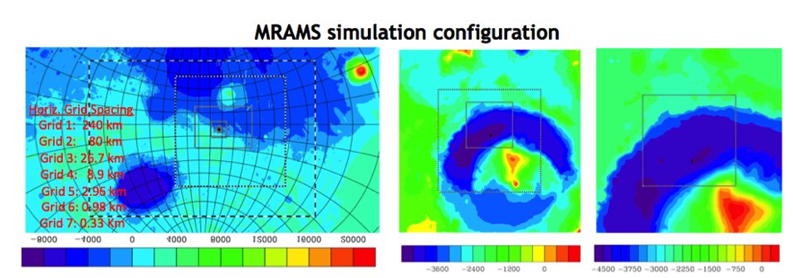
MSL landing site
MSL landing site
Altitude in meters (MOLA instrument)
The simulation is configured with 7 grids. The model is run for 3 sols with 5 grids and then the 2 additional grids are added and run for at least 3 more sols.
Horizontal Grid Spacing: Grid 1 (240km), Grid 7 (330m)
Vertical Grid Spacing: 50 points, 51km model top, 14.5m first layer, 30m initial grid spacing, 2500m maximum grid spacing, 1.12 stretch factor

Slide 4
Test 1

Slide 5
Test 2

Slide 6
Test 3

Slide 7
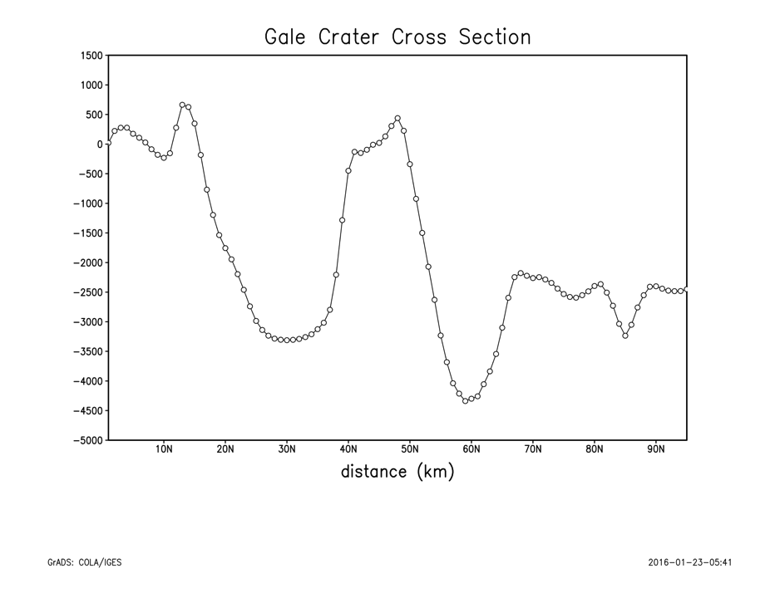
Tracer 1
MSL landing site
South
North
Tracer included into Gale crater
atmospheric simulations

Slide 8
14 meters AGL
Ls270. Summer equinox.
Tracer #1 transport
N
Crater cross section
LMST
S
10 kms AGL
S
N
N
Tracer 1# fraction
tracer1/tracer1+tracer2+tracer3
S

Slide 9
14 meters AGL
Ls90. Winter equinox.
Tracer #1 transport
N
Crater cross section
S
10 kms AGL
S
N
N
Tracer 1# fraction
tracer1/tracer1+tracer2+tracer3
S

Slide 10
Computing total mass Total mass of tracer grid box = mixing ratio of tracer * mass of air Mass of air = density of air * dX*dY*dZ The tracers are on thermodynamic points in the vertical stagger grid. dZ corresponds to the distance where the tracer is in the middle of the box: ---------- tracer level k+1 thermodynamic level - - - - - - - w level k momentum level ------------ tracer level k thermodynamic level - - - - - - - w level k-1 momentum level ----------- tracer level k-1 thermodynamic level dZ is the thickness of the vertical layer, that is, the value we want to include in the sum function in order to compute total mass. Unlike dX and dY, dZ can not be digged out directly from the experiments results and must be computed modifying MRAMS code.

