Slide 1
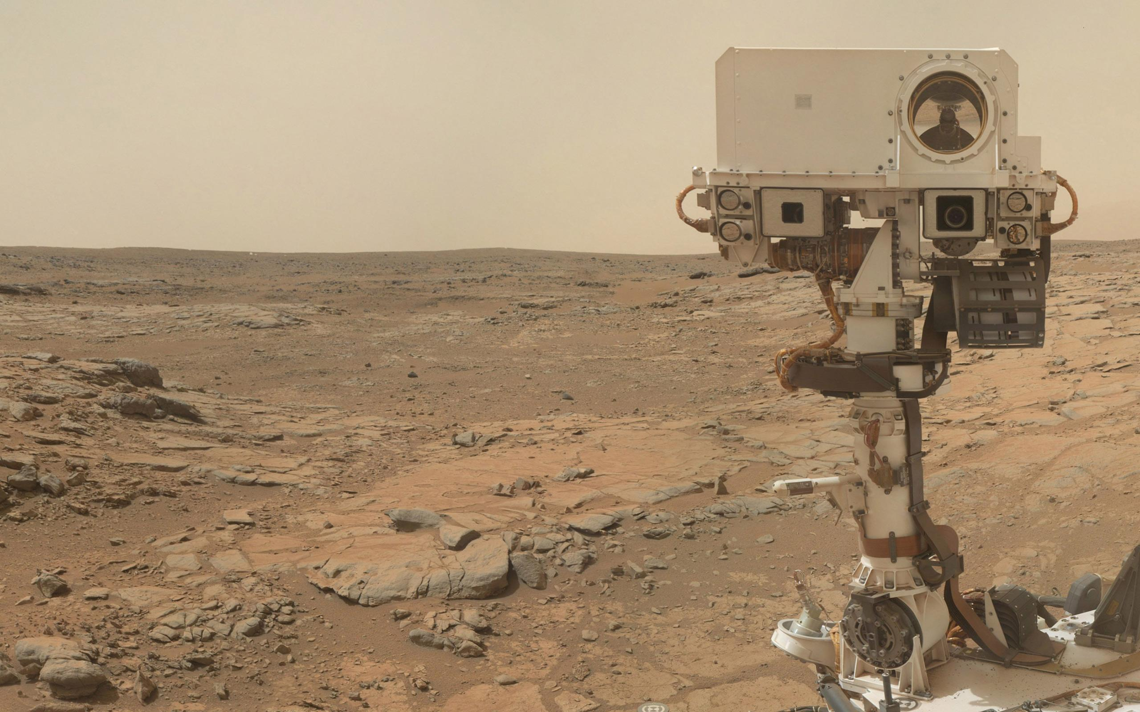





Meteorological Circulations at Gale Crater Through Rover Environmental Monitoring Station (REMS) Observations and Mesoscale Modeling (MRAMS)
Jorge Pla-García^{1,2}, Scot Rafkin¹
and the REMS and MSL Science teams
¹Southwest Research Institute, Boulder CO 80302, USA
²Centro de Astrobiología (CSIC-INTA), Madrid, Spain
jpla@cab.inta-csic.es
EPSC2015, Nantes
MSL sol 1119 (Ls=48), 29th September 2015

Slide 2
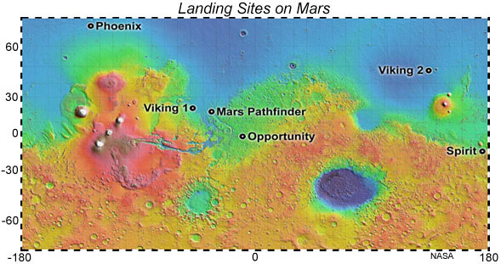
Oil and Water: Topography and Mission Meteorology

Slide 3
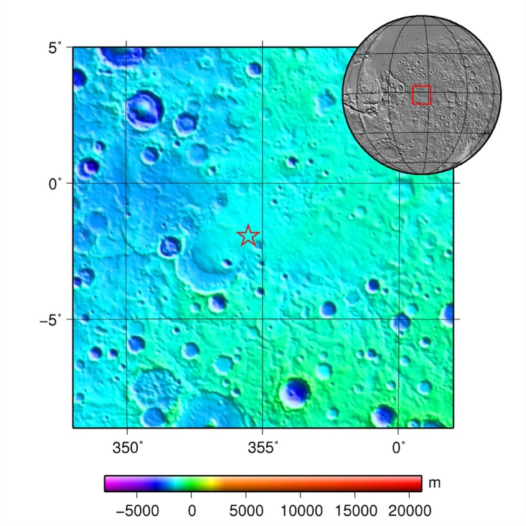
Oil and Water: Topography and Mission Meteorology
Opportunity: Flat with no Met

Slide 4
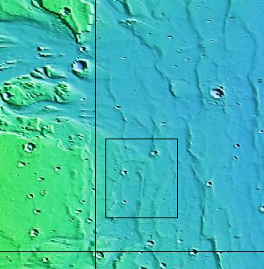
Oil and Water: Topography and Mission Meteorology
VL1: Flat with Meteorology

Slide 5
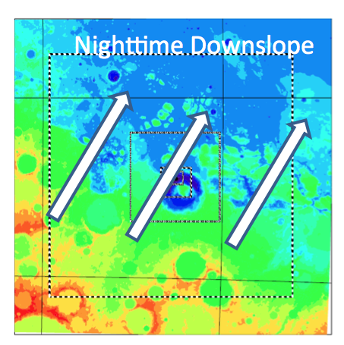
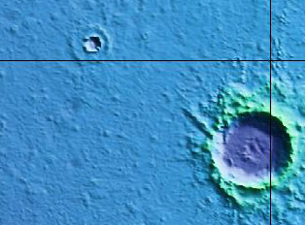
Oil and Water: Topography and Mission Meteorology
VL2: Flat with Meteorology

Slide 6
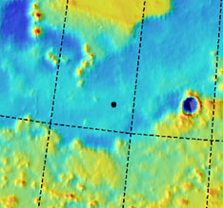
Oil and Water: Topography and Mission Meteorology
Phoenix: Flat with limited Met

Slide 7
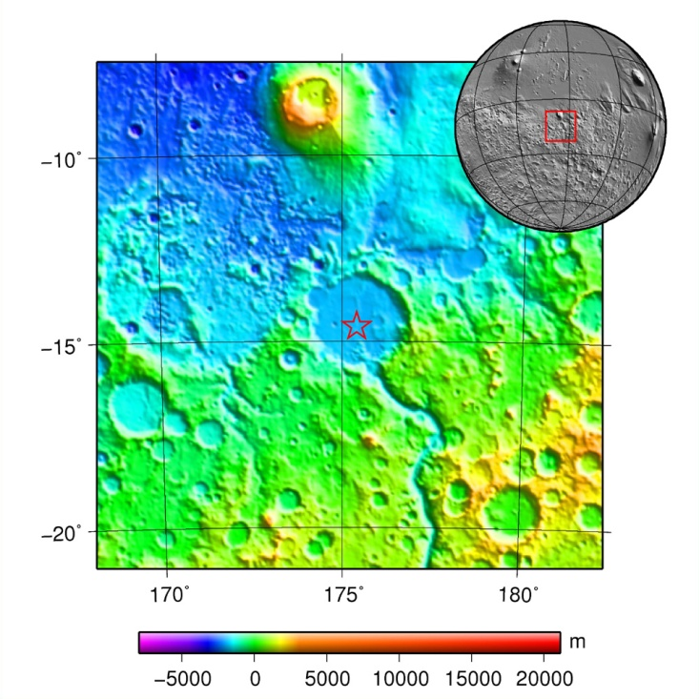
Oil and Water: Topography and Mission Meteorology
Spirit: Topography with no Met

Slide 8
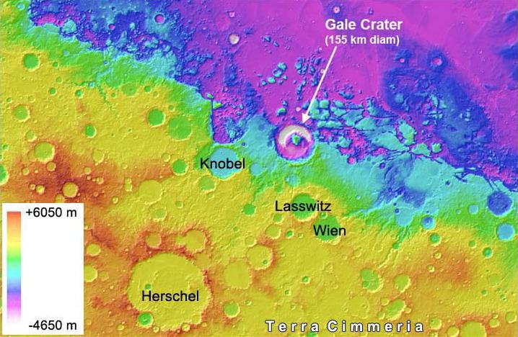
Gale: A Region of Complex Topography With Meteorological Instrumentation (REMS)
MSL
MSL provides the first opportunity to look at strongly forced mesoscale meteorology

Slide 9
MRAMS: Mars Regional Atmospheric Modeling System
Mesoscale model that simulates the circulations of the Martian atmosphere at regional and local scales [Rafkin et al. 2001]. Applied to MSL landing site at Gale crater. Includes:
  Non hydrostatic dynamics
  Conductive regolith model (with CO₂ deposition and sublimation)
  Water microphysics (not active for this experiment)
  Initialization, boundary conditions and CO₂ ice data are taken from a NASA Ames GCM [Kahre, Haberle et al.]:
    Simulation with column dust opacity driven by zonally-averaged TES retrievals.
    Vertical dust distribution is given by a Conrath-v parameterization that varies with season and latitude.
    NASA Ames two-stream, correlated-k radiation
Topography shadowing and slope radiation effects

Slide 10
The simulation is configured with 7 grids. The model is run for 3 sols with 5 grids and then the 2 additional grids are added and run for at least 3 more sols.
Horizontal Grid Spacing: Grid 1 (240km), Grid 7 (330m)
Vertical Grid Spacing: 50 points, 51km model top, 14.5m first layer, 30m initial grid spacing, 2500m maximum grid spacing, 1.12 stretch factor

Slide 11
Model validation
Ground Temperature Comparison
MRAMS vs REMS_GTS

Slide 12
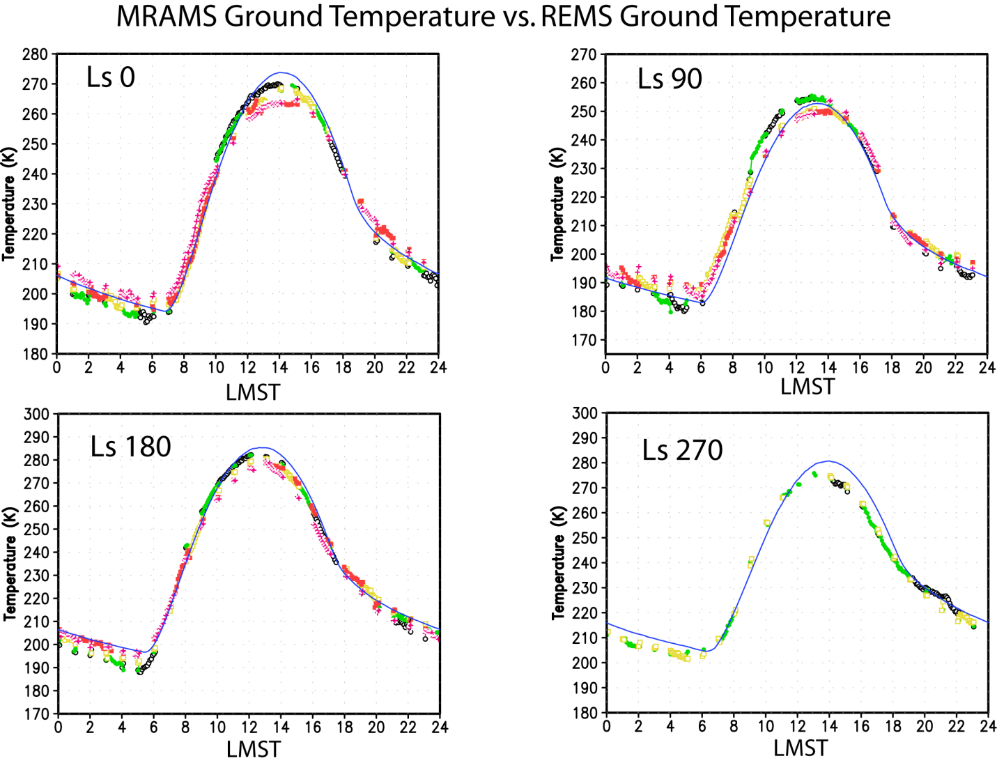
MRAMS sol 350:
REMS sols 348-352: dots
MRAMS sol 543:
REMS sols 541-545: dots
Discrepancy likely due to albedo and dust loading
MRAMS sol 53:
REMS sols 51-55: dots
MRAMS sol 196:
REMS sols 195-197: dots
Notes:
Ls0: southern autonm equinox
Ls90: southern winter solstice
Ls180: southern spring equinox
Ls270: southern summer solstice
Ls270: model underestimates both dust and albedo. This is Yellowknifie bay
1sigma error of 5K

Slide 13
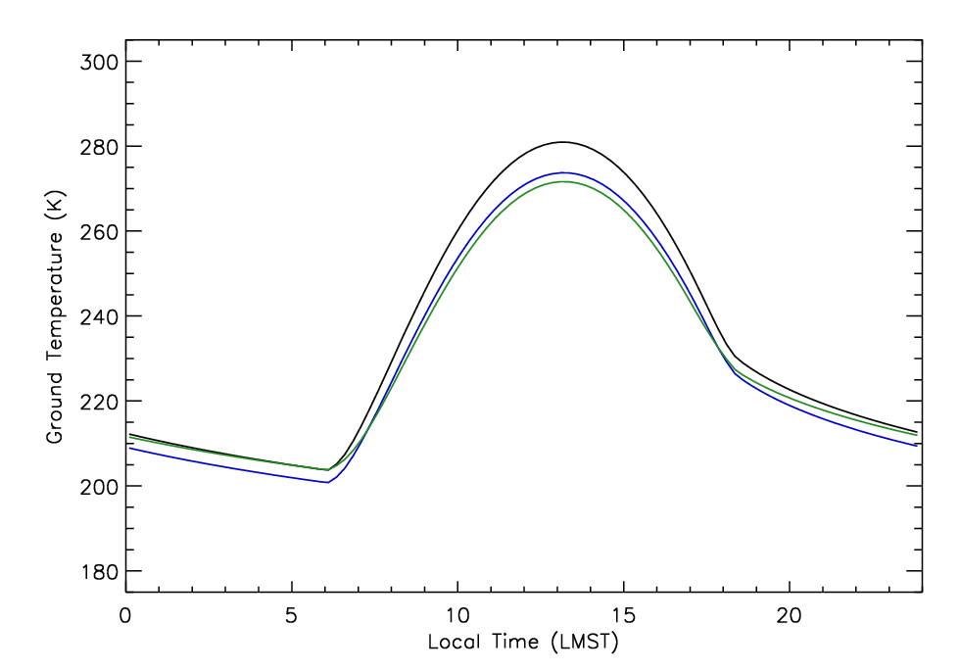
Ground temperature predictions from the model of Vasavada et al [2012] for three different scenarios at Ls 270: 1) Input with MRAMS values of TI, albedo and dust (black); 2) Input with MRAMS TI, albedo=0.3, and MRAMS dust (blue); 3) Input with MRAMS TI, albedo=0.3, and dust = 0.8 vis (~0.4 9 μm) (green).

Slide 14
Model validation
Pressure Comparison
MRAMS vs REMS_PS

Slide 15
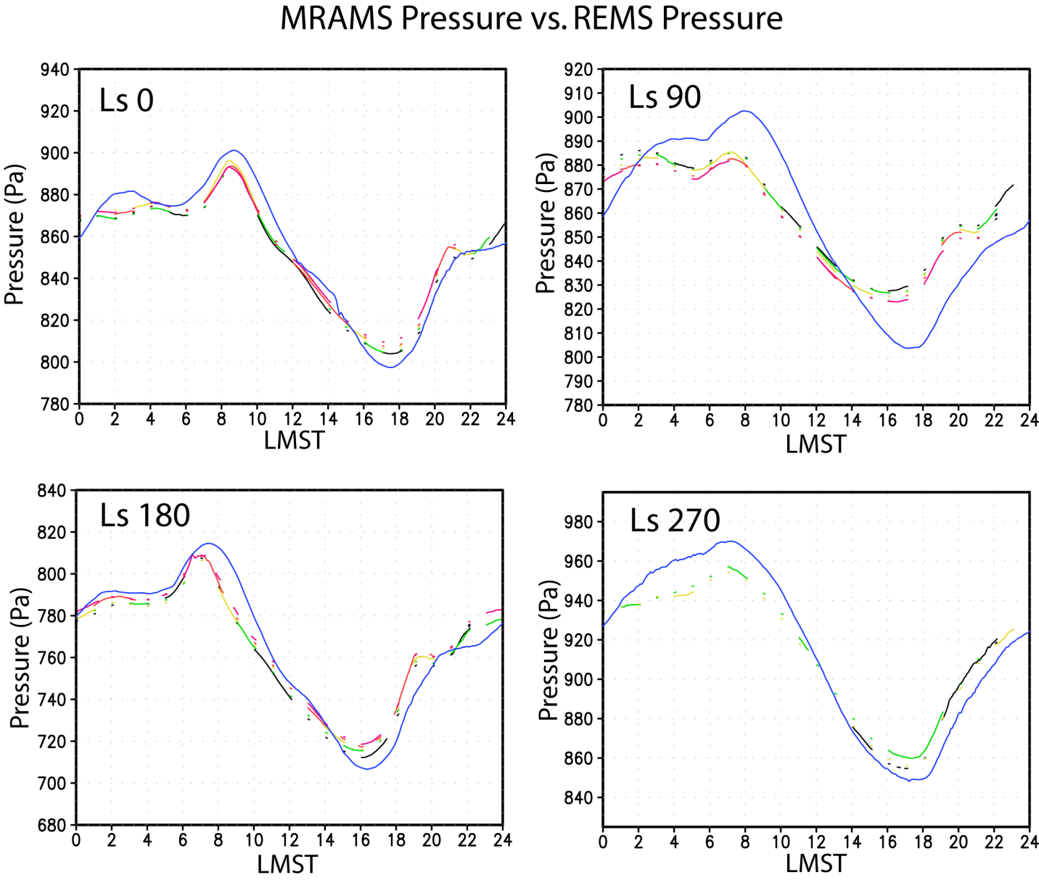
MRAMS sol 350:
REMS sols 348-352: dashed lines
MRAMS sol 543:
REMS sols 541-545: dashed lines
MRAMS sol 53:
REMS sols 51-55: dashed lines
MRAMS sol 196:
REMS sols 195-197: dashed lines

Slide 16
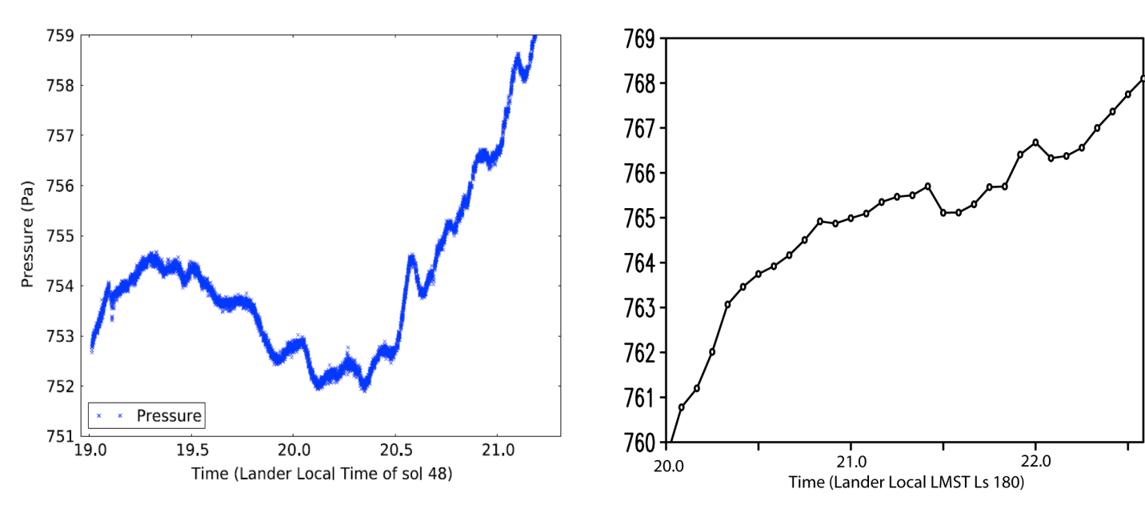
Evening pressure oscillations
Similar oscillation is seen in the output, beginning about 1900LMST and diminishing around 2200LMST. The waves are heavily aliased by the 5 min sampling from MRAMS (right)
Notes:
0.5 Pa and 12-18 minutes duration

Slide 17
Seasonal Changes in Pressure
When global and regional winds are favorable, the crater circulation stays local, and influences the local pressure signal.
At Ls 270, the global and regional circulation spreads the crater circulation impacts away from the crater.

Slide 18
Model validation
Air Temperature Comparison
MRAMS vs REM_ATS

Slide 19
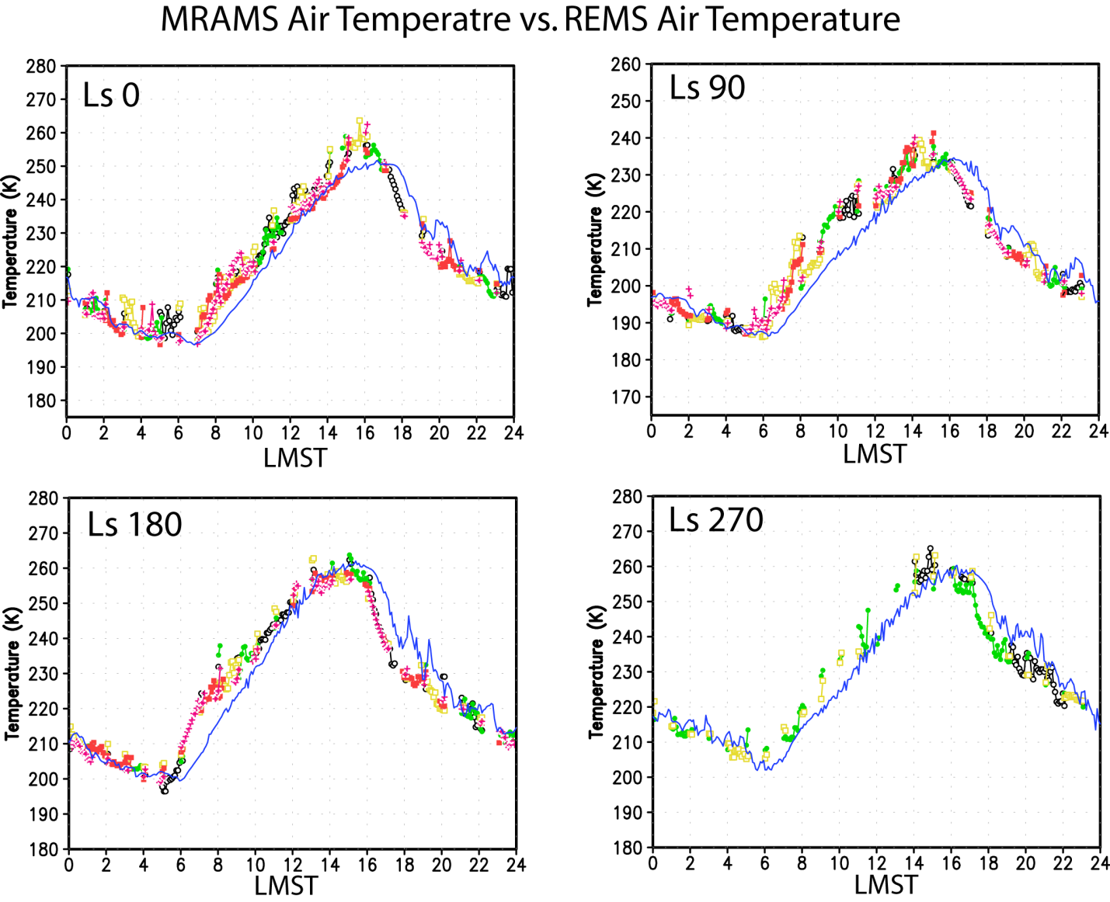
Notes:
Explicar porque la discrepancia: 14metros vs 1.5metros
THIS IS THE DIRECT RESULT OF THE STEEP AFTERNOON LAPSE RATE AND THE STRONG NOCTURNAL INVERSION

Slide 20
Model validation
Wind (speed and direction) Comparison
MRAMS vs REMS_WS

Slide 21
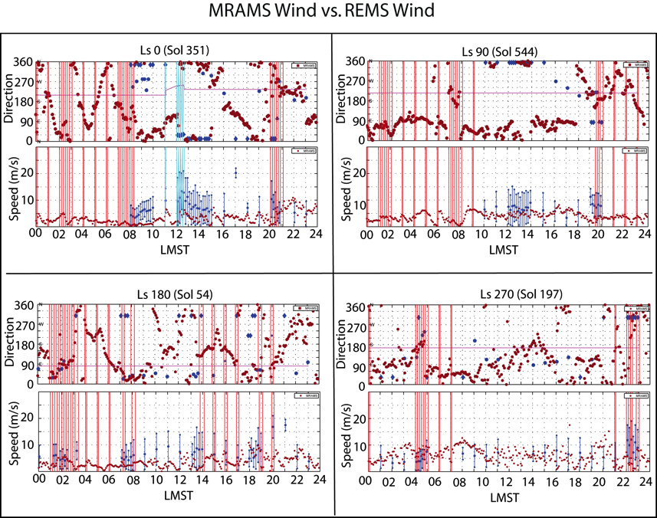
The blue lines show periods when the rover was moving.
The red lines highlight periods with electronic noise in the sensor.
The magenta line indicates the direction in which the rover is pointing.
MRAMS simulations are shown with solid red circles.
REMS data are shown with solid blue circles.
Blue diamonds indicate winds coming from behind the rover, and should be treated very cautiously.

Slide 22
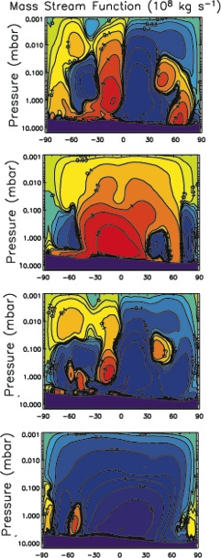
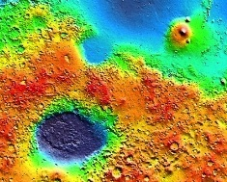
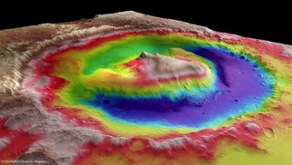

Local Weather is the Sum of Different Scale Circulations
Global Mean Circulation
Regional Topographic
Dichotomy Circulation
Local Topographic Circulations
at Gale crater
Day
N
Ls 0
Fall
equinox
Gale
S
N
S
Day
Ls 90
Winter
solstice
Night
N
S
N
Gale
Ls 180
Spring
equinox
S
Night
S
N
Ls 270
Summer
solstice
Circulations interact in complex, nonlinear ways to produce observed weather at any give location.
S
Gale
N

Slide 23
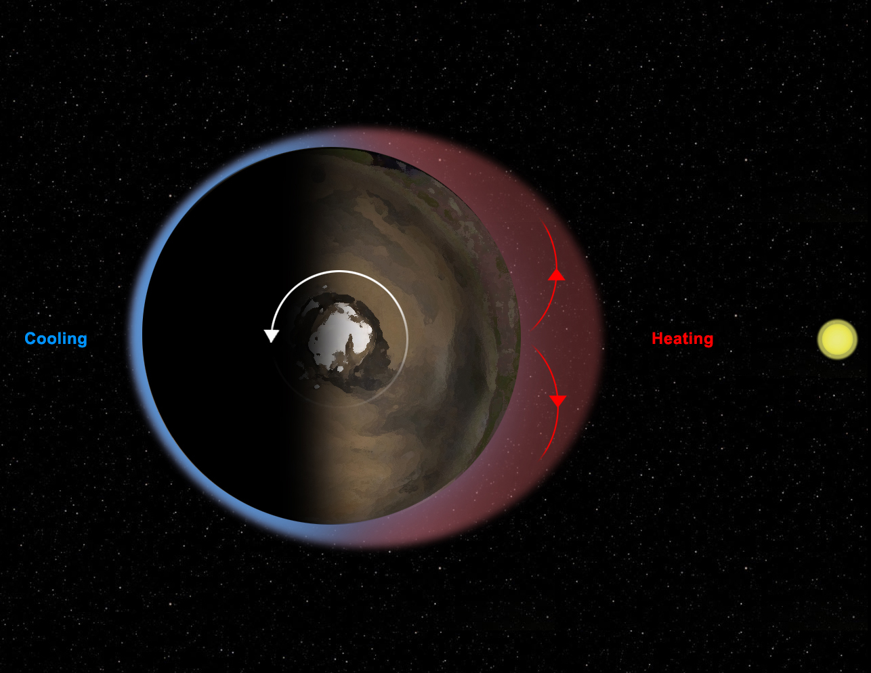
To previous slide circulations we have to add:
Thermal tides at Mars
Sunlight heats the surface and atmosphere on the day side of the planet, causing air to expand upwards.
At higher levels in the atmosphere, this bulge of air then expands outward, to the sides, in order to equalize the pressure around it, as shown by the red arrows.
Air flows out of the bulge, lowering the pressure of air felt at the surface. Contrary effect is shown on the night side of the planet.

Slide 24
Upslope/Downslope Winds
Slope winds may be driven by:
  Buoyancy (anabatic/katabatic)
  Dynamical forcing (pressure gradients): this mesoscale flows, like mountain waves and gravity waves, are dynamically generated by the interaction of the wind with the topography. These phenomena can oppose buoyancy forces and provide a mechanism for warm air to descend or cold air to rise.
  Some combination of the two
Potential temperature provides a convenient way to assess
  Potentially cold air will sink, warm air will rise.
  Sinking warm air or rising cold air must be dynamically driven.
Notes:
Dynamical forcing → THERMAL TIDE + MOUNTAIN WAVES

Slide 25
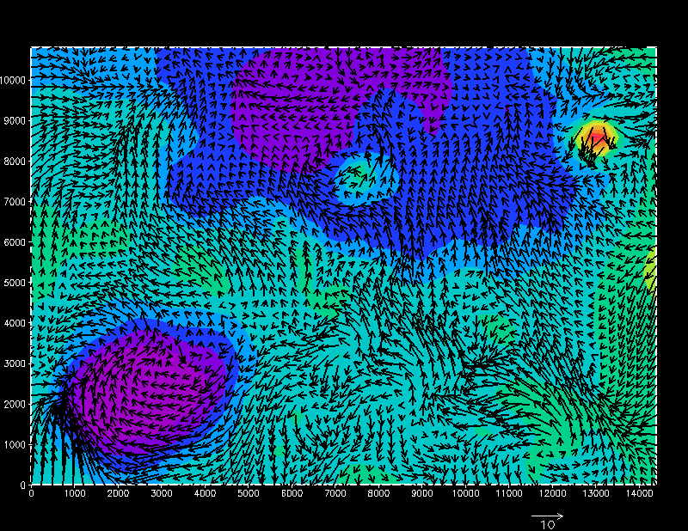
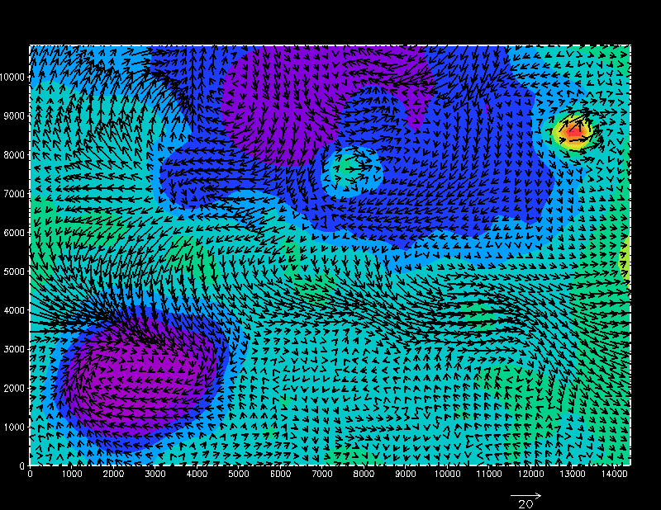
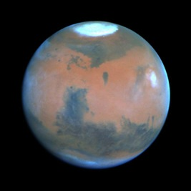
Global scale circulation
Mean Winds Ls 90
Mean Winds Ls 270
Seasonal Reversal of
Mean Circulation

Slide 26
The Regional-Scale. Nighttime

Slide 27
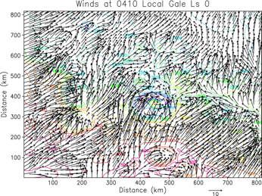
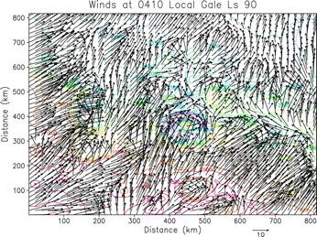

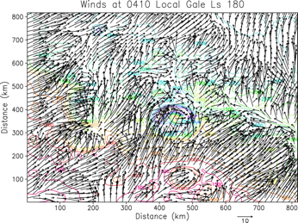
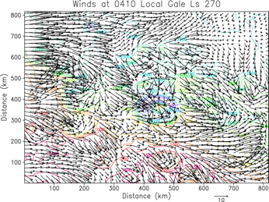
Regional scale (dichotomy). Nighttime
Hadley
Cell
Dichotomy
Downslope
Dichotomy
Downslope
Hadley
Cell
FIGHT
Dichotomy
Downslope
Dichotomy
Downslope
Gale crater circled. Strong Influence of Topographic Dichotomy Except Ls=270
Southerly Regional Winds Except at Ls=270: Hadley Cell winds WINS!!

Slide 28
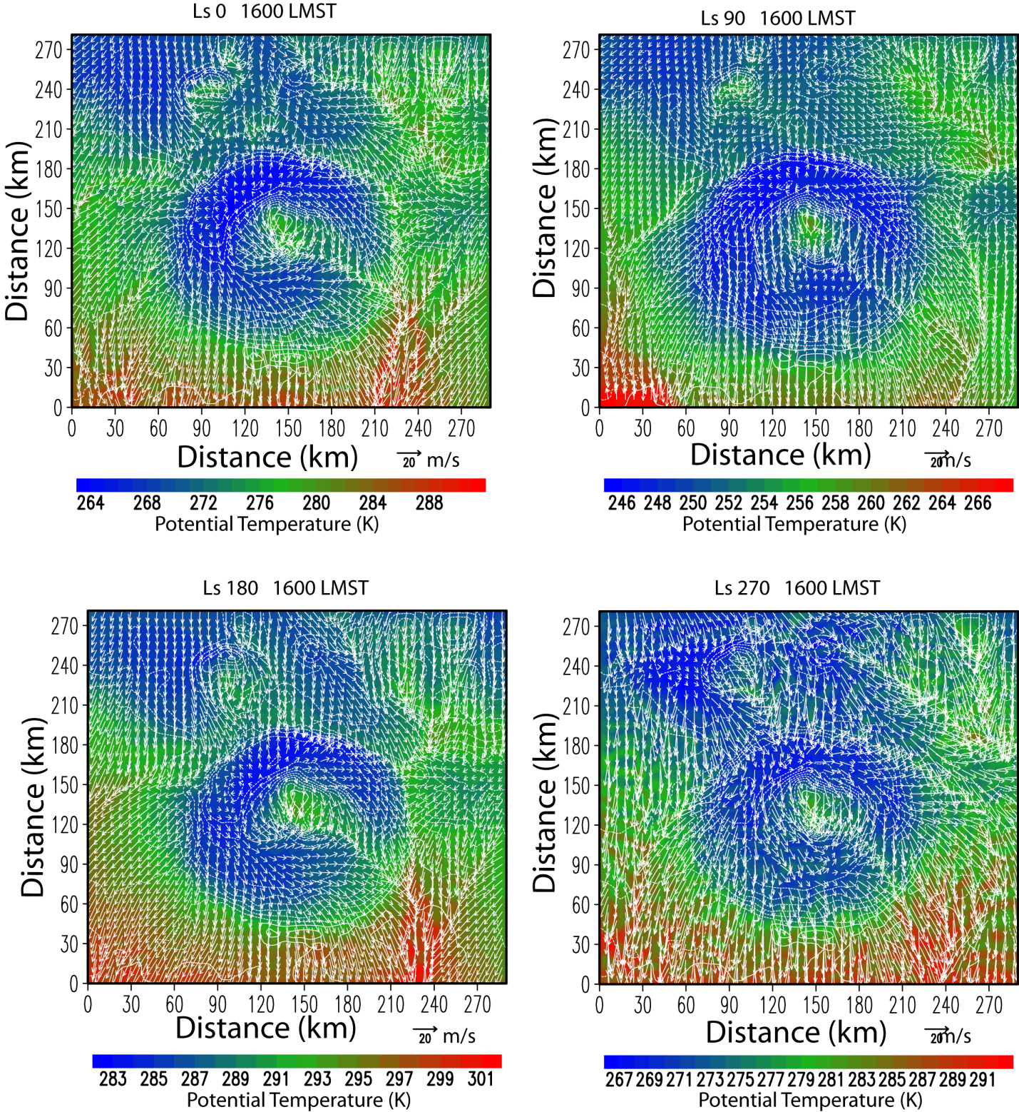
Surface winds and potential temperature (1600LMST)

Slide 29
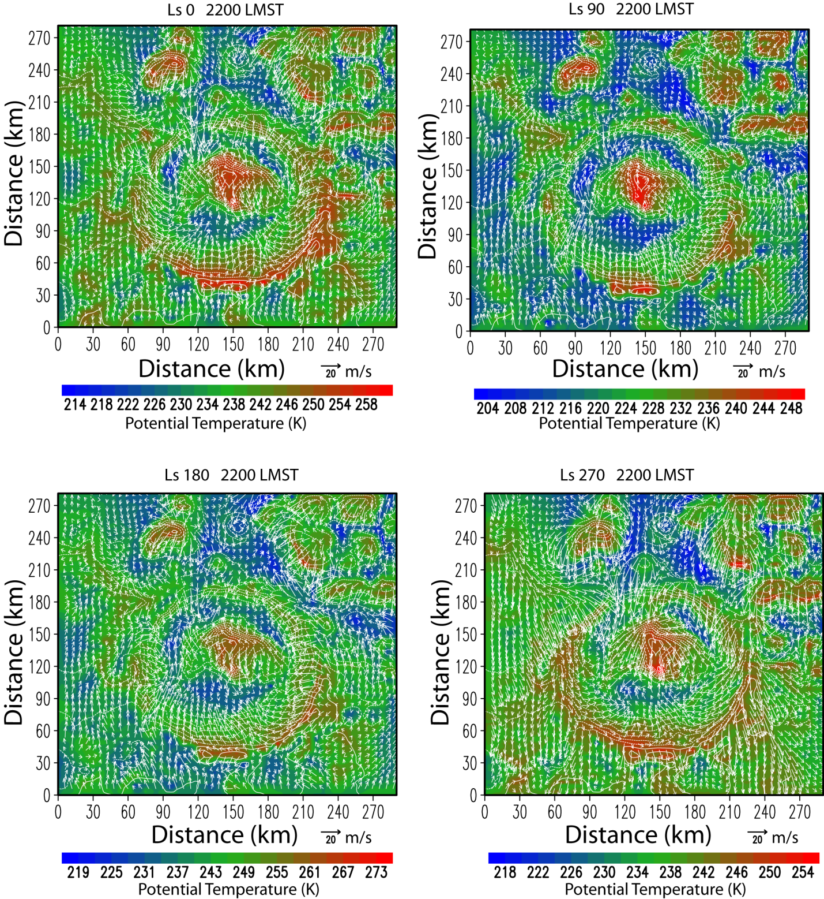
Surface winds and potential temperature (2200LMST)

Slide 30
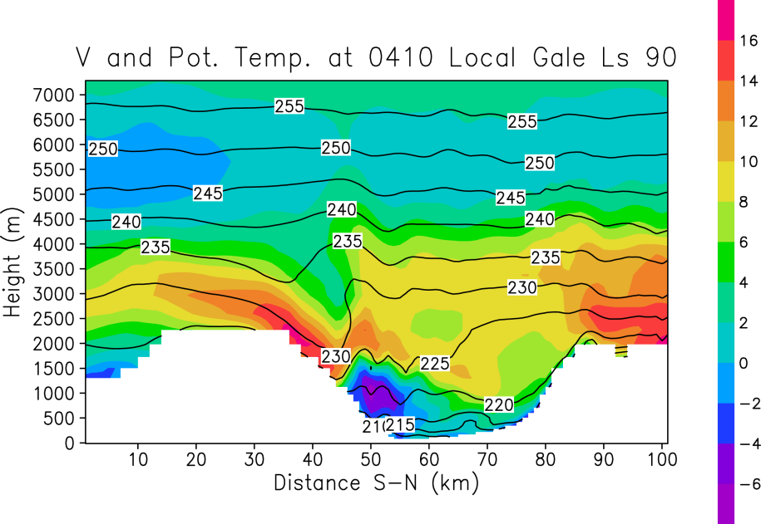
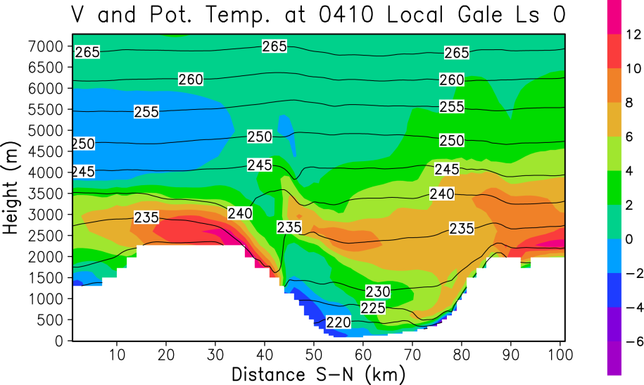
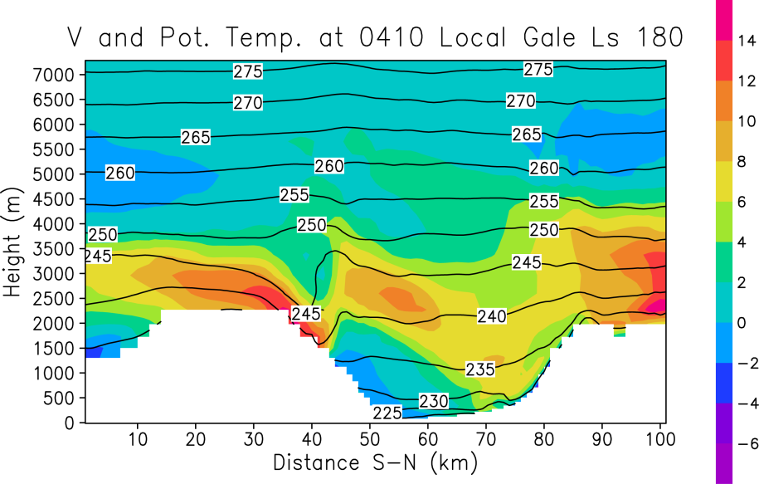
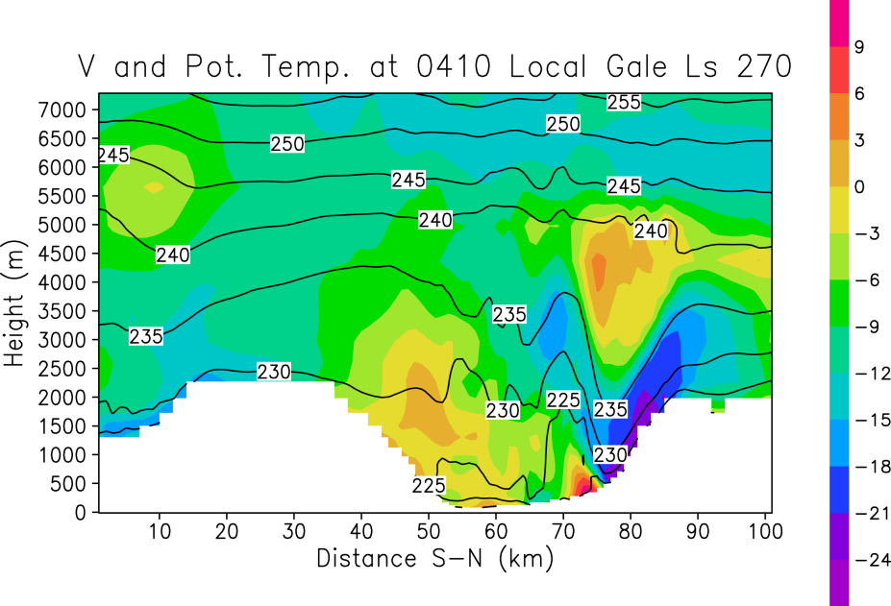
Cross-Sections: meridional wind and potential temperature
Warm, capping inversion at all seasons but Ls=270: stronger vertical mixing. Warm air tends to override crater air mass at other seasons. Mountain wave at Ls=270. Strong downslope winds AND MIXING at Ls=270 along north rim.
Notes:
Massive push of cold air. This is the only season where downslope can flush out crater air mass.
The only season where northern hemisphere air makes it into the crater.
Warm air from south overrides.
North rim gravity waves.

Slide 31
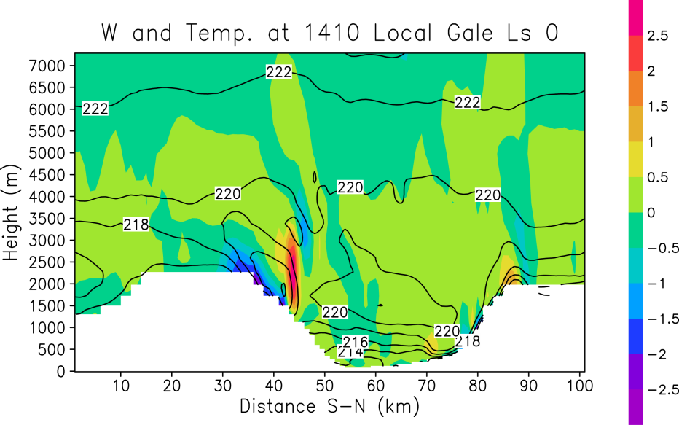
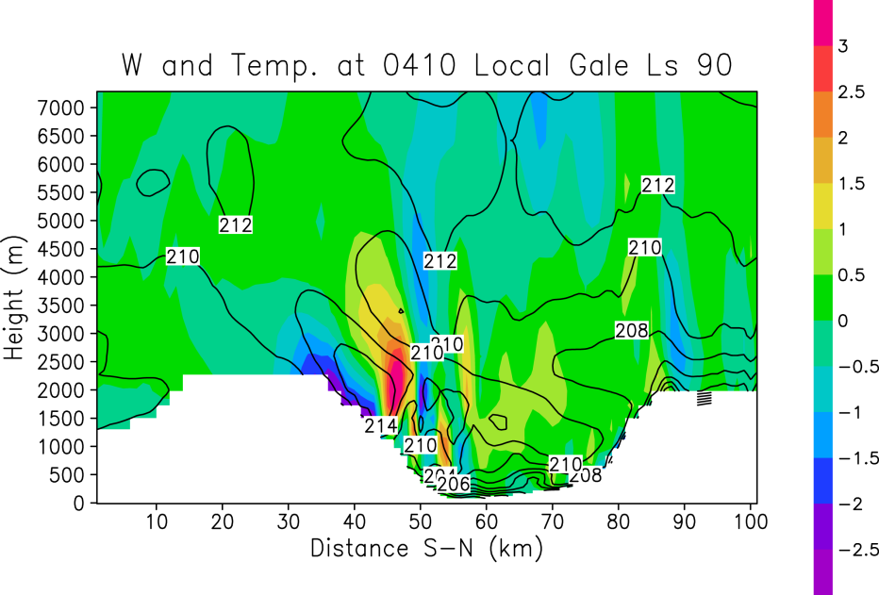
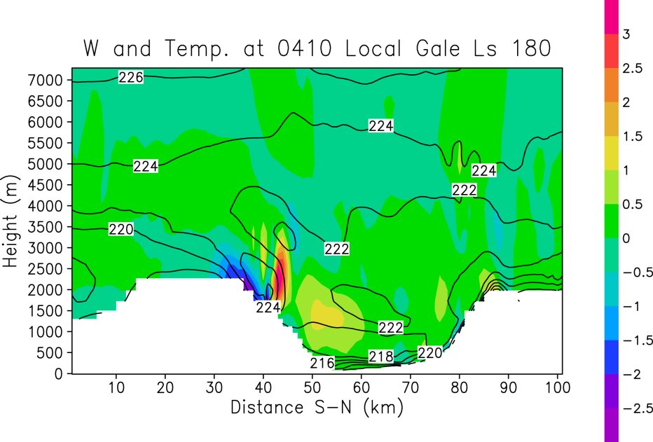
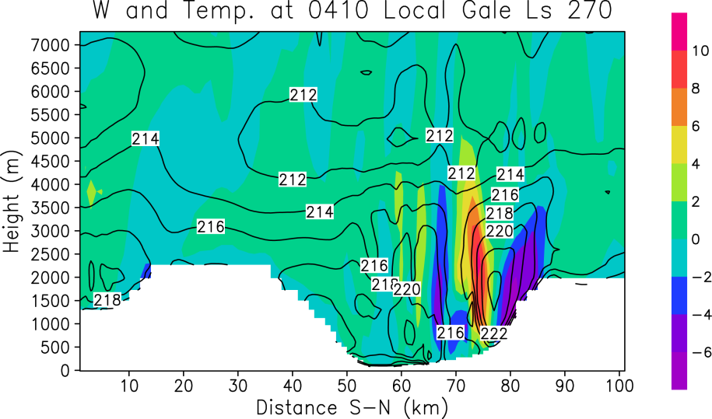
Cross-Sections: Vertical wind and potential temperature
0410
Cold air in crater. Action shifts from Mt. Sharp to north crater room at Ls=270. Strong mountain wave AND MIXING at Ls=270.

Slide 32
Cross-Sections: Vertical wind and potential temperature
0410
Warming
Downslope
Winds
Cold air in crater. Action shifts from Mt. Sharp to north crater room at Ls=270. Strong mountain wave AND MIXING at Ls=270.

Slide 33
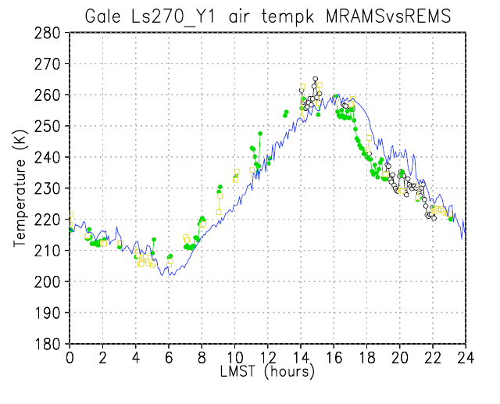
Onset of radiational cooling
Shallow turbulent convection and mixing within crater.
Downslope arrives
Extensive mixing from breaking mountain waves slows radiational cooling
Dichotomy beats back crater downslope; radiative cooling and cold air reestablished.

Slide 34
Regional scale crater circulation animations
Surface winds vs potential temperature

Slide 35
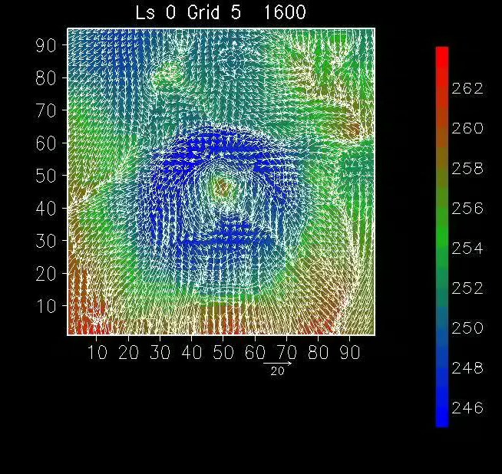
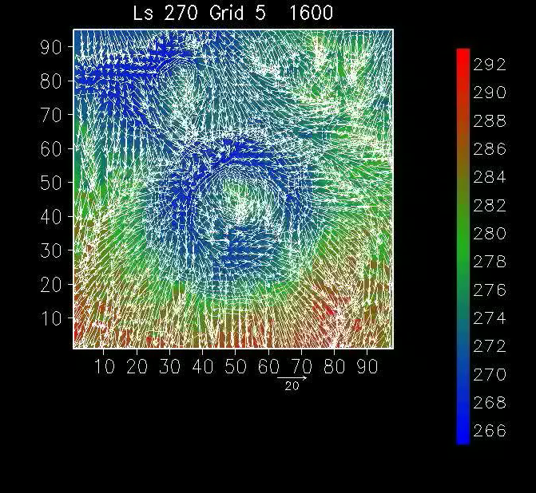
Regional scale crater circulation animations
Surface winds vs potential temperature
Ls 90 Grid 5
Potential temperature
Potential temperature
Potential temperature
Wind speed and direction
Wind speed and direction
During Ls0, Ls90 and Ls180 the crater air mass is generally much colder than outside the crater. As the cold air descends encounters ever increasing cold air until loss of negative buoyancy. Reduced mixing in bottom of crater.
UNIQUE season at Gale. Slope winds driven by buoyancy+dynamical forcing. Air mass in crater mixes with the atmosphere external due to strong, flushing, northerly flow and breaking mountain waves.

Slide 36
Implications for Water, Dust and Trace Gasses
The primary origin of water is N. Polar cap in Spring/Summer.
  Mean circulation not favorable for transport to Gale.
  Daytime crater circulation ventilates crater.
  Nighttime circulations from outside crater cannot penetrate to crate floor.
  Ls 270 allows for mixing to crater floor, but air is dry.
Dust lifting is suppressed during day
  Shallow boundary layer = no dust devils
  Little lifting of dust at night in crater floor.
  Stronger winds and dust devils outside crater.
  Dusty air should blow over crater.
  Crater is relatively clear (Moores et al., 2014)
Trace gasses (incl. methane).
  Reduced air mass exchange between crater and external air except Ls 270.
  Crater may not be representative of bulk trace gas composition depending on photochemical lifetimes.
  Gas sources in crater will tend to increase concentration with time.

Slide 37
Gale Crater Water Cycle
Atmospheric transport is the driving mechanism in the absence of a local source.
Global seasonal water sources are at the poles with the north being the most dominate.
What is the origin of the air in Gale Crater?

Slide 38
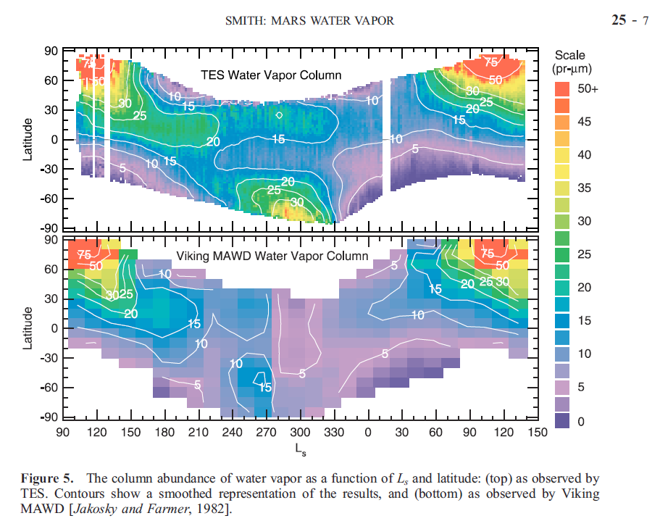
Seasonal Water Vapor Transport
Sublimation of north H₂O cap

Slide 39

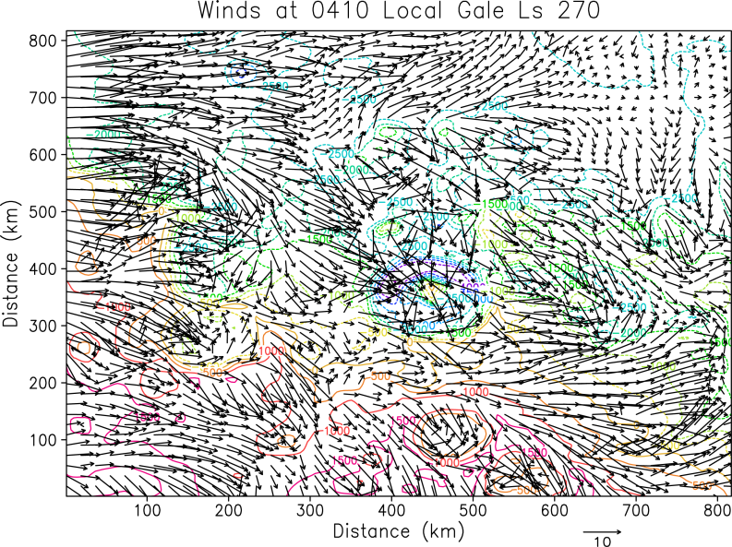
The Regional-Scale (Nighttime)
Hadley
Cell
Dry (?) air from south flowing towards crater.
Dichotomy
Downslope
Hadley
Cell
Dry (?) air from north flowing towards crater.
Dichotomy
Downslope

Slide 40
Summary of Water Story
North polar cap is source of water in Spring/Summer and sink of water in Fall/Winter.
In Spring/Summer air comes from north during day…
…but does not make it to crater floor.
At night, air comes from dry southern hemisphere.
Floor of Gale crater predisposed to dry air flow at all seasons and all times of day.

Slide 41
Conclusions
The most meteorologically rich environment measured on Mars.
The model does appear to be doing a reasonable job representing the meteorological conditions. Pressure and ground temperatures provide the most robust parameters with which to test the model predictions. Good agreement MRAMS-REMS.
REMS data interpretation is hindered by a lack of spatial context in which to place the observations. MRAMS, properly validated, can be used to provide this context.
Global and regional circulations play a major role in the crater environment → Context is everything!
Variability at night in pressure and temperatures both in modeling and observations due to complex downslope flow interactions.
Crater air mass is generally much colder than outside the crater.
  Reduced mixing in very bottom of crater—but more than previously thought.
  Overrunning air flow.
  Stable boundary layer.
Ls270 season at Gale is unique. Is a period when the air mass in crater mixes with the atmosphere external due to breaking mountain waves
Model results should be considered representative, but not necessarily predictions of the exact time or locations of meteorological events.

Slide 42
Backup Slides

Slide 43
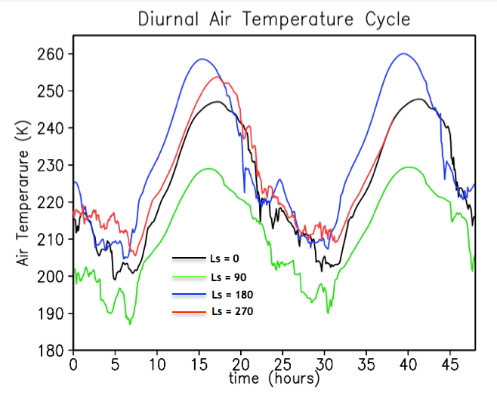
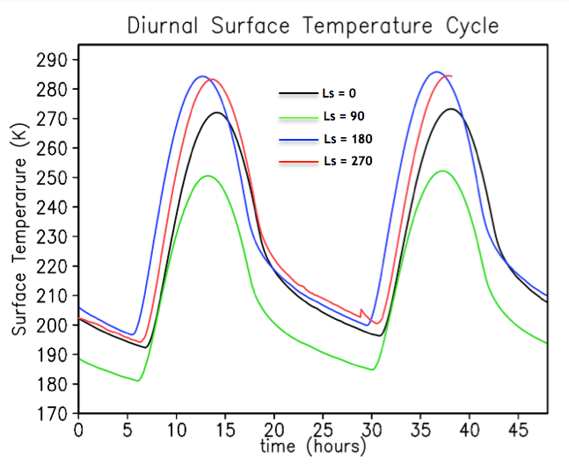
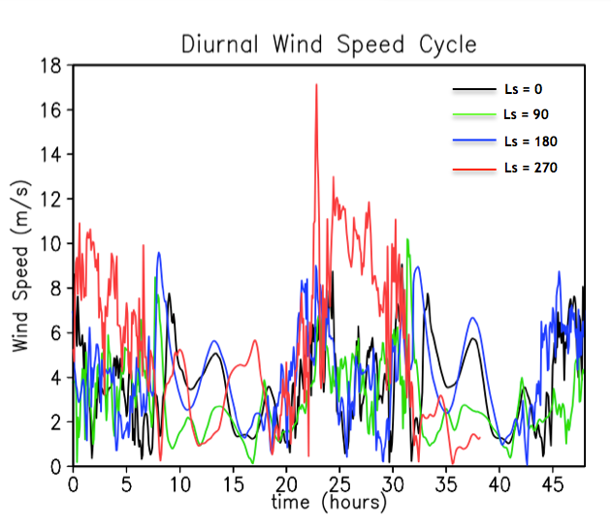
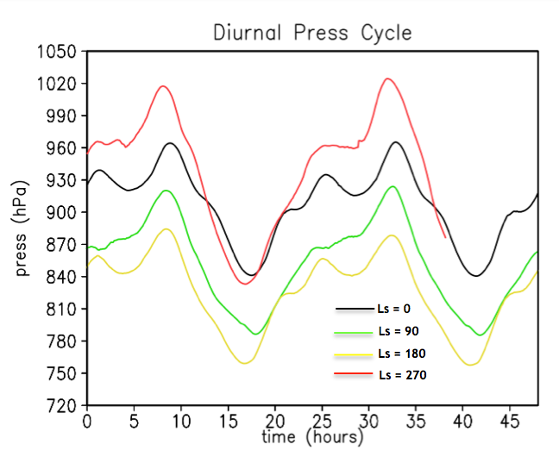
Gale MRAMS Predictions. Time series
Seasonal changes in ground temperature: min/max and amplitude.
Variability at night due to complex downslope flow interactions. Warm departures due to downslope winds and vertical mixing.
  Highest wind speeds overnight Ls=270. Winds speeds show a diurnal pattern with the strongest winds at night, regardless of season.
Amplitude of the diurnal pressure cycle is reasonable accurate. Overall global pressure is slighty lower.
Notes:
----- Notas de la reunión (10/01/14 13:07) -----
Xq la temperatura del aire en Verano no es la más caliente → posible dust cycle
----- Notas de la reunión (12/01/14 17:56) -----
The model does appear to be doing a reasonable job representing both:

Slide 44
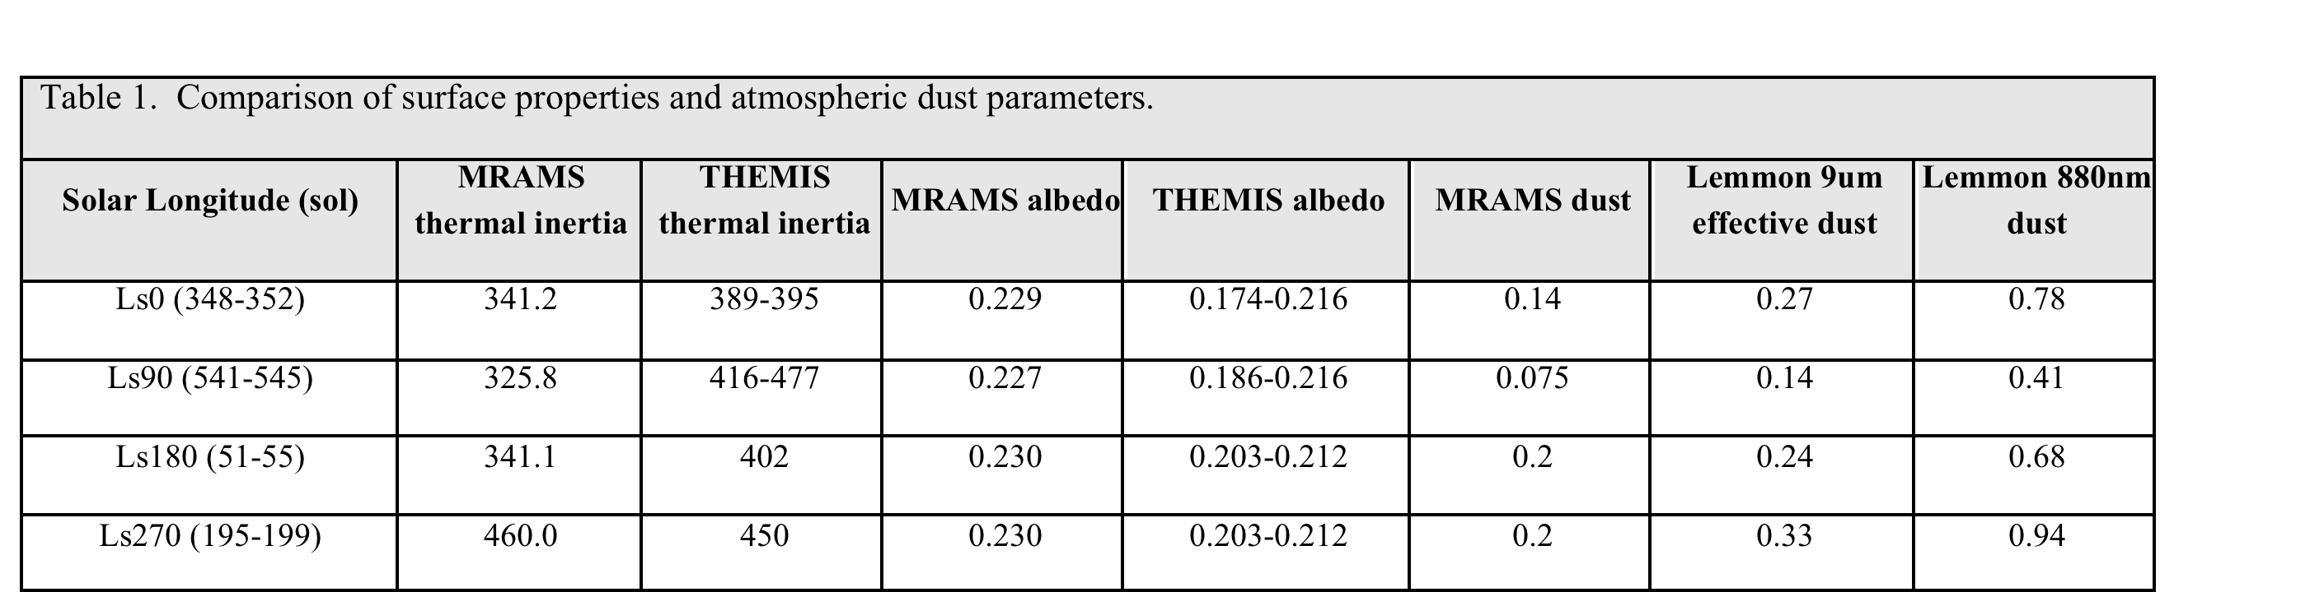
A corrective process was undertaken to minimize the pressure bias between MRAMS and observations.
A fractional adjustment factor for pressure is determined by dividing the REMS mean pressure by the MRAMS mean pressure.
This multiplication preserves hydrostatic balance, leaves temperature unaffected. The kinematic fields are assumed to be unaltered. Changes considered here are small enough to be inconsequential.
Furthermore, any potential impact is applicable only to the GCM; the mesoscale model will adjust the wind field to be consistent with the thermodynamic field.
Solar Longitude | Corrected factor
Ls0 | 1.03613
Ls90 | 1.113
Ls180 | 1.03960
Ls270 | 1.03644

Slide 45
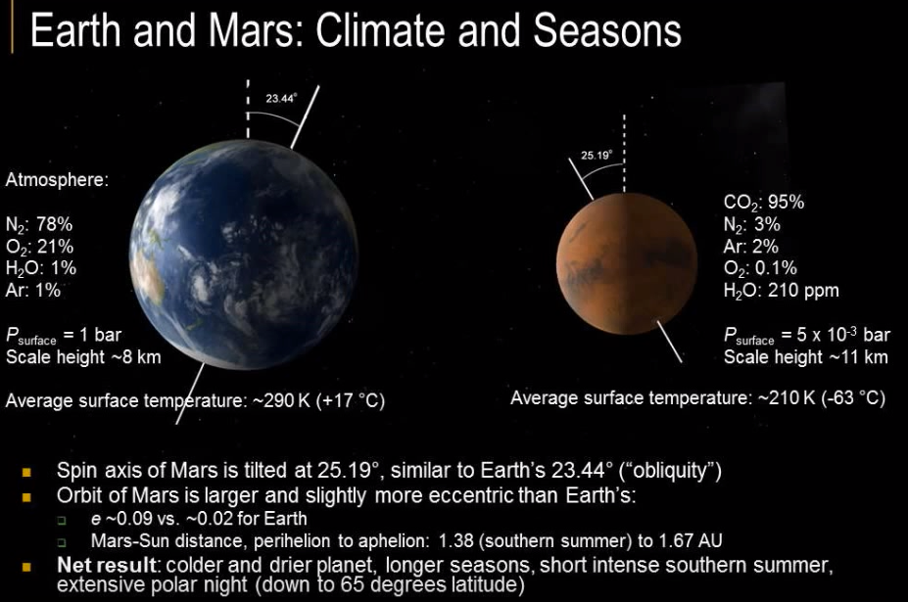
Notes:
Tierra = 1bar = 1000 mbar = 1000 hPa = 100000 Pa
Marte = 5x10-3 bar = 5 mbar = 5 hPa = 500 Pa = Tierra x 200 veces

Slide 46
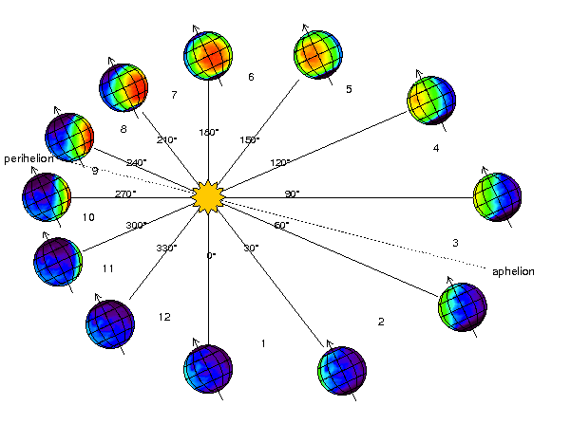
Solar longitude (Ls)

Slide 47
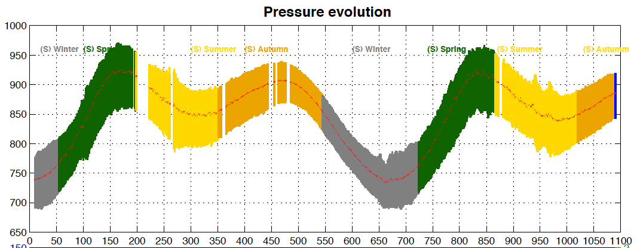
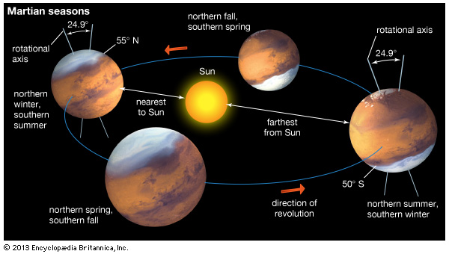
REMS
Ls180
Ls270
Ls0
Ls90
Ls180
Ls270
Ls0
Ls90
Ls180
Ls270
Ls90
Ls0

Slide 48


Slide 49
Notes:
Ls0 y 90 switched??

Slide 50


Slide 51
TKE = Turbulent Kinetic Energy = medida de la turbulencia atmosférica
S = Shear: cizalla horizontal del viento vertical. Isotropic (u'=v'=w').
B = Buoyancy: excite w', but there is u' and v' associated with the circulation
D = Dissipation of energy by viscosity in turbulent flow
T_{r} = Transport of energy from or to other regions of flow
In mesoscale modeling, TKE is considered to be due to the unresolved wind (u', v', w').

Slide 52

Nocturnal Turbulence
Nocturnal Turbulence
Notes:
FIJATE COMO EL TKE EN LS270 ES MUUUUUUUCHO MAS GRANDE QUE EN OTRAS ESTACIONES: HAY MAS TURBULENCIA POR LA TARDE (MAYOR CONVECCION, ESTAMOS EN VERANO?)

Slide 53
Origin of Nocturnal Turbulence
Growth of stable layer above rim and Mt. Sharp conducive to mountain wave amplification.
Stable layer decouples air above from surface, reduces eddy friction, and air accelerates.
Accelerating air increases vertical shear, which lowers Richardson Number until turbulence sets in.
Turbulence mixes to surface, bringing down warm air.

Slide 54

REMS (Rover Environmental Monitoring System)

Slide 55


Two recently papers published in Icarus

