Slide 1








Tracking the MSL-SAM methane detection source location
Through Mars Regional Atmospheric Modeling System (MRAMS)
Jorge Pla-García^{1,2}
Scot C.R. Rafkin², Alberto Gonzalez-Fairén¹
¹Centro de Astrobiología (CSIC-INTA), Madrid, Spain
²Southwest Research Institute, Boulder, CO, USA
jpla@cab.inta-csic.es
Japan Geoscience Union (Tokyo)
MSL sol 1349 (Ls156), May 23rd 2016

Slide 2
Outline
  Introduction
  Experiment design for Gale crater
  MRAMS Gale simulations vs REMS data. Validation
  Atmospheric circulations (including tracers) interpretation for constraining the source of Curiosity’s methane detections
  Conclusions

Slide 3
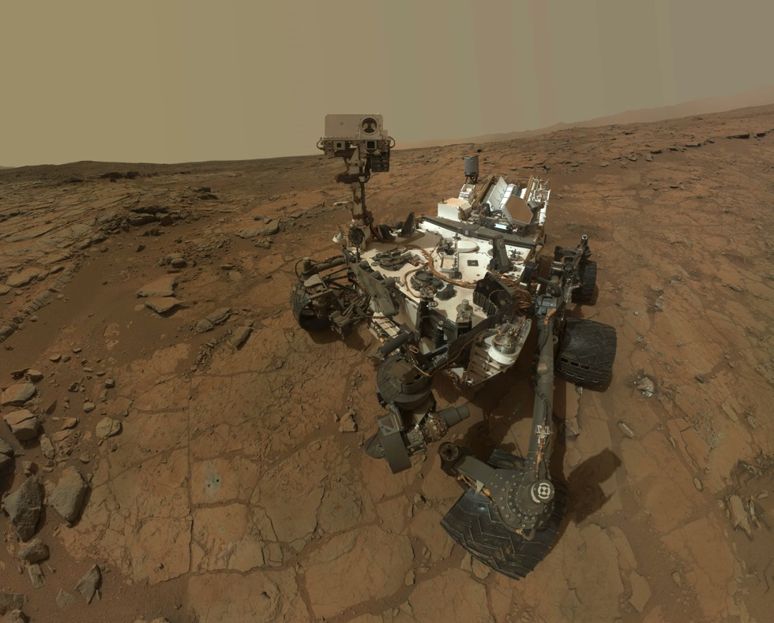
(1) Introduction (2) Experiment design (3) Validation (4) Interpretations (5) Conclusions
REMS (Rover Environmental Monitoring System)
^{SAM (Sample Analysis at Mars)}

Slide 4
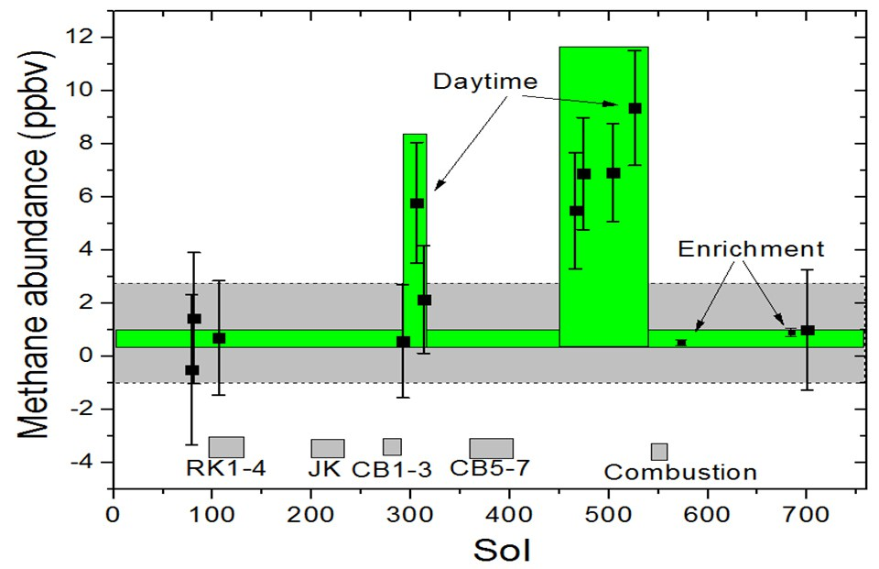
(1) Introduction (2) Experiment design (3) Validation (4) Interpretations (5) Conclusions
Ls82
Ls336
Mars methane detection and variability at Gale crater
(Webster et al., 2015)

Slide 5
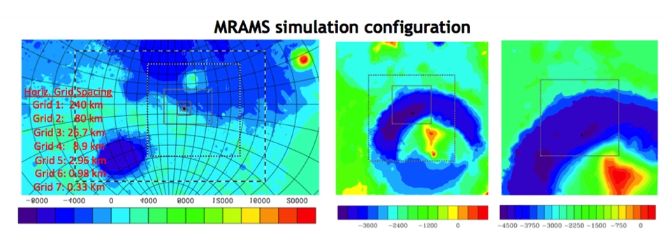
(1) Introduction (2) Experiment design (3) Validation (4) Interpretations (5) Conclusions
MSL landing site
MSL landing site
Altitude in meters (MOLA instrument)
The simulation is configured with 7 grids. The model is run for 3 sols with 5 grids and then the 2 additional grids are added and run for at least 3 more sols.
Horizontal Grid Spacing: Grid 1 (240km), Grid 7 (330m)
Vertical Grid Spacing: 50 points, 51km model top, 14.5m first layer, 30m initial grid spacing, 2500m maximum grid spacing, 1.12 stretch factor

Slide 6
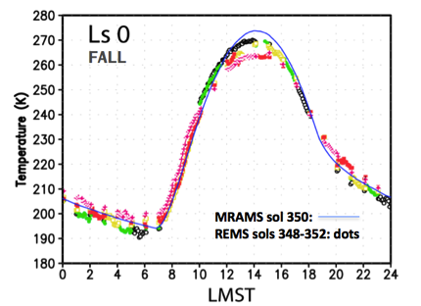
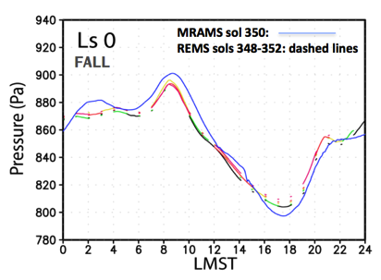
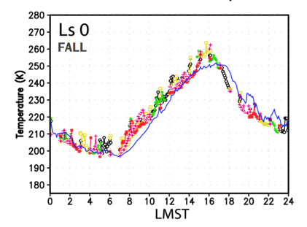
(1) Introduction (2) Experiment design (3) Validation (4) Interpretations (5) Conclusions
Model validation: MRAMS vs REMS
Ground temperature
Pressure
Air temperature
More details at
Pla-Garcia et al. 2016

Slide 7
(1) Introduction (2) Experiment design (3) Validation (4) Interpretations (5) Conclusions
Atmospheric circulations interpretation
for methane tracking

Slide 8
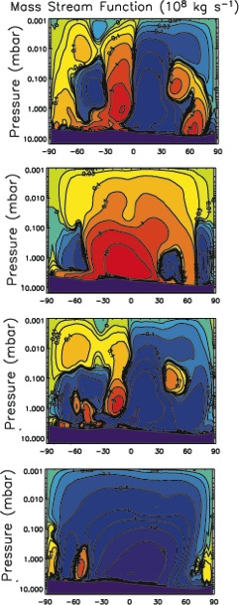
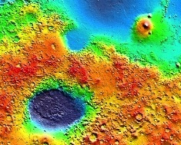
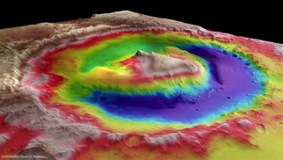

Local Weather is the Sum of Different Scale Circulations
Global Mean Circulation
Regional Topographic
Dichotomy Circulation
Local Topographic Circulations
at Gale crater
Day
N
Ls 0
Fall
equinox
Gale
S
N
S
Day
Ls 90
Winter
solstice
Night
N
S
N
Gale
Ls 180
Spring
equinox
S
Night
S
N
Ls 270
Summer
solstice
Circulations interact in complex, nonlinear ways to produce observed weather at any give location.
S
Gale
N

Slide 9
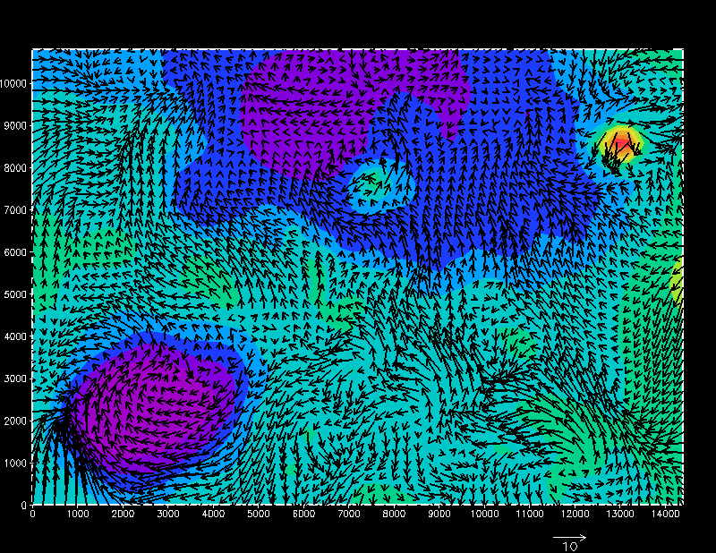
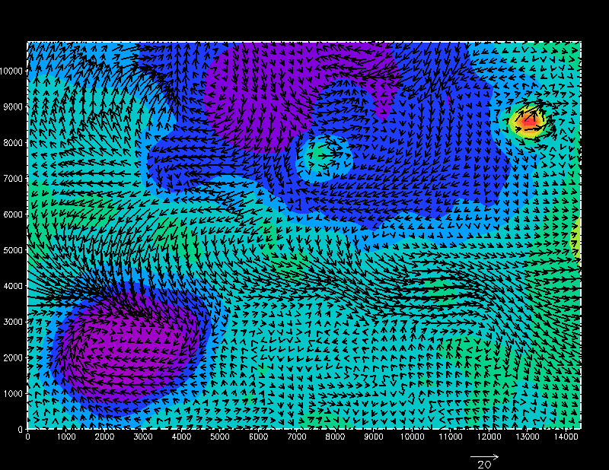
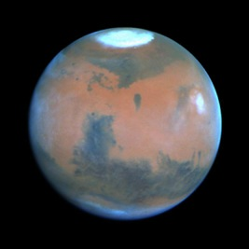
Global scale circulation
Mean Winds Ls 90
Mean Winds Ls 270
Seasonal Reversal of
Mean Circulation

Slide 10
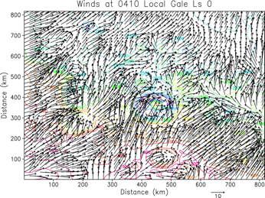
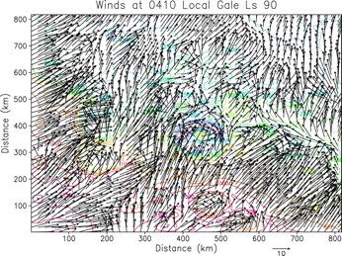

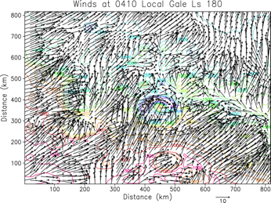
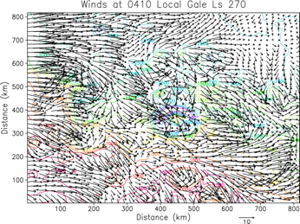
(1) Introduction (2) Experiment design (3) Validation (4) Interpretations (5) Conclusions
Regional scale (dichotomy). Nighttime
Hadley
Cell
Dichotomy
Downslope
Dichotomy
Downslope
Hadley
Cell
FIGHT
Dichotomy
Downslope
Dichotomy
Downslope
Gale crater circled. Strong Influence of Topographic Dichotomy Except Ls=270
Southerly Regional Winds Except at Ls=270: Hadley Cell winds WINS!!

Slide 11
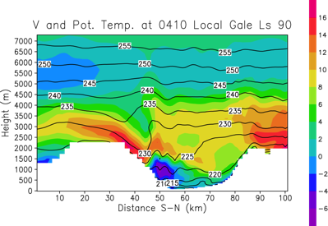
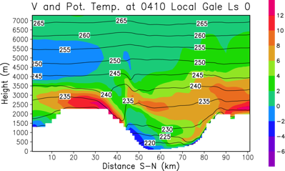
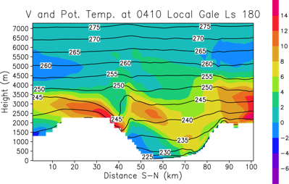
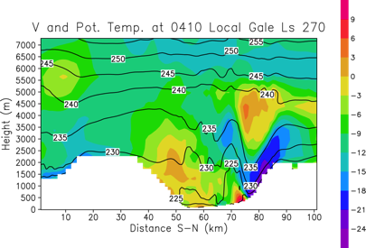
Cross-Sections: meridional winds and potential temperature
Warm, capping inversion at all seasons but Ls=270: stronger vertical mixing. Warm air tends to override crater air mass at other seasons. Mountain wave at Ls=270. Strong downslope winds AND MIXING at Ls=270 along north rim.

Slide 12
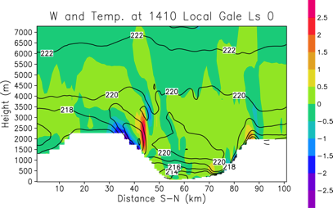
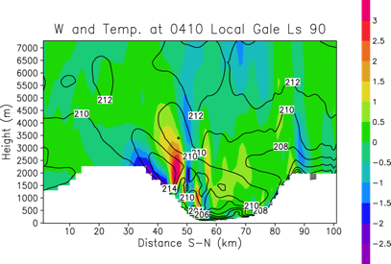
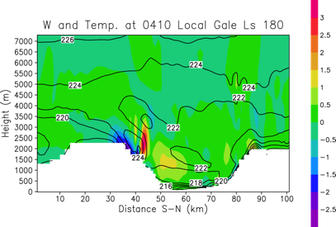
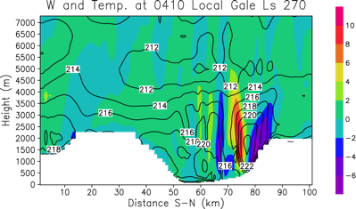
(1) Introduction (2) Experiment design (3) Validation (4) Interpretations (5) Conclusions
Cross-Sections: Vertical winds and potential temperature
0410
Cold air in crater. Action shifts from Mt. Sharp to north crater room at Ls=270. Strong mountain wave AND MIXING at Ls=270.

Slide 13
Upslope/Downslope Winds
Slope winds may be driven by:
  Buoyancy (anabatic/katabatic)
  Dynamical forcing (pressure gradients): this mesoscale flows, like mountain waves and gravity waves, are dynamically generated by the interaction of the wind with the topography. These phenomena can oppose buoyancy forces and provide a mechanism for warm air to descend or cold air to rise.
  Some combination of the two
Potential temperature provides a convenient way to assess
  Potentially cold air will sink, warm air will rise.
  Sinking warm air or rising cold air must be dynamically driven.
Notes:
Dynamical forcing → THERMAL TIDE + MOUNTAIN WAVES

Slide 14
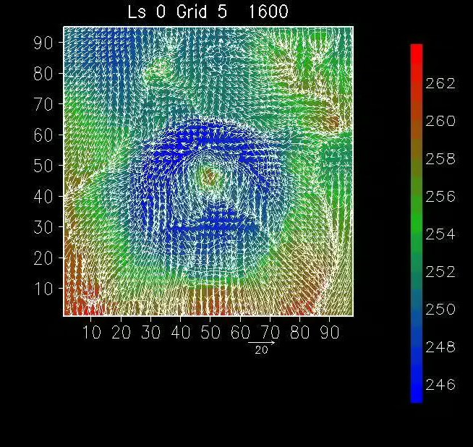
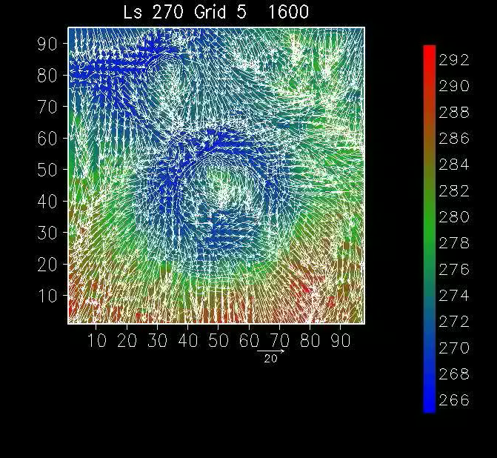
Regional scale crater circulation animations
Surface winds vs potential temperature
Ls 90 Grid 5
Potential temperature
Potential temperature
Potential temperature
Wind speed and direction
Wind speed and direction
During Ls0, Ls90 and Ls180 the crater air mass is generally much colder than outside the crater. As the cold air descends encounters ever increasing cold air until loss of negative buoyancy. Reduced mixing in bottom of crater.
UNIQUE season at Gale. Slope winds driven by buoyancy+dynamical forcing. Air mass in crater mixes with the atmosphere external due to strong, flushing, northerly flow and breaking mountain waves.

Slide 15
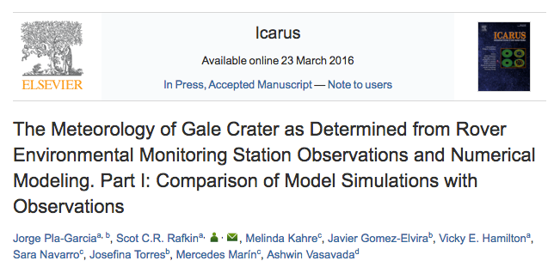
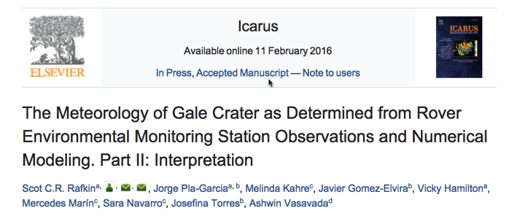
(1) Introduction (2) Experiment design (3) Validation (4) Interpretations (5) Conclusions
Two recently papers submitted to Icarus

Slide 16
(1) Introduction (2) Experiment design (3) Validation (4) Interpretations (5) Conclusions
?
?
?
Mars methane variability and mixing epochs at Gale crater
(Pla-Garcia et al. in preparation)

Slide 17
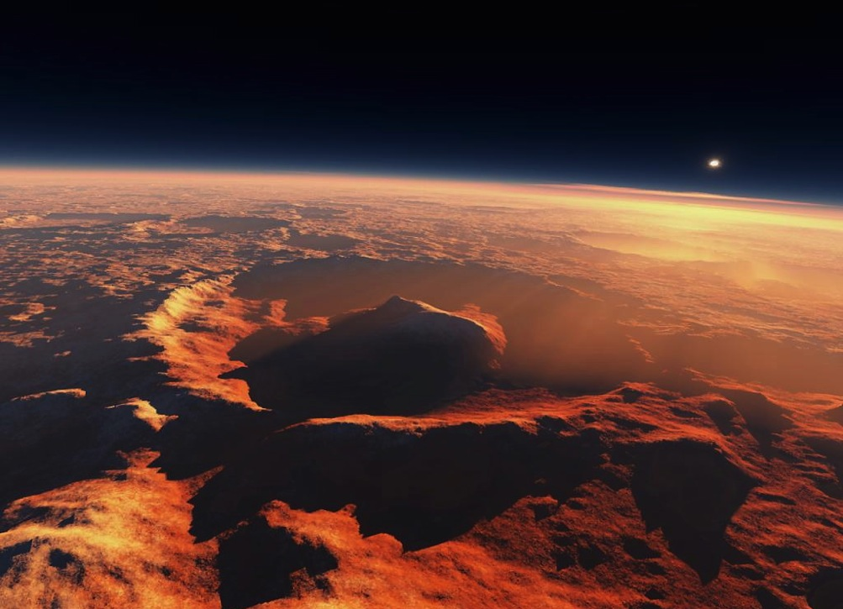


Two different release location scenarios:
2.) Inside the crater?
1.) Outside the crater?
More likely BUT also could be coming out in many other places on Mars (Gale is not unique) and then the background values should likely be far HIGHER than the observed values.
Unlikely due to the “semi-isolated” crater environment during increase and peak methane periods

Slide 18
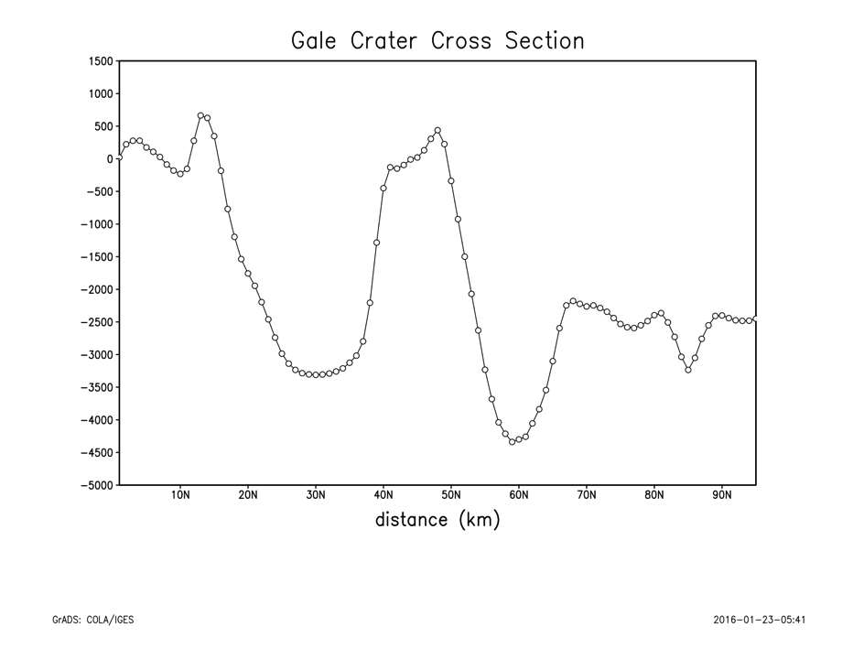
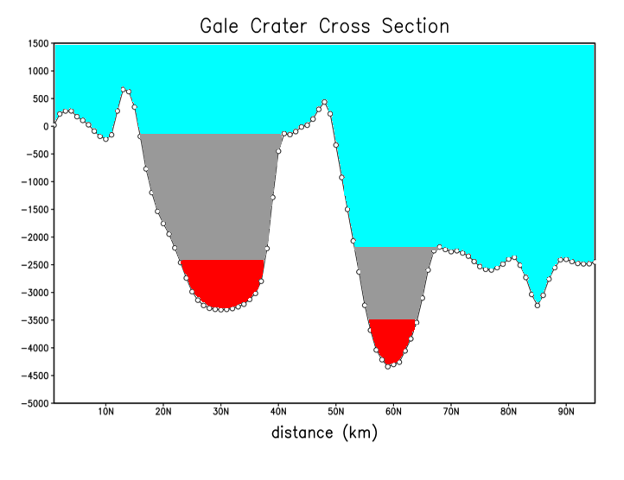
(1) Introduction (2) Experiment design (3) Validation (4) Interpretations (5) Conclusions
Tracer 1
Tracer 2
Tracer 3
MSL landing site
South
North
Three gas tracers included into Gale crater
atmospheric simulations

Slide 19
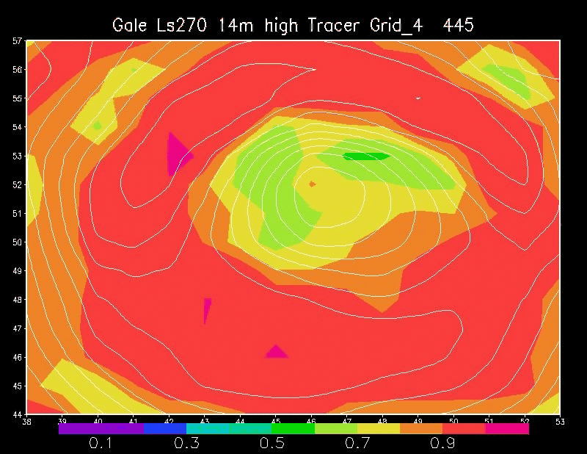
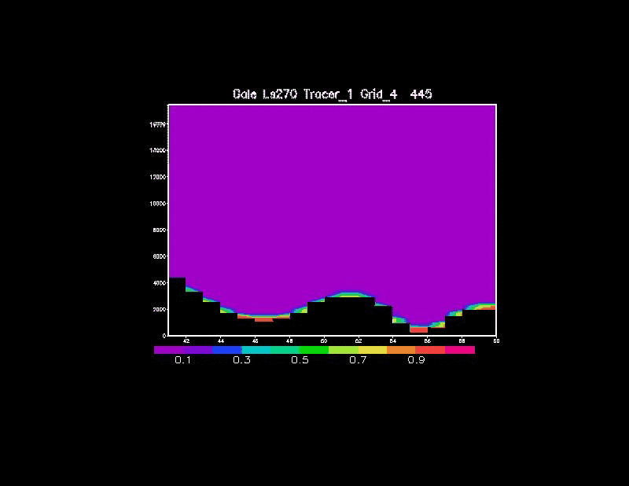
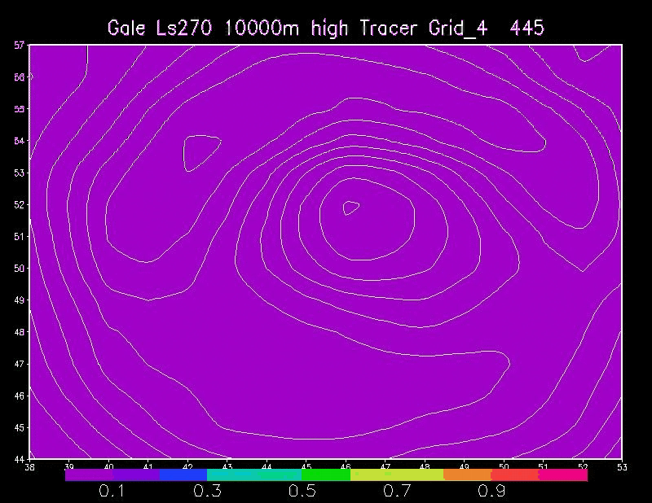
14 meters AGL
Ls270. Summer equinox.
Tracer #1 transport
N
Crater cross section
LMST
S
10 kms AGL
S
N
N
Tracer 1# fraction
tracer1/tracer1+tracer2+tracer3
S

Slide 20
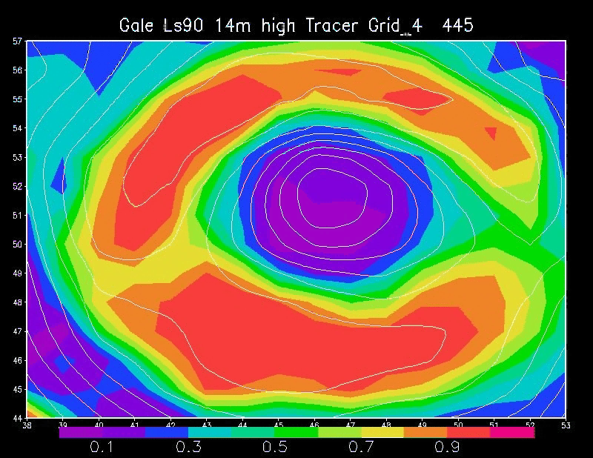
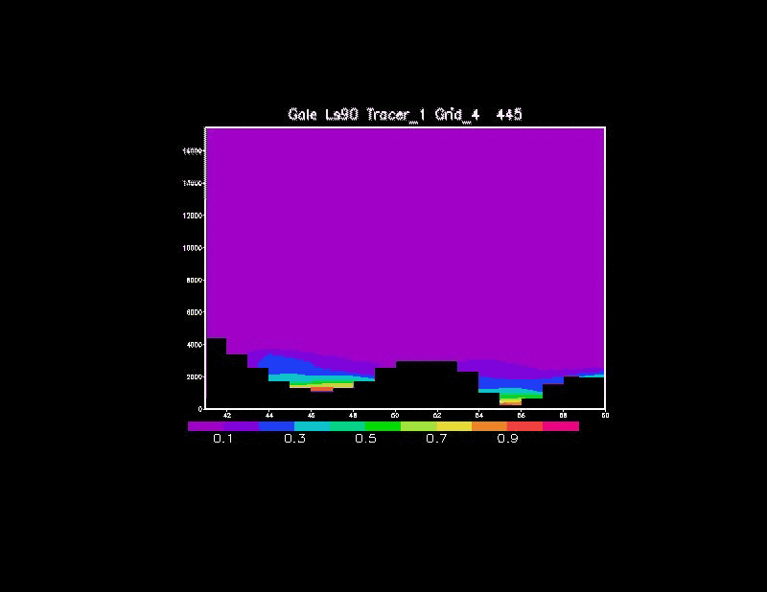
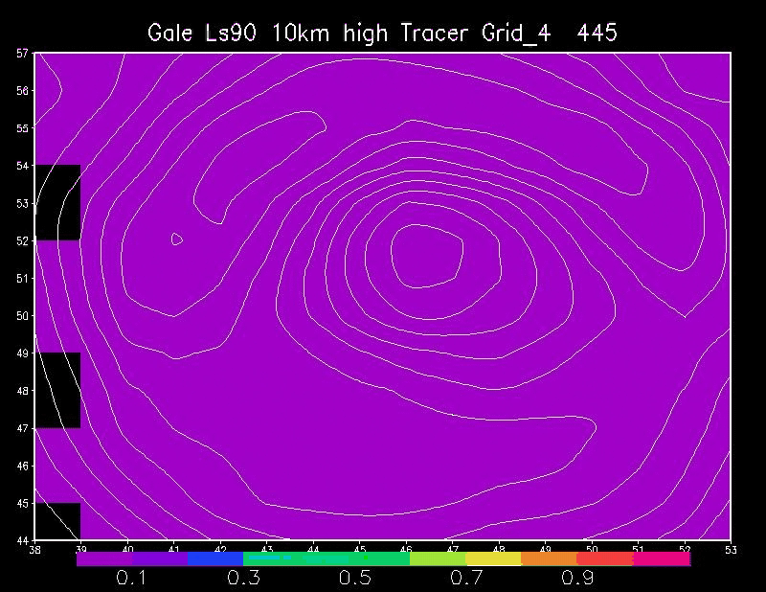
14 meters AGL
Ls90. Winter equinox.
Tracer #1 transport
N
Crater cross section
S
10 kms AGL
S
N
N
Tracer 1# fraction
tracer1/tracer1+tracer2+tracer3
S

Slide 21
Conclusions
(1) Introduction (2) Experiment design (3) Validation (4) Interpretations (5) Conclusions
Crater air mass is generally much colder than outside the crater.
  Reduced mixing in very bottom of crater—but more than previously thought.
  Overrunning air flow.
  Stable boundary layer.
  Crater “semi-isolated” most of the Mars year
Ls270 season at Gale is unique. Is a period when the air mass in crater mixes with the atmosphere external due to strong, flushing, northerly flow and breaking mountain waves (Rafkin et al. 2016, Pla-García et al. 2016).
Methane peak detection occurs at Ls325, a transitional time at Gale Crater, when the flushing winds are giving way to the more limited mixing crater scenario.
From our simulations standpoint, an scenario where the release of methane is within the crater seems at least plausible.
More work is needed to establish the amount of mixing.

Slide 22
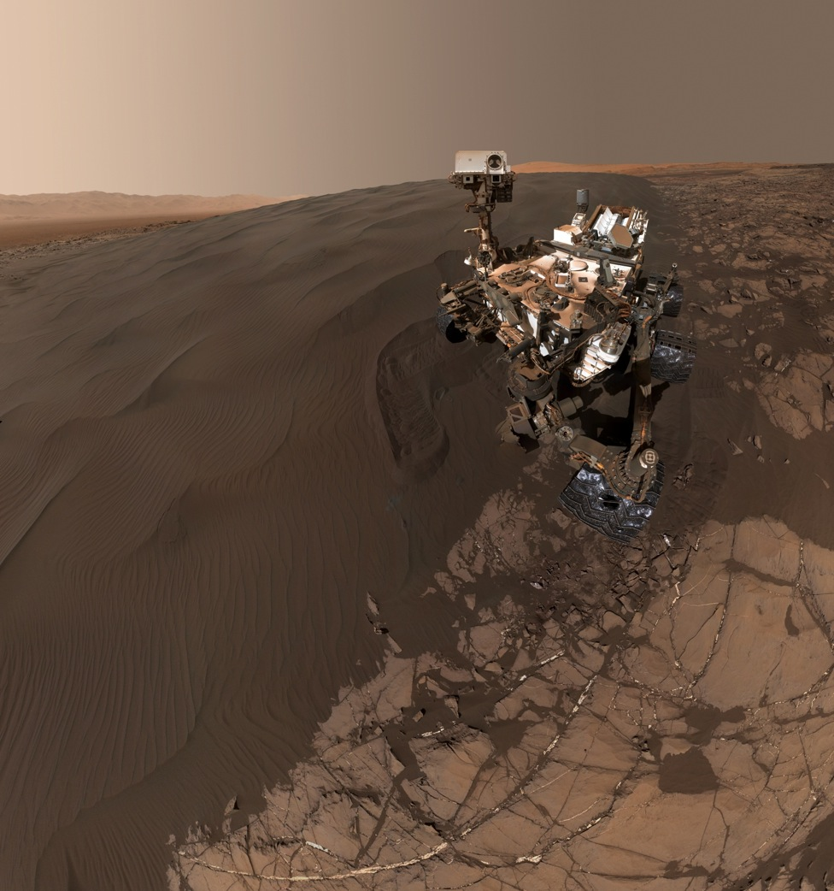
ありがとう!

Slide 23
Backup Slides

Slide 24
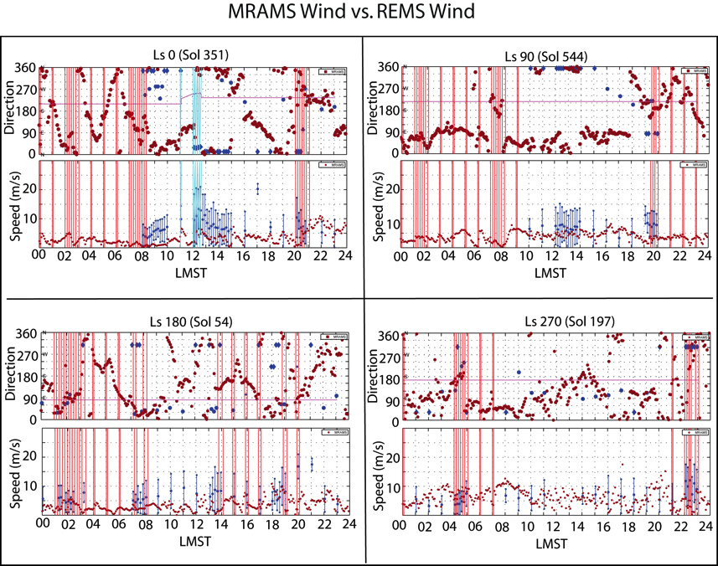
The blue lines show periods when the rover was moving.
The red lines highlight periods with electronic noise in the sensor.
The magenta line indicates the direction in which the rover is pointing.
MRAMS simulations are shown with solid red circles.
REMS data are shown with solid blue circles.
Blue diamonds indicate winds coming from behind the rover, and should be treated very cautiously.

Slide 25
Implications for Water, Dust and Trace Gasses
The primary origin of water is N. Polar cap in Spring/Summer.
  Mean circulation not favorable for transport to Gale.
  Daytime crater circulation ventilates crater.
  Nighttime circulations from outside crater cannot penetrate to crate floor.
  Ls 270 allows for mixing to crater floor, but air is dry.
Dust lifting is suppressed during day
  Shallow boundary layer = no dust devils
  Little lifting of dust at night in crater floor.
  Stronger winds and dust devils outside crater.
  Dusty air should blow over crater.
  Crater is relatively clear (Moores et al., 2014)
Trace gasses (incl. methane).
  Reduced air mass exchange between crater and external air except Ls 270.
  Crater may not be representative of bulk trace gas composition depending on photochemical lifetimes.
  Gas sources in crater will tend to increase concentration with time.

Slide 26
MRAMS: Mars Regional Atmospheric Modeling System
Mesoscale model that simulates the circulations of the Martian atmosphere at regional and local scales [Rafkin et al. 2001]. Applied to MSL landing site at Gale crater. Includes:
  Non hydrostatic dynamics
  Conductive regolith model (with CO₂ deposition and sublimation)
  Water microphysics (not active for this experiment)
  Initialization, boundary conditions and CO₂ ice data are taken from a NASA Ames GCM [Kahre, Haberle et al.]:
    Simulation with column dust opacity driven by zonally-averaged TES retrievals.
    Vertical dust distribution is given by a Conrath-v parameterization that varies with season and latitude.
    NASA Ames two-stream, correlated-k radiation
Topography shadowing and slope radiation effects

Slide 27
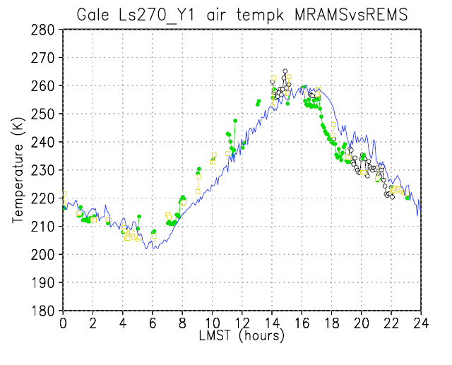
(1) Introduction (2) Experiment design (3) Validation (4) Interpretations (5) Conclusions
Onset of radiational cooling
Shallow turbulent convection and mixing within crater.
Downslope arrives
Extensive mixing from breaking mountain waves slows radiational cooling
Dichotomy beats back crater downslope; radiative cooling and cold air reestablished.
MRAMS sol 196:
REMS sols 195-197:

Slide 28
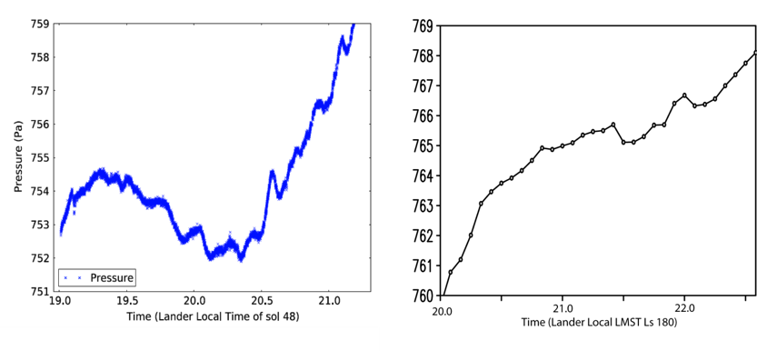
Evening pressure oscillations
Similar oscillation is seen in the output, beginning about 1900LMST and diminishing around 2200LMST. The waves are heavily aliased by the 5 min sampling from MRAMS (right)
Notes:
0.5 Pa and 12-18 minutes duration

Slide 29
Origin of Nocturnal Turbulence
Growth of stable layer above rim and Mt. Sharp conducive to mountain wave amplification.
Stable layer decouples air above from surface, reduces eddy friction, and air accelerates.
Accelerating air increases vertical shear, which lowers Richardson Number until turbulence sets in.
Turbulence mixes to surface, bringing down warm air.

